Slide 1

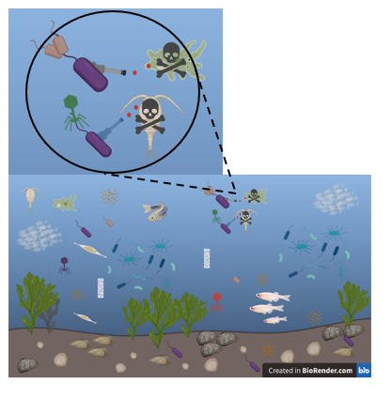
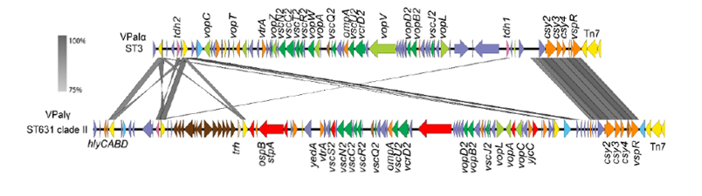
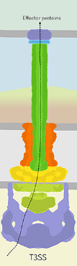
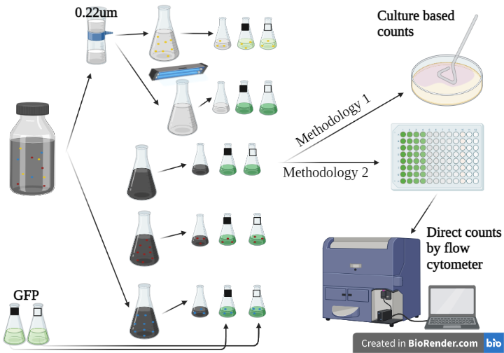
Friday - June 10th, 2022
2608
University of New Hampshire
269-720-0014
anna.early@unh.edu
  Contribution of Type III Secretion to Competitive Survival of Pathogenic Vibrio parahaemolyticus
Anna L. Early¹, Randi Foxall¹, Elizabeth Harvey², Stephen H. Jones³, and Cheryl A. Whistler¹
¹Molecular, Cellular, & Biomedical Sciences, University of New Hampshire, Rudman Hall, 46 College Rd, Durham, NH 03824
²Biological Sciences, University of New Hampshire, Spaulding Hall, 38 Academic Way, Durham, NH 03824
³Natural Resources & the Environment, University of New Hampshire, Jackson Estuarine Laboratory, 85 Adams Point Rd, Durham, NH 03824
Background
Research Questions & Hypothesis
As water temperatures in temperate coastal areas like New England have risen over the past 15 years, cases of Vibrio parahaemolyticus (Vp) gastroenteritis that historically occurred in warmer climates, have also significantly increased over this same timeframe. Strains of V. parahaemolyticus that are pathogenic contain one of three evolutionarily distinct Vibrio Pathogenicity Islands (VPaIs) that confer human virulence (Figure 1) ^{1,4}. These VPaIs all encode for a dedicated Type III Secretion System (T3SS), however, VPaIγ the most prevalent in the US are distinct from the well-characterized VPaIα from Asian-derived pandemic strains and delivers a unique array of toxins (Figure 2), (Table 1). In the Great Bay Estuary (GBE), New Hampshire, despite few infections, there has been an increase in detection of VPaIγ containing strains of V. parahaemolyticus. This shift in the community suggests that these bacteria are provided a fitness benefit for utilizing the resources to encode for the VPaI like out-competing other bacteria, better utilization of resources, or defense against predation from protozoa, nanobacteria, and viruses, which have been known to drive evolutionary defense mechanisms (Figure 3) ³. A previous study showed the VPaIα confers resistance to predation by protists endemic to the Baltic Sea ².
Do toxins secreted from the T3SS confer a fitness advantage to V. parahaemolyticus strains in the Great Bay Estuary by conferring resistance to native protist predation?
    H₁: V. parahaemolyticus populations will survive better in GBE microcosms without the presence of native protozoan predators.
    H₂: In microcosms with protozoan predators an isogenic strain of V. parahaemolyticus with a functioning T3SS will survive better and cause a decline in protozoan populations in contrast to a strain without the ability to secrete toxins.
Results
Figure 7: V. parahaemolyticus Survival was Influenced by Selective Removal of Community Members. Vp increased in abundance over time when all native community members and particles were removed reflective of a lack of competition and predation (pink). Vp fitness declined with the retention potentially predatory viruses and nanobacteria (yellow). Vp fitness further declined in the presence of particles and viruses as well as the retention of native bacteria (green), native protozoan predators (teal), and all native community members (dark purple), though the impact of each of theses complex conditions were indistinguishable from one another, perhaps reflective of complex community interactions. T-test: p = 0.0075. Vp were quantified by GFP label and size via Flow cytometry. Error bars represent Standard Error. Control data not shown.
Figure 1: Vibrio Pathogenicity Islands content. VPaIα (top) is the VPaI present in pandemic strain RIMD 2210633. VPaIγ (bottom) is associated with strains causing most US infections, including those in New England. T3SS apparatus and known toxins are shown in green. Putative divergent toxins are shown in red.
Figure 3: Illustrated Microbial Dynamics in estuarine ecosystems. Viral, nanobacterial, and numerous protozoan predators attacking Vp and subsequent toxin impacts from T3SS.
Toxins | VpaIα | VpaIγ
tdh-1 | ✓ | -
tdh-2 | ✓ | ✓
trh | - | ✓
VopA/P | ✓ | ✓
VopC | ✓ | Divergent
VopL | ✓ | Divergent
VopO | ✓ | -
VopT | ✓ | -
VopV | ✓ | Divergent
VopZ | ✓ | Divergent
Figure 6: V. parahaemolyticus Fitness Increased when Native Bacterial Competitors and Protozoan Predators were Removed, as Demonstrated by Two Enumeration Methodologies. Vp survived better in the absence (purple) of native protozoa and bacteria compared to in the presence (green) of these community members. Vp was enumerated by culture-based methodology via spread plating (dashed lines) or by GFP label and size Flow cytometry (solid line). Error bars represent Standard Deviation. Control data not shown.
Figure 5: Toxin Secretion Allows for 99.95% More Survival of V. parahaemolyticus in the Presence of A. castellanii. T-test: p = 0.0075. Error bars represent Standard Error.
Table 1: Toxins of VpaIα and VPaIγ. Distinct array of toxins secreted from pathogenicity islands of Vp.
Figure 2: Type III Secretion System Apparatus.
Methods
Named treatment | Protists | Bacterial Competitors | Viruses/ Nanobacteria | Vp | T3SS
T3SS+ PROT+ BACT+ VIR+ | + | + | + | + | +
T3SS- PROT+ BACT+ VIR+ | + | + | + | + | -
T3SS+ PROT+ BACT- VIR+ | + | - | + | + | +
T3SS- PROT+ BACT- VIR+ | + | - | + | + | –
T3SS+ PROT- BACT+ VIR+ | – | + | + | + | +
T3SS- PROT- BACT+ VIR+ | – | + | + | + | –
T3SS+ PROT- BACT- VIR+ | - | - | + | + | +
T3SS- PROT- BACT- VIR+ | - | - | + | + | -
T3SS+ PROT- BACT- VIR- | - | - | - | + | +
T3SS- PROT- BACT- VIR- | - | - | - | + | -
PROT+ BACT+ VIR+ (control) | + | + | + | - | N/A
PROT+ BACT- VIR+ (control) | + | - | + | - | N/A
PROT- BACT+ VIR+ (control) | - | + | + | - | N/A
PROT- BACT- VIR+ (control) | - | - | - | - | N/A
PROT- BACT- VIR- (control) | - | - | - | - | N/A
Figure 8: Protozoan Fitness Declined in the Presence of V. parahaemolyticus with Functional T3SS Toxin Secretion. Functioning T3SS toxin secretion conferred only a subtle, and not statistically significant fitness benefit to Vp (squares). However, zooplankton fitness decreased in the presence of Vp T3SS+ (solid fill) relative to their fitness in the presence of Vp T3SS- (open fill). Zooplankton were quantified using SYBR green stain and size, whereas Vp was quantified by GFP label and size, both via Flow cytometry. Error bars represent Standard Error. Control Data not shown.
Microcosms were constructed with water collected at low tide which were subjected to one of five treatments (Table 1). The microcosms were then inoculated with V. parahaemolyticus either with a functioning T3SS (T3SS+) or defective T3SS (T3SS-) labeled with green fluorescent protein (GFP) at 1x10⁶ CFU/mL. Flasks were stationarily incubated at RT in 12-hour light/ dark cycle and sampled daily for 4 days (Days 0 – 3). Concentrations of microbes in each microcosm were enumer-
Table 2: Microcosm Treatments. Breakdown of components present in microcosm treatments.
Conclusions
Figure 4: Microcosm Workflow. Seawater subjected to array of treatments (Kanamycin, cycloheximide, filtration, and UV) to selectively remove native seawater community members. Quantification of bacteria by both spread plating and flow cytometry.
Acknowledgements
ated by Flow cytometry. Concentrations of GFP- labeled V. parahaemolyticus and SYBR-green labeled plankton were recorded following size fractionation. Bacteria were also enumerated by plating on Trypticase Soy Agar and the selective and differential media Vibrio ChromAgar. (Figure 4).
Single predator prey model experiment was set up by diluting 5-day old protozoan predator Acanthamoeba castellanii (Ac) to 1x10⁵ cells/mL and inoculating in triplicate with V. parahaemolyticus either with a functioning T3SS or defective T3SS labeled with GFP. V. parahaemolyticus started at 1x10⁶ CFU/mL and was diluted 10-fold for eight dilutions. V. parahaemolyticus survival was tracked without predation by inoculation of artificial seawater rather than A. castellanii. All dilutions were spot plated on Luria-Bertani agar. V. parahaemolyticus survival was calculated by CFU calculations at the lowest dilution and compared to V. parahaemolyticus survival without predation.
Thank you to Dr. Liz Harvey, the Whistler Lab, and Jones Labs.
Thank you to my committee: Dr. Whistler, Dr. Jones, Dr. Launen.
Thank you UNH Graduate School, NH AES, NH Sea Grant, and Robert and Ruth Zsigray Academic Enrichment Fund.
Flow cytometry is an efficient and reliable method of bacterial enumeration.
Native community members hinder the success of V. parahaemolyticus in the GBE thus are likely integral in shaping the V. parahaemolyticus population.
Toxins released from the T3SS could confer defense against protist predation and could be a driver of the successful invasion and establishment of pathogenic strains within the GBE V. parahaemolyticus population.
References
1 = Eggert, S.H. (2019). Identification of Novel Type Three Secretion System Effectors Linked to Clinical and Environmental Prevalence of Vibrio parahaemolyticus. Master's Thesis, University of New Hampshire.
2 = Matz, C., Nouri, B., McCarter, L., Martinez-Urtaza, J. (2011). Acquired Type 3 Secretion System Determines Environmental Fitness of Epidemic Vibrio parahaemolyticus in the interaction with Bacterivorous Protists. PLoSONE 6(5): 1-10.
3 = Noorian, P., Hu, J., Chen, Z., Kjelleberg, S., Wilkins, M. R., Sun, S., and McDougald, D. (2017). Pyomelanin produced by Vibrio cholerae confers resistance to predation by Acanthamoeba castellanii. FEMS Microbiology Ecology 93(12): 1-20. doi: 10.1093/femsec/fix147
4 = Xu, F., Gonzalez-Escalona, N., Drees, K.P., Sebra, R.P., Cooper, V.S., Jones, S.H., and Whistler, C.A. (2017). Parallel Evolution of Two Clades of an Atlantic-Endemic Pathogenic Lineage of Vibrio parahaemolyticus by Independent Acquisition of Related Pathogenicity Islands. Appl Environ Microbiol 83:e01168-17. https://doi.org/10.1128/AEM.01168-17.

