Slide 1


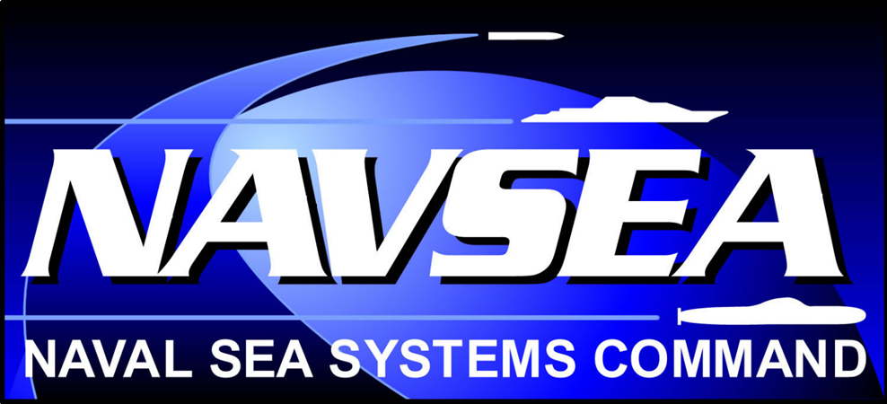

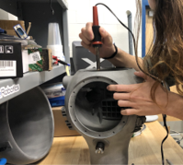
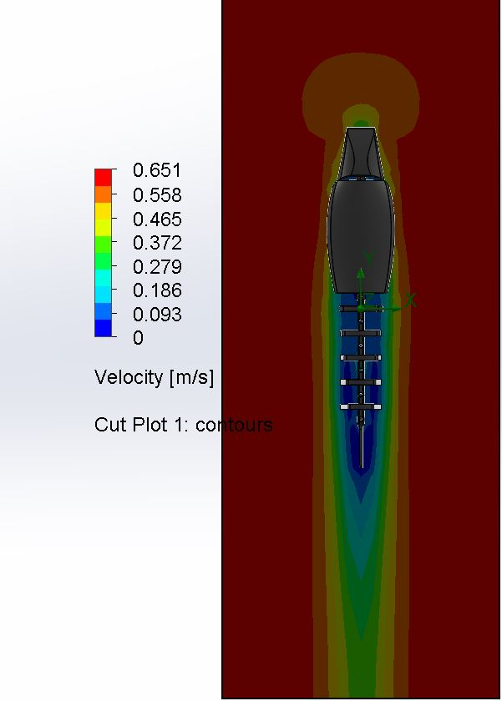
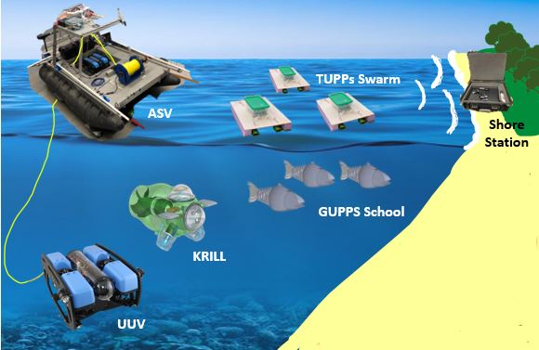
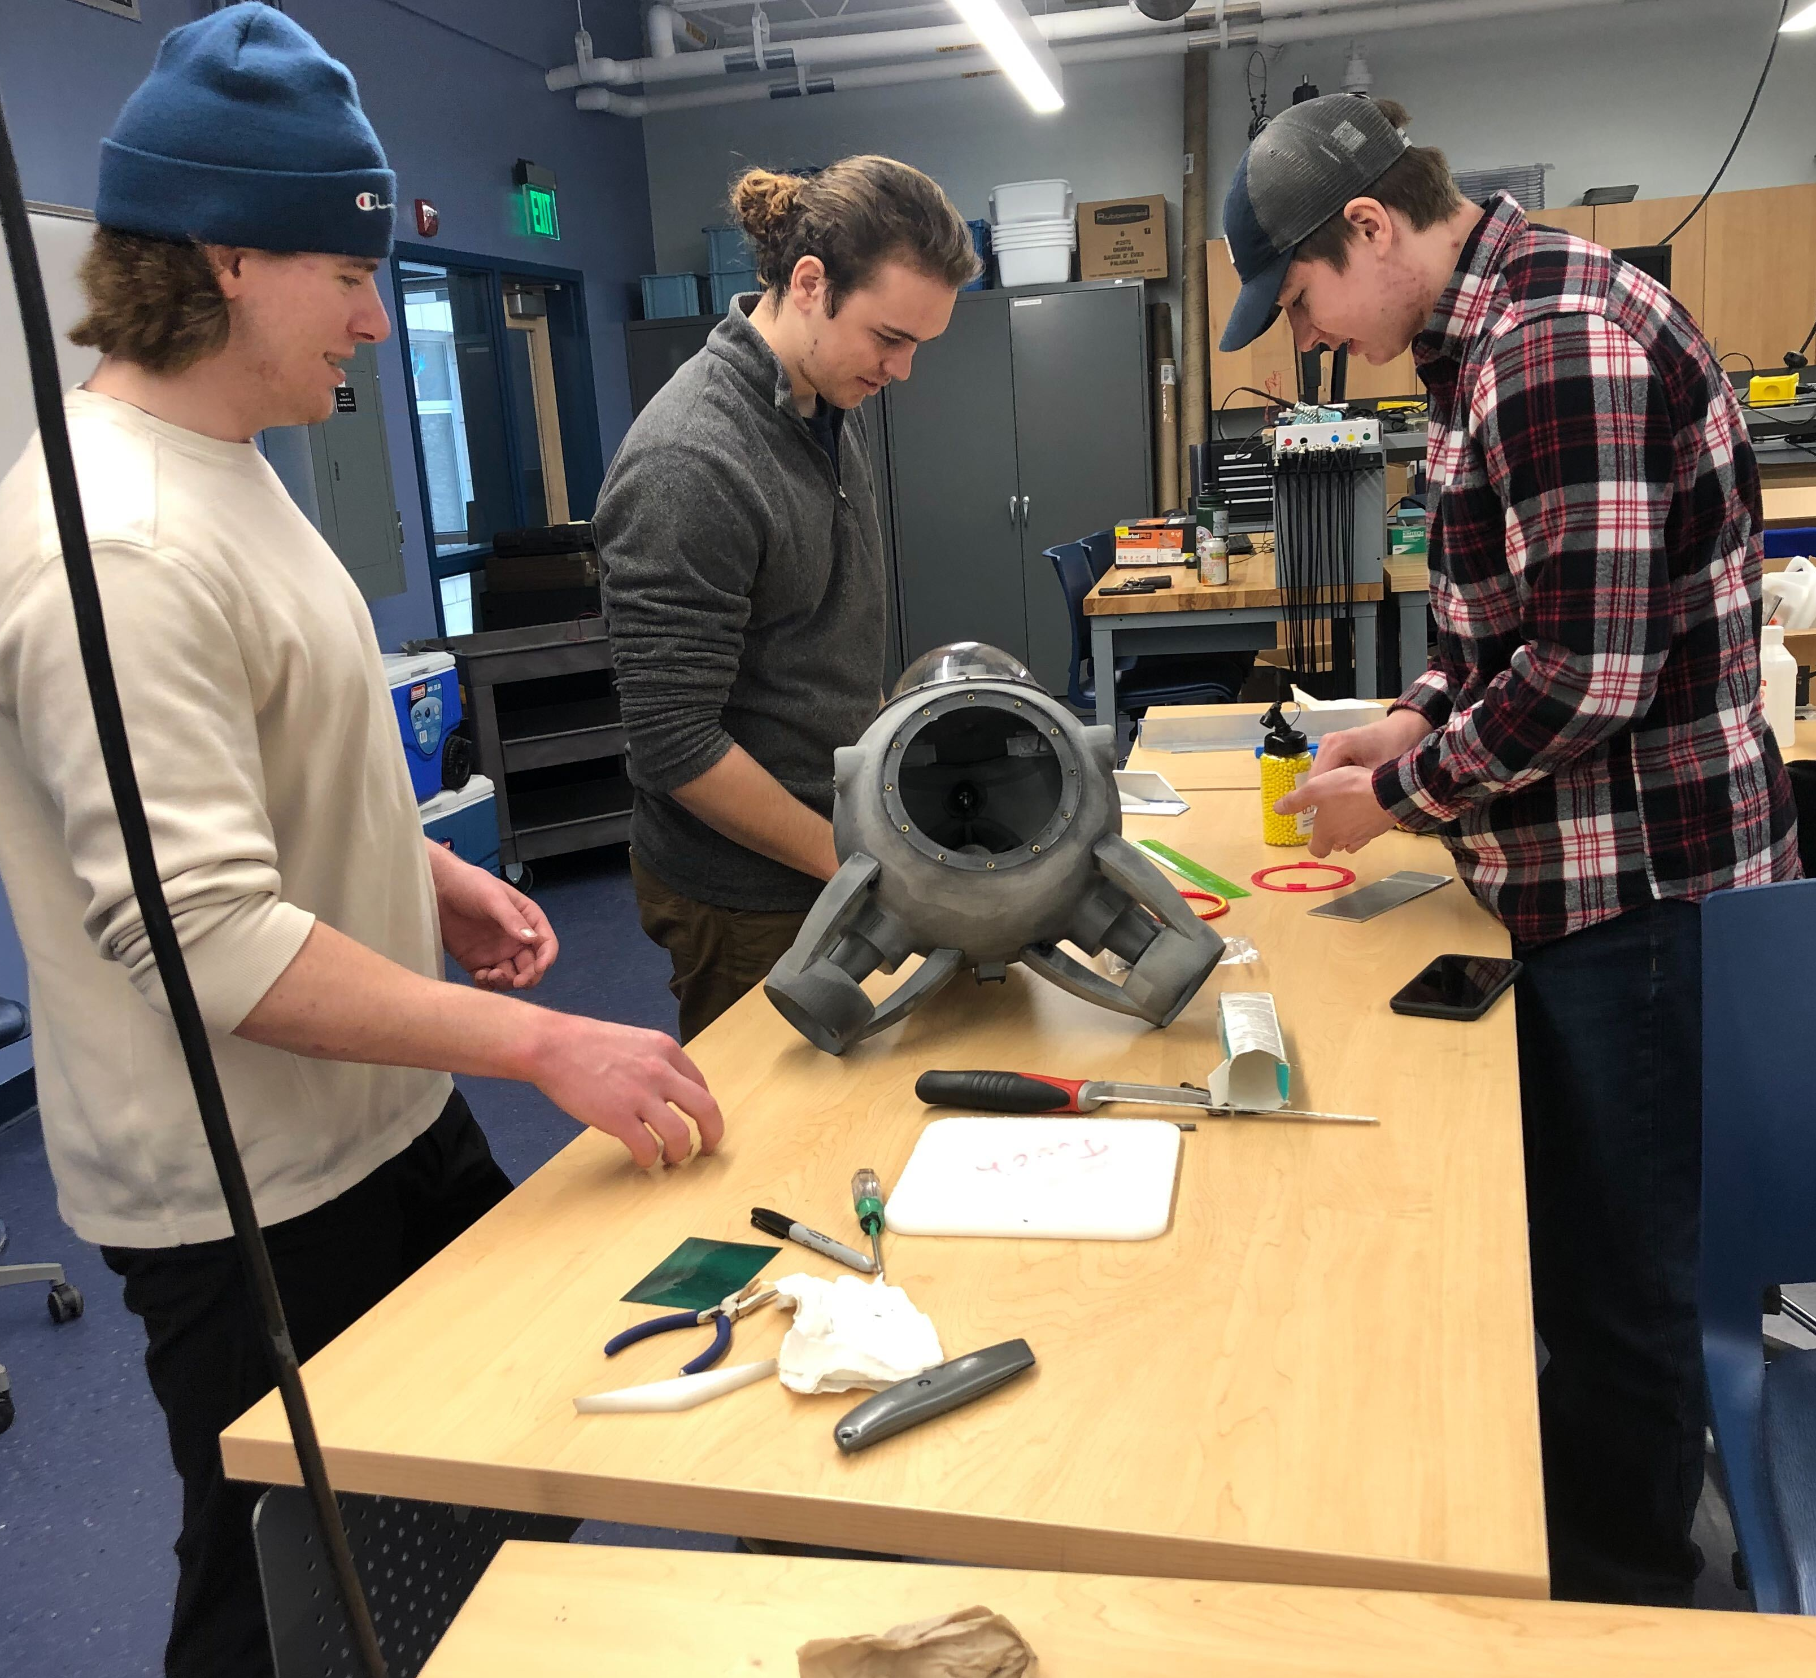
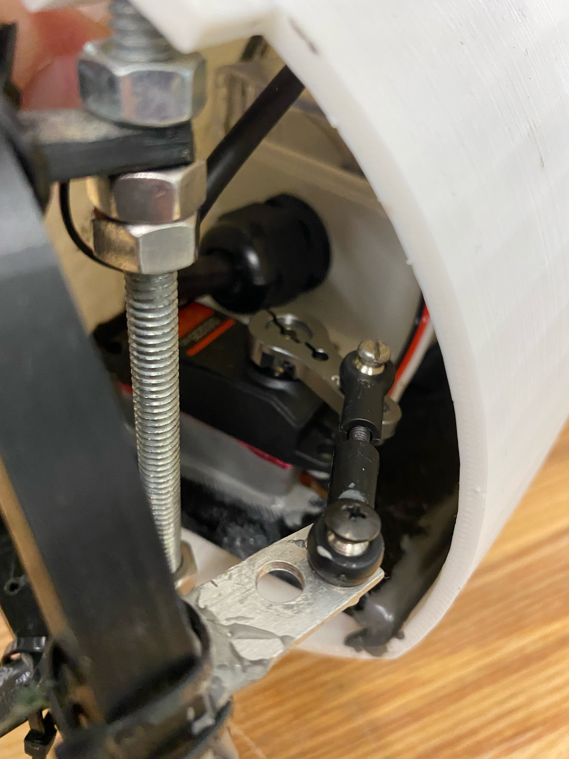
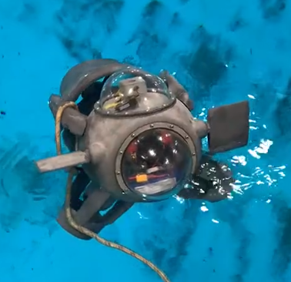
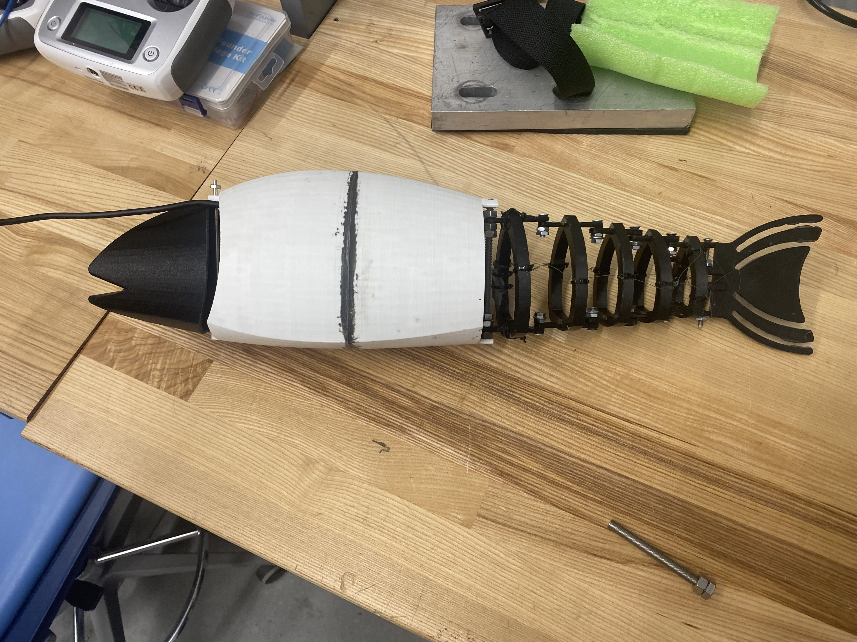
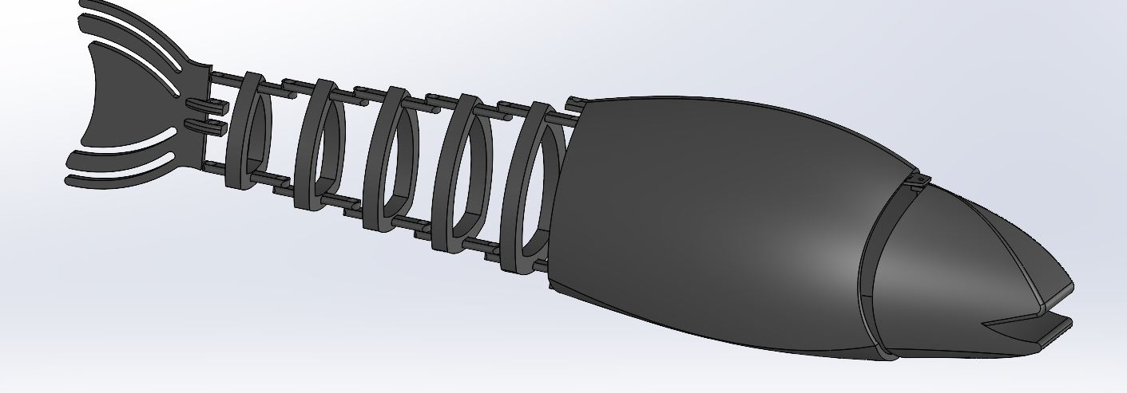
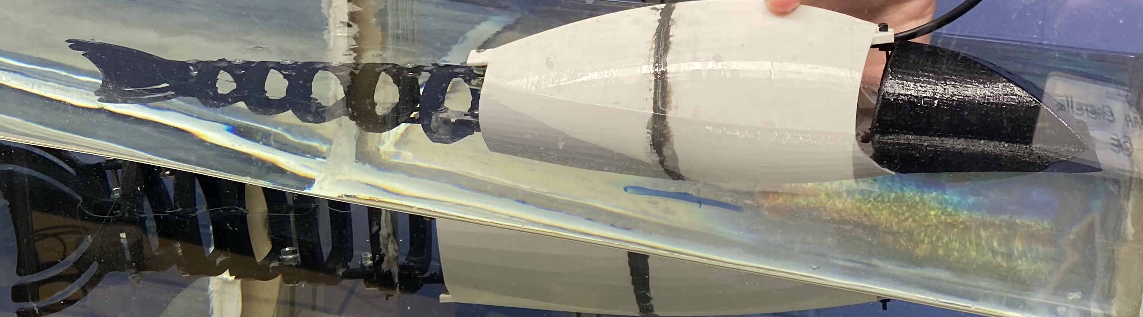
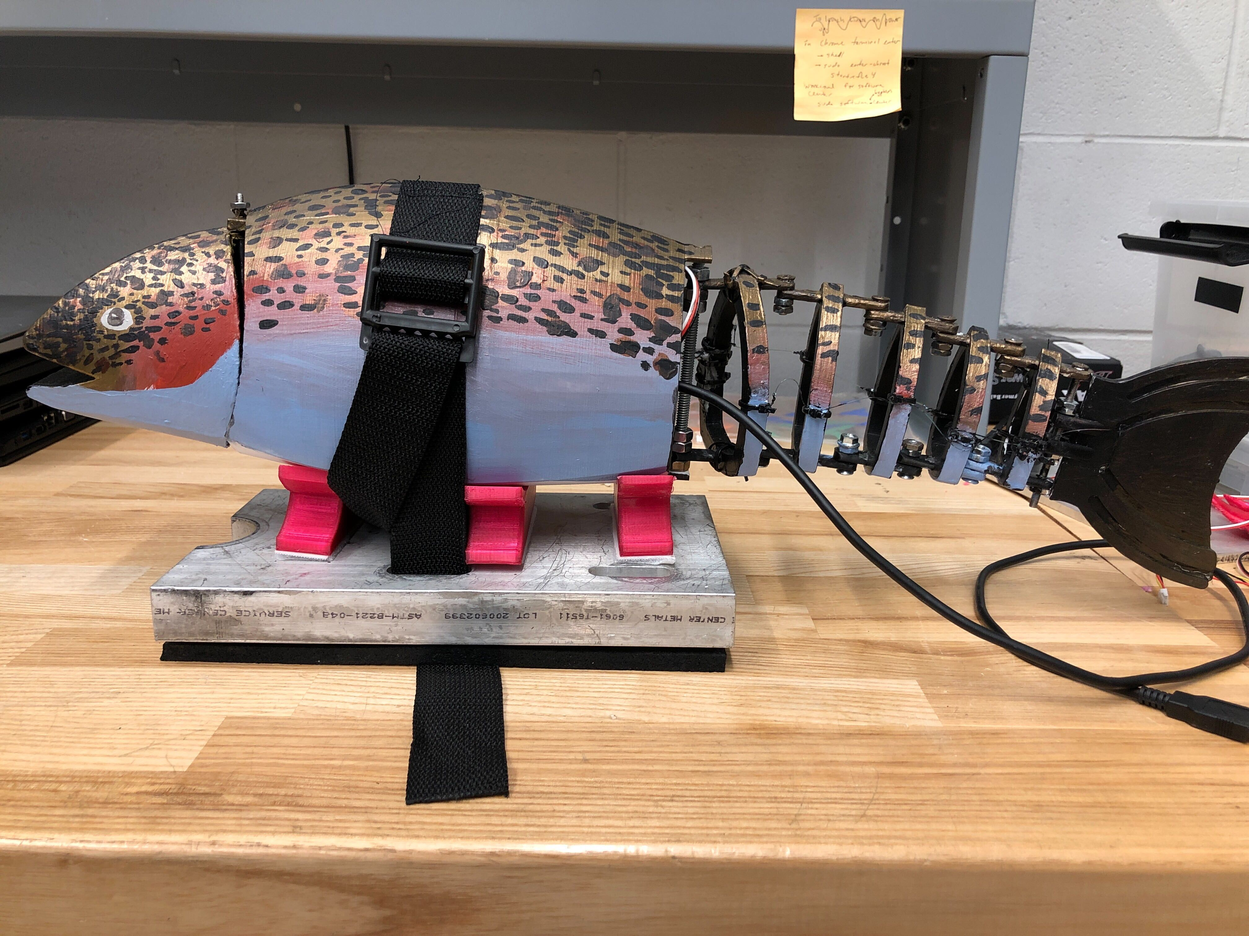
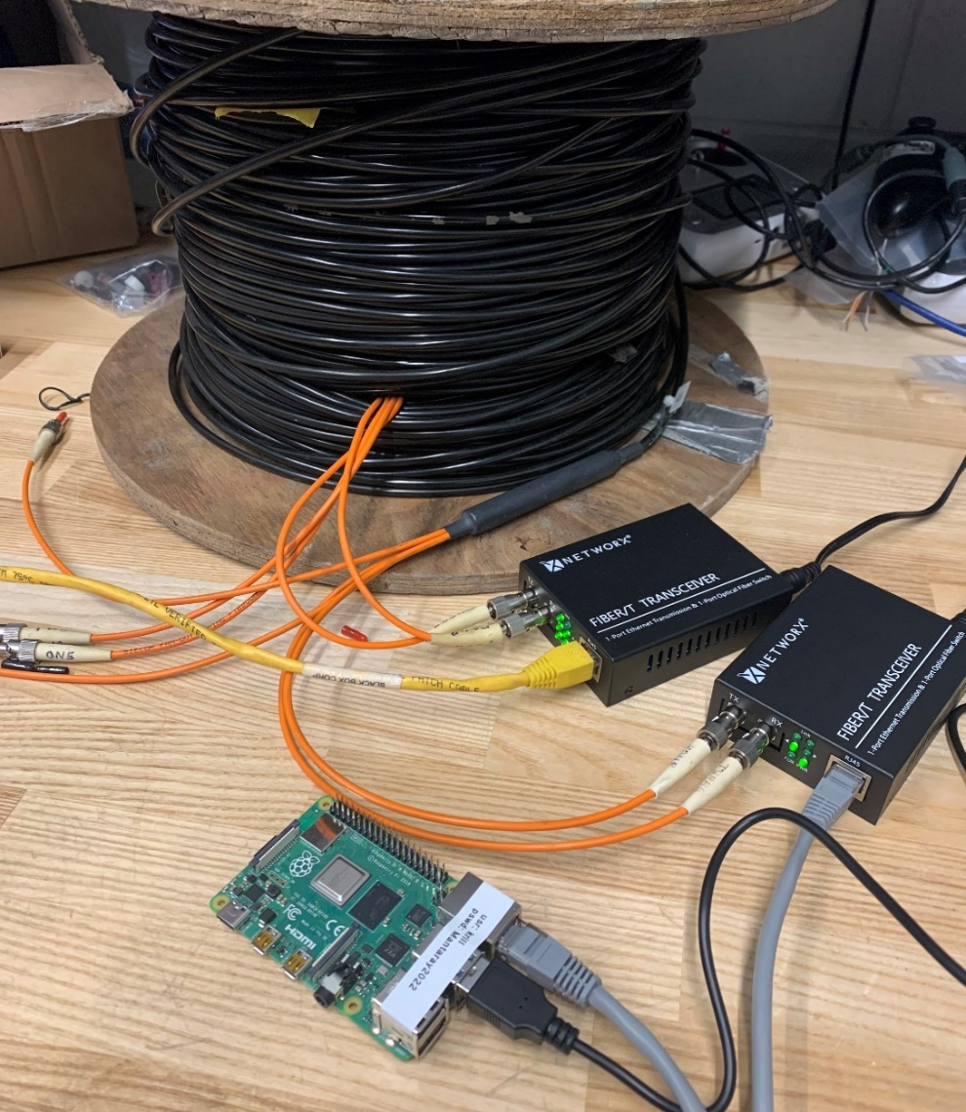
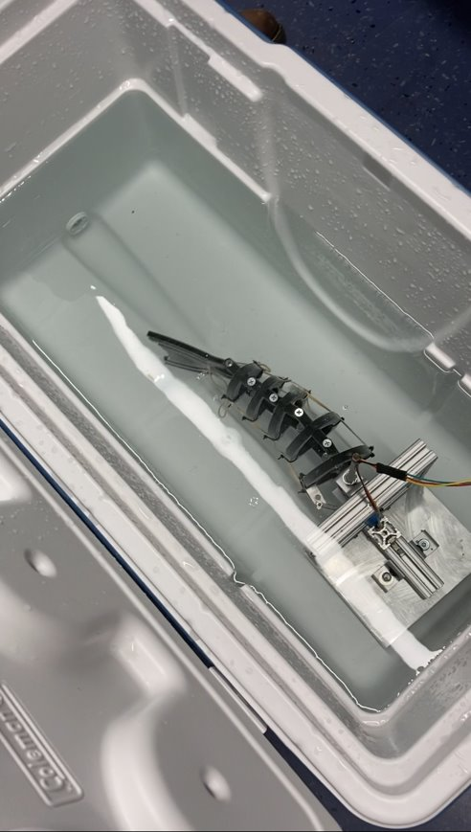
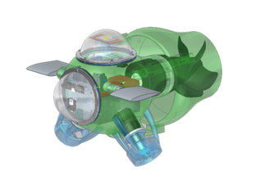
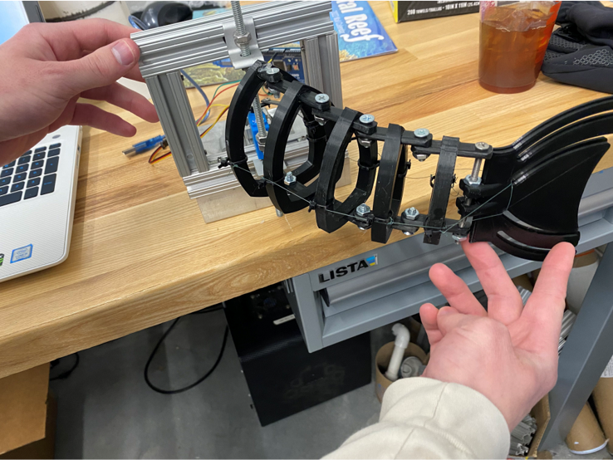
Marine And Naval Technological Advancements for Robotic AutonomY (MANTA RAY):
Ghost Unpiloted Performance Platform Submersible (GUPPS) and KRILL
Principal Investigators: Dr. May-Win Thein, Dr. Yuri Rzhanov,
Project Advisors: Dr. Elizabeth Fairchild, Dr. Michael Chambers
Graduate Advisors: Ozzy Oruc, Hannah Arnholt, Nicholas Custer, Igor Vladimirov, Richard Randall
Team Members: Caroline Russell (ME), Will Conner (OE), Amanda Enderson (ME), Gavin Cherella (OE),
Shelly Lancaster (Wildlife & Conservation Biology), Heather Nelson (Zoology), Marguerite Kennish (ME), Jack Hamilton (ME), Brendan Ulrich (ME), Noah Wilder (CS), Jeff Pitts (CS), Sydney Chock (EE), Gabriella Liano (EE), Aidan Boucher (CS)
GUPPS- DESIGN SPECIFICATIONS & EVALUATION
Manta Ray Mission
KRILL - development
3D Model
Modifying dimensions, and proportions accurate to steelhead trout
  Approximately 2 feet in length
Dynamics
Propelled by tail motion
Modularity
Removable electronics container
Evaluation
Simplified Flow simulation
Turbulent areas of interest
Team MANTA RAY is an interdisciplinary project dedicated to creating, maintaining, and expanding a network of marine robots for seafloor mapping and underwater perception. The network began as just the autonomous surface vehicle (ASV) and unpiloted underwater vehicle (UUV), but has expanded to include a prototype of the ASV, known as TUPPS, and two kinds of remotely operated vehicles, known as GUPPS and KRILL. With these systems, students work to improve communication between vehicles, develop autonomous behaviors and algorithms, and upgrade existing mechanical systems to improve precision and performance.
Reverse Engineering
Disassemble 3D files
Decipher given documentation
Manufacturing
Mill additional dome features
Laser-cut gaskets
Water Jet pressure plates
Soldered threaded heat inserts
Epoxy Neodymium Magnets
Fiber-optic Cable
Maintain communication from remote sub-surface
Transmit signal from joystick to PixHawk4 (PX4) over fiber optic tether, without RC receiver
Gupps- CONSTRUCTION
Tail Connections
17 separate pieces for mobility
Connector arm from servo to tail
Manufacturing
3D printing
Hardware connects head and body
Assembly
Epoxied body components
Insertion and securement of shelf Dimensions
22' 7/16" x 4' 3/8" x 5' 1/8''
Weight
1.9 lbs.
GUPPS- SUBTEAM mission
KRILL - Testing
GUPPS is one of newest additions to the MANTA RAY fleet. The purpose of GUPPS is to non-intrusively investigate underwater areas of interest using a biomimetic robotic fish. Previous to this year, GUPPS existed solely as an idea with basic drafts of CAD models. The GUPPS team goal this year was to finalize design specifications and bring it to life as a working model in air.
Preliminary Tank Test
Side thrusters performed as expected
Hull remained waterproof throughout the test
limited to the surface due to controls, and buoyancy
Fiber-optics Cable
Cable tested by passing light through captured with transceiver over ethernet to a laptop
Integrated the Pi and PX4; confirmed communication through MAVProxy
Gupps- Tail motion & tension testing
Code & Circuit Design
Tail motion is to follow biomimicry of fish
Arduino code to power a servo to provide tail motion
Tension System-Fishing Line
Turbulent areas of interest
Reliable and improved resistance
Testing in and out of water
Reliable and improved resistance and potential propulsion
Feasibility in-water tests
Krill- subteam Mission
KRILL is the newest addition to the MANTA RAY fleet. The 3D laser-printed hull was gifted to MANTARAY in 2021 by NUWC Keyport, Washington. The MANTARY team supplemented funds to purchase and manufacture additional hardware to reproduce the KRILL design. Once recreated the team began making alterations such as a fiberoptics tether. Long-term KRILL will act as a platform for autonomy testing.
Future work .
Gupps | Krill .
Design
Buoyancy and Ballasting
Soft Robotics
Sensors
Temperature, pressure, optics
MANTA RAY
Integration
Tethered to TUPPs for telemetry
Design
Buoyancy, Ballasting, and Balance
Main thruster and fin actuators improvements
Waterproof fiber optic tether
Switch and power sense module to monitor battery
Configure transceivers to run on battery
Testing
Conduct a power analysis
Submergence testing
Special Thanks to NUWC Division Keyport: Thai Tran and Dr. Martin Renken
UNH: Laura Gustafson, Kelly Danforth, Scott Campbell, Debarpan Bhowmick and the Olson Center
Notes:
To change this poster, replace our sample content with your own. Or, if you'd rather start from a clean slate, use the New Slide button on the Home tab to insert a new page, then enter your text and content in the empty placeholders. If you need more placeholders for titles, subtitles or body text, copy any of the existing placeholders, then drag the new one into place.

