Slide 1


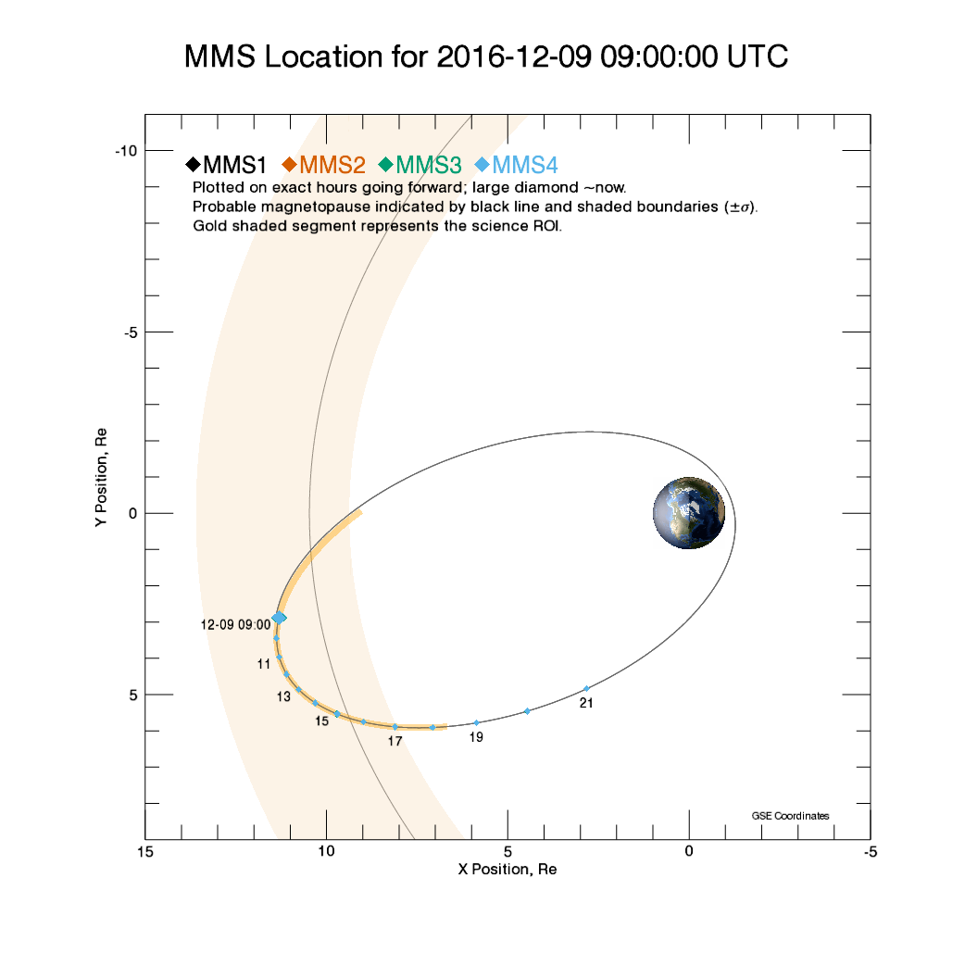
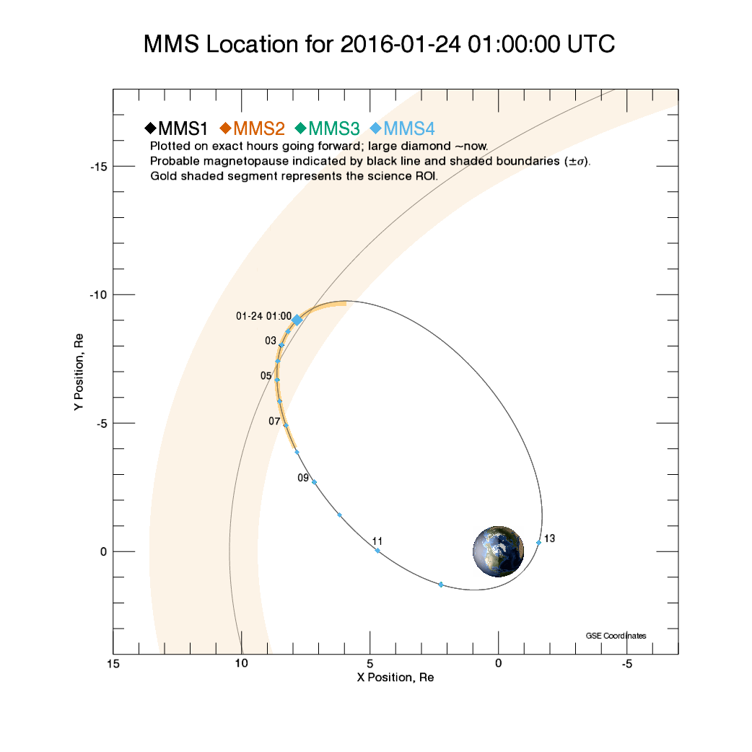


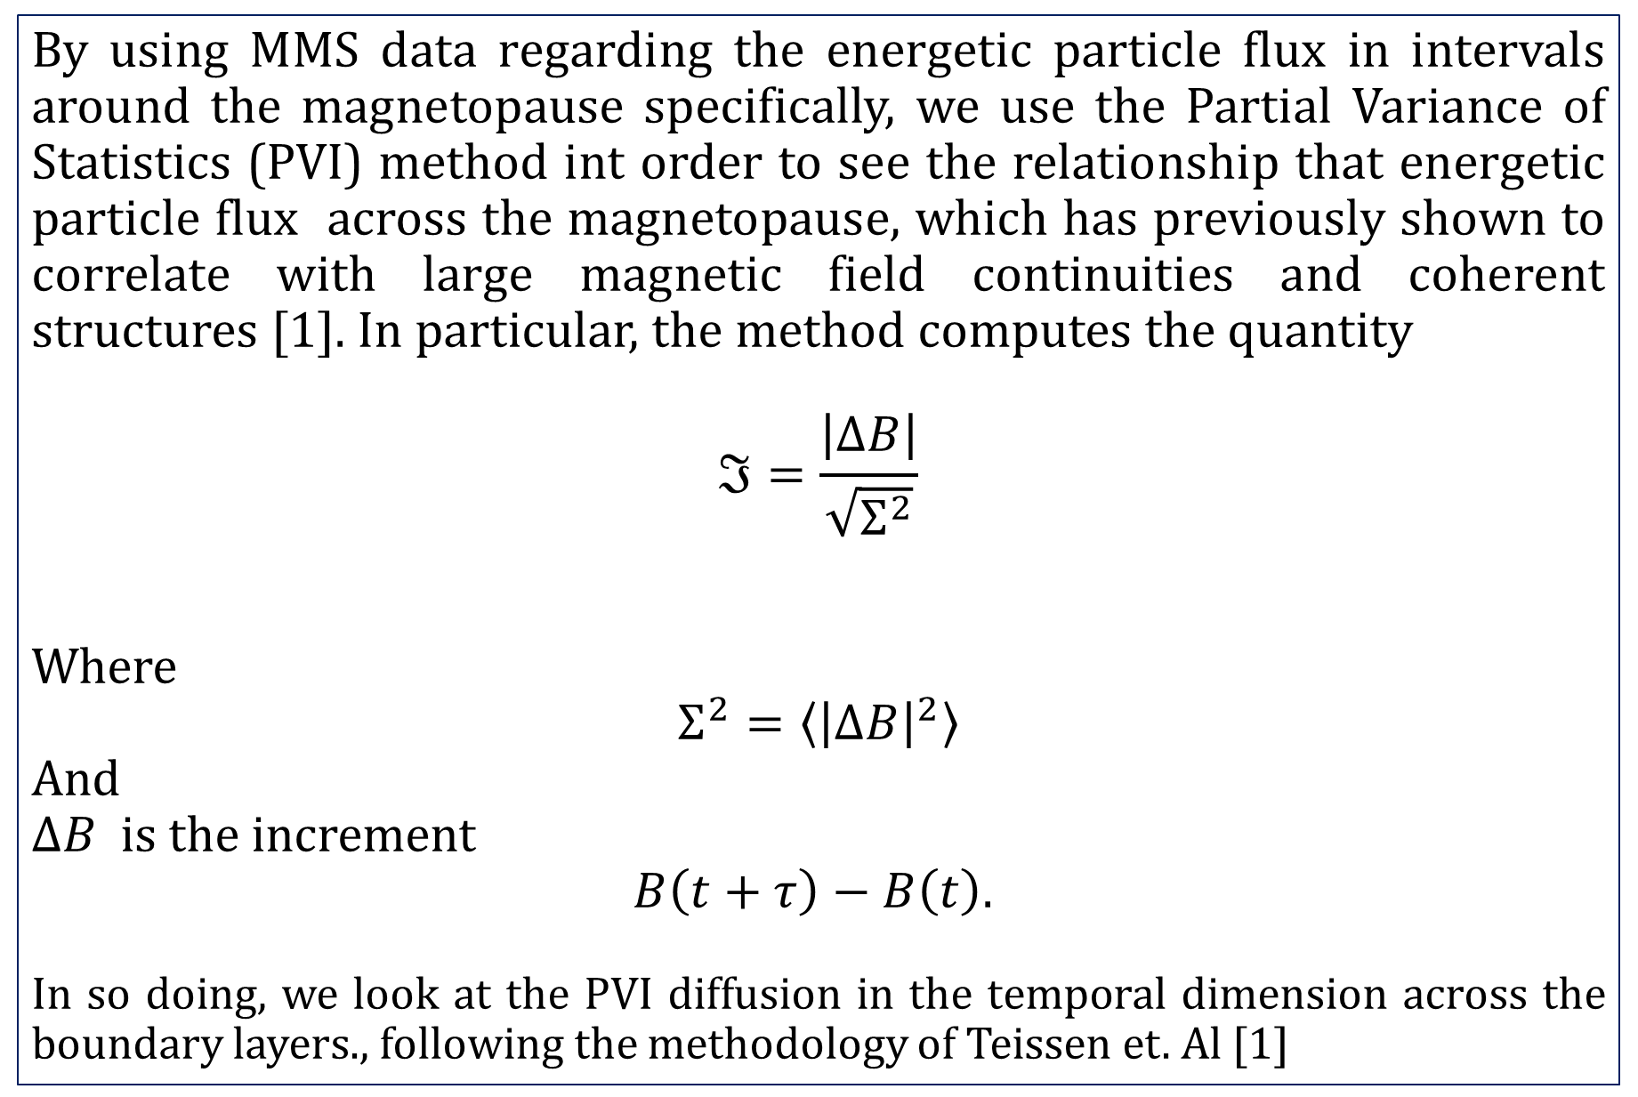
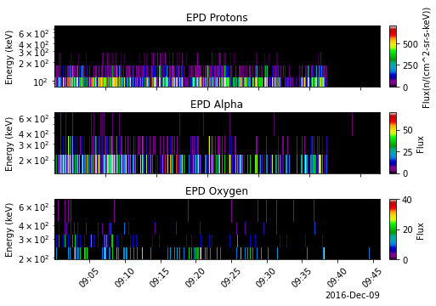
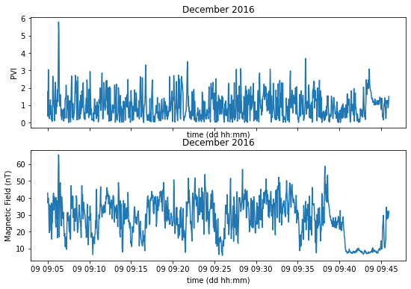

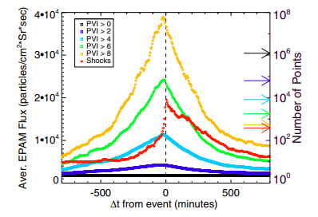
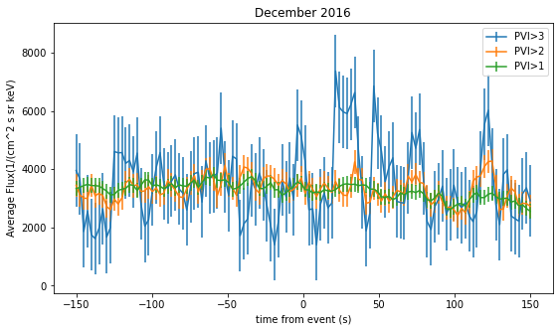
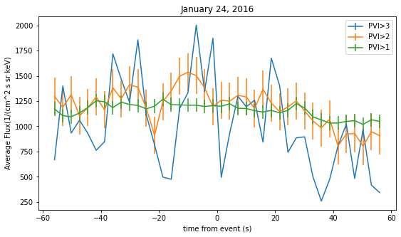
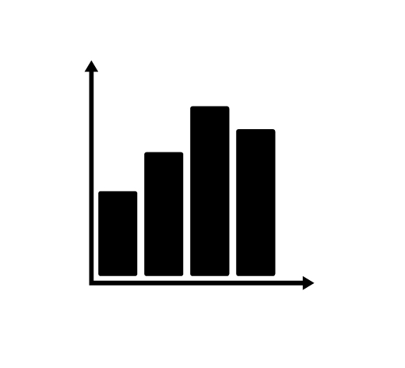

Impact of Coherent Structures on Energetic Particle Acceleration across the Magnetopause
E .O. McDougall, M. R.Argall, J. Raeder,
Department of Physics, University of New Hampshire, Durham, NH 03824
Introduction
Location of the MMS probes during our data tests
Results
Given the recent developments in the MMS probes, we have been able to look at multiscale magnetic fields in the magnetosphere in a much more comprehensive manner, but a question yet unsolved but well suited to the MMS mission is to look at the role of energetic particles in the magnetopause and what causes their acceleration across the shock boundary?
How much of that is due to solar wind driven turbulence and associated subproton scale coherent structures? How much due to the influence of cyclotron waves in the magnetosphere?
Image #1 Sub-Title Here
Image #2 Sub-Title Here
Along our data intervals we find evidence of, but relatively few instance of the magnetic discontinuities associated with turbulence related electron current sheets, but of the instances we did find we noticed a much stronger correlation of energetic proton flux with PVI>3 with particle flux being highest closest to the discontinuity in the temporal dimension.
Error ranges remain high however, due to the limited quantities of data, although the trend appears to persist in spite of the large error.
We also tend to see fluctuating behavior in the flux that varies quite rapidly in wavelike forms,
This seems to persist both on timescales equal to the period of the cyclotron frequency, and below it.
Methodology
Charts
Conclusions
By using MMS data regarding the energetic particle flux in intervals around the magnetopause specifically, we use the Partial Variance of Statistics (PVI) method int order to see the relationship that energetic particle flux across the magnetopause, which has previously shown to correlate with large magnetic field continuities and coherent structures [1]. In particular, the method computes the quantity
Where
And
is the increment
In so doing, we look at the PVI diffusion in the temporal dimension across the boundary layers., following the methodology of Teissen et. Al [1]
Energy density flux in the Magnetosheath
PVI and Magnetic Field in the Magnetosheath
While we do see evidence that the energetic particle flux correlates with the strong magnetic discontinuities associated with coherent structures, during turbulent flow periods.,
It remains to be seen whether or not ion cyclotron waves will be more of an issue in the broader datasets outside turbulent flow periods.
Future work will need to include larger data intervals and timescales in order to make this differentiation as well as comparisons to power density spectrum information derived from FSM instrument data. In order to search for peaks at the cyclotron frequency.
Data
sTAMD Simulations
Acknowledgements
The PVI Results
The data consists of FGM instrument data for magnetic field strength as well as EPD-EIS data on energetic particle flux for the dates and times of January 24, 2016 between 1 AM and 2 AM and December 9, 2016, from 9 to 9:40 AM. Both times the MMS probes were in the magnetosheath relatively close to the magnetopause.
While multiple species of particles exist in this range, we primarily look at protons flux, which are the most numerous.
Future data will include longer intervals of data along this range when the probes are in the vicinity of the magnetopause.
energetic Proton flux before and after magnetifc discontinuities
Special thanks to Riddhi Bandyopadhyay for introducing us to this topic and area of research.
References
[1] J. A. Tessein et al 2013 ApJL 776 L8
[2] J. E. Stawarz et al 2019 ApJL 877 L37
[3] Chhiber, R., Chasapis, A., Bandyopadhyay, R., Parashar, T. N., Matthaeus, W. H., Maruca, B. A., et al. (2018). Higher-order turbulence statistics in the Earth's magnetosheath and the solar wind using Magnetospheric Multiscale observations. Journal of Geophysical Research: Space Physics, 123, 9941– 9954. https://doi.org/10.1029/2018JA025768

