Slide 1


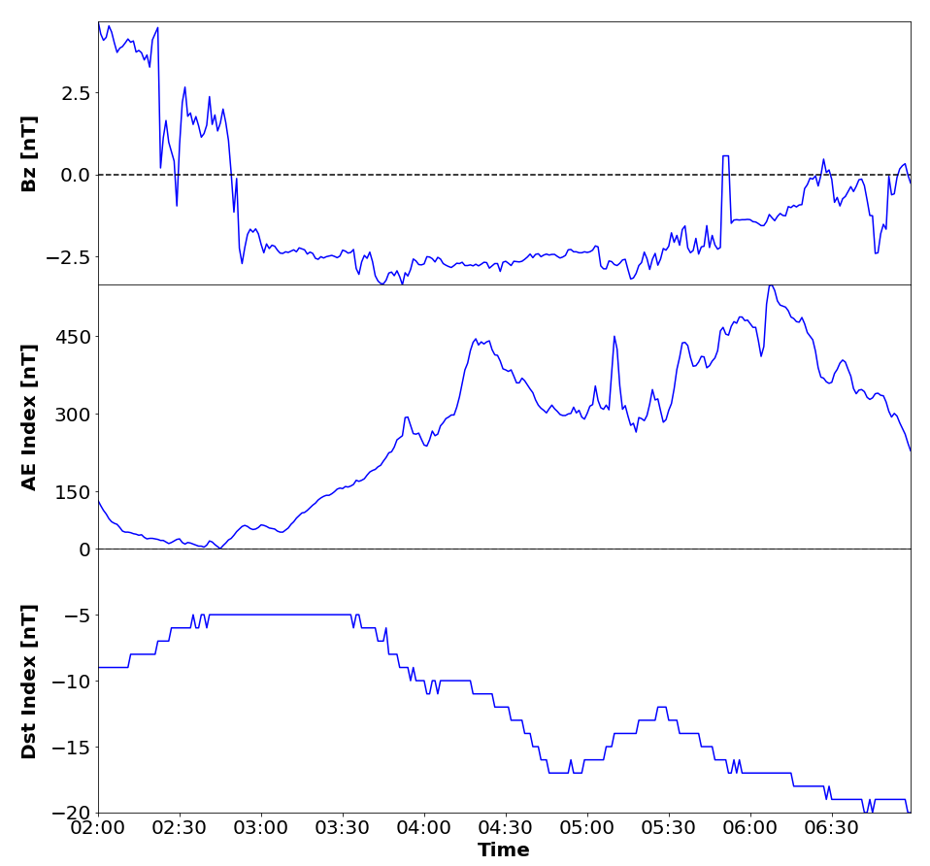
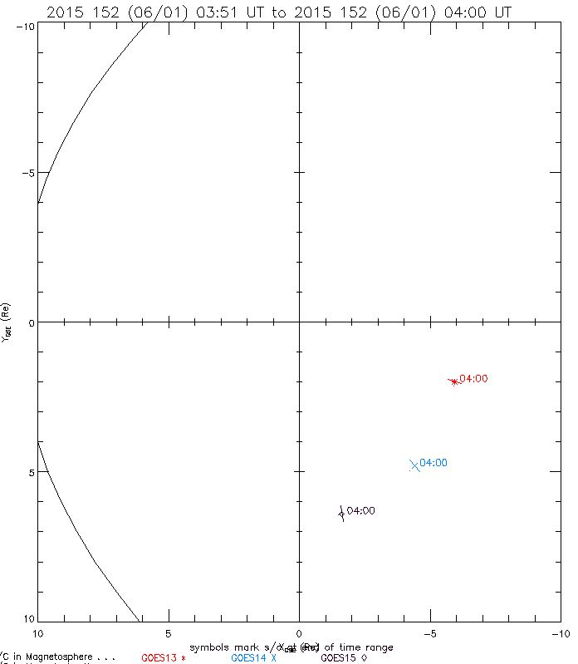
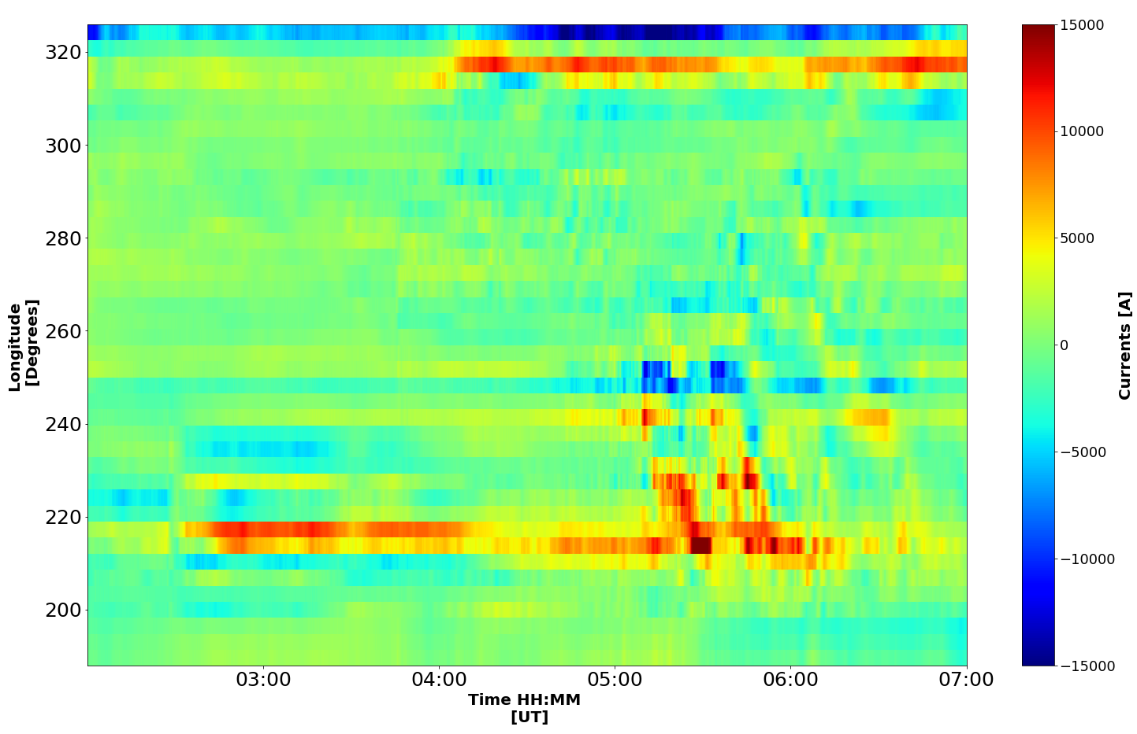
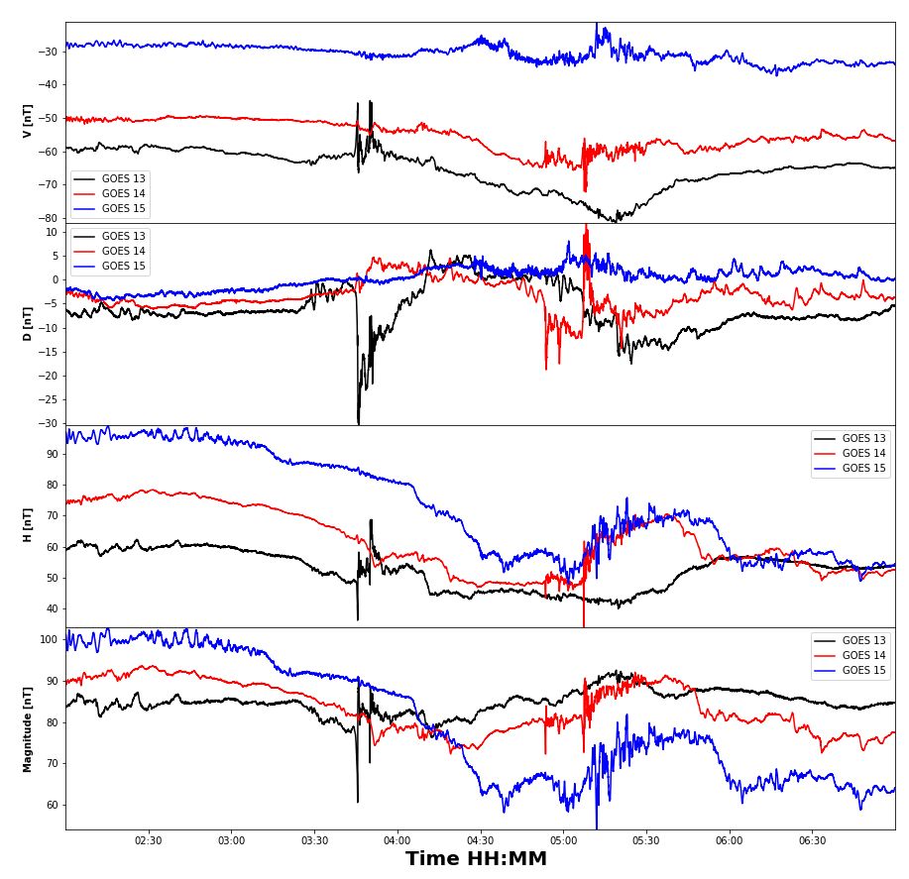
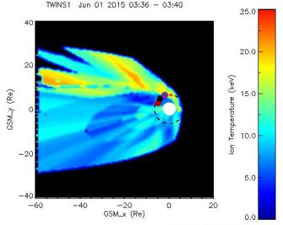
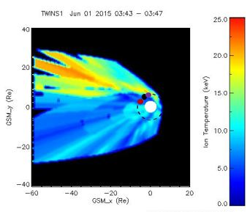
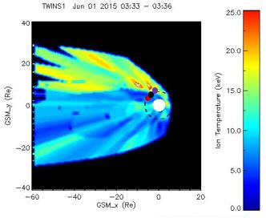
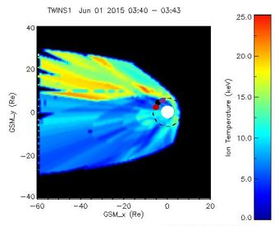
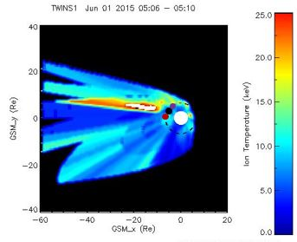
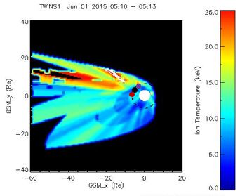
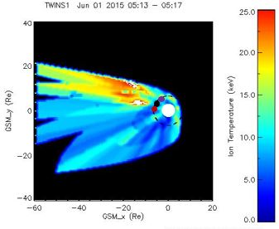
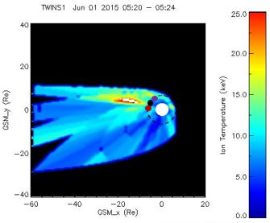
Observation of Magnetotail Structures in Comparison to the Substorm Current Wedge
Adewuyi M.¹, Keesee A.¹
¹Department of Physics and Astronomy, University of New Hampshire, Durham, NH 03824
Introduction
Geomagnetic Background
SECS
Using the data provided by the TWINS ENA Imager, a global temperature map of the magnetotail is generated.
Using the generated temperature map of the magnetotail, we examine the mesoscale structures observed in these maps for the June 1st 2015 substorm event, and it’s relation to the substorm current wedge (SCW).
GOES 13,14, and 15 satellites were used to determine the boundaries of the SCW that formed during this event, based on the deflections in the D coordinates of the magnetic field (VDH Coordinates).
Spherical Elementary Current Systems (SECS) [Weygand et al. 2011], was used for ionospheric observations of the SCW.
Fig. 1: Geomagnetic background of the June 1st 2015 event. Fairly quiet geomagnetic activity, with a minimum DST of ~-20. Substorm onset measured from the ground at ~2:29 UT and 4:01 UT.
Fig. 2: Locations of the three GOES satellites used for the in-Situ observation, with red being GOES 13, blue being GOES 14, and black being GOES 15.
Fig. 3: Keogram of Currents averaged over latitudes (58 – 80). Instances of current enhancements can be seen in the keogram, starting around 2:30 UT, with upward FAC at ~ 220 degrees. A clear indication of SCW can be seen around 5:15 UT (represented by the second line), while moving down in longitude over time.
GOES In Situ Observation
ENA Temperature Map
Conclusions
3:30 UT – 3:47 UT
SCW signature observed around 3:45 UT and 5:15 UT at geosynchronous orbit.
Consistent regions of enhanced ion temperature seen in the maps.
SECS keogram shows regions of enhanced upward FAC temporally consistent with in-Situ observations and temperature maps.
A clear indication of SCW can be seen at 5:15 UT.
Future work is to perfom a statistical analysis based on multiple event to see the temporal and spatial evolutions of SCW formation.
5:05 UT – 5:24 UT
References
A. M. Keesee, R. M. Katus, M.Floyd, and E. E. Scime (2020), Database of storm-time equatorial ion temperatures in Earth’s magnetosphere calculated from energetic neutral atom data. Journal of Geophysical Research: Space Physics
Scime, E., and S. Hokin (1992), Design and calibration of a fast‐time resolution charge‐exchange analyzer, Rev. Sci. Instrum., 63, 4527.
Fig. 4: In situ Observation of the 2015 event from the GOES satellites in VDH coordinate system. Deflections in the D component of the magnetic field at geosynchronous orbit can be used as a proxy for the identification of substorm current wedge. Negative deflection in the D component of GOES 13 at around 3:45 UT, accompanied by the positive deflection at GOES 14 indicates the occurrence of a SCW extending about 2 hours MLT, based on the positions of the GOES 13 and 14 satellites. The same signature can be seen around 5:15 UT
Fig. 5: Temperature maps of the magnetotail for the time intervals of interest. Dots on the maps are approximate locations of the GOES satellites, with red being GOES 13, black being GOES 14, and purple being GOES 15. The black dashed circles is geosynchronous orbit. The white circle has a radius of about 3 Re, and blocks out region where the temperature map calculations are not valid. The ovals that are seen in the maps are relics of the process, and might have blocked out some interesting features, especially in the first set of maps. Consistent regions of enhanced proton temperature can be observed. Region of enhanced ion temperature can be seen approaching GOES 13 and 14 satellite in the second set of maps, consistent with in situ observation.
Acknowledgements
This work is funded by the NASA TWINS Mission and NASA grant 80NSSC19K0755.
NSF Award AGS-2109543

