Slide 1
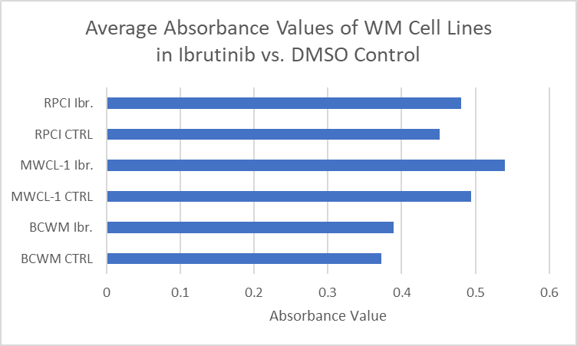
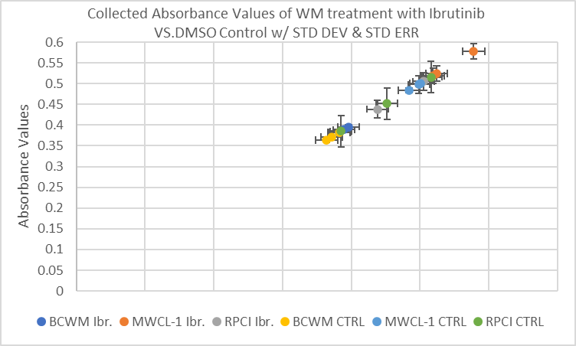
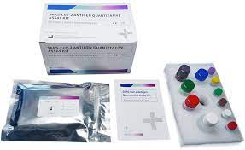
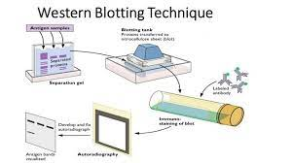
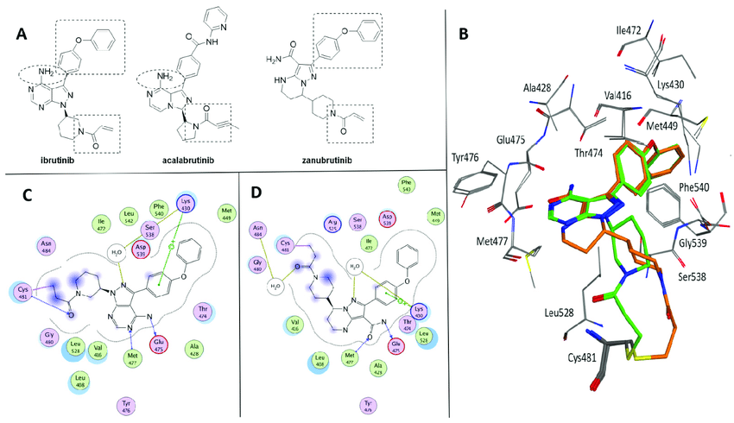
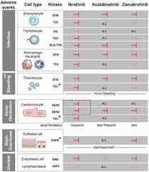
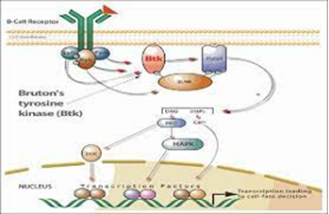
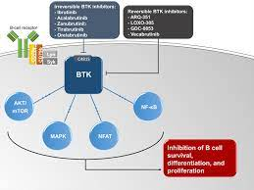
Testing Different Treatment Methods for Waldenström macroglobulinemia (WM)
Lymphoma to Investigate the Divide between
Clinical Application and Conceptual Cancer Therapies
Christopher Clark UNH College of Life Sciences Bachelor of Science, Biochemistry and Cellular Biology, 2024
McNair Scholars Program Mentor: Dr. Sherine F. Elsawa Ph.D. 25 June 2022
Abstract
Literature Review
Methodology
Results (Preliminary)
Within this study researchers will be investigating the divide between clinical application and conceptual treatment regarding the treatment of the rare lymphoma, Waldenström’ macroglobulinemia (WM). This will be done by examining the conceptual and clinical application of the BTK Inhibitor drug known as Ibrutinib and comparing it amongst two other BTK Inhibitor medications Acalabrutinib and Zanubrutinib. This will be tested clinically by treating WM cells with the different drugs to test which would be the most effective at treating WM Lymphoma. The data will be compared to the conceptual nature of the drug, which is how it should react to proposed treatments, by looking at how effective the inhibitory action is in WM B-cells. Results will be analyzed based on cell growth, cell viability and IgM production by WM cells. If a WM cell is more active, it will remain viable and produce more IgM proteins.
One of the other vital parts to the treatment and development of WM Lymphoma is GLI genes. The GLI genes are essential for embryonic development and are dysregulated in many cancers. BTK inhibition has been shown to be important for WM biology. Therefore, we will examine the expression of BTK Inhibition in response to the drugs mentioned above. This is vital to cancer research as it is a very difficult form of the condition to treat with no widely accepted treatments as of now so further research into WM Lymphoma is very important to the progression of the research.
.
What is WM lymphoma?
Waldenström macroglobulinemia is a low-grade rare form of lymphoma that currently has no standard of care which is characterized by the overproduction of the Immunoglobulin-M (IgM) protein and localization of the cancer cells in the bone marrow (Dimopoulos, M A et al.). An activating mutation is found in >90% of patients, the mutations in the MYD88 and CXCR4 genes, which may be associated with the clinical application and discrepancies caused by such the application. (Dimopoulos, M A et al.)
What are current therapies for WM?
Monoclonal Antibody therapies are used to target the specific malignant cells of the immune system to target and lyse (kill) the cells. One of these medications is Rituximab; a monoclonal antibody therapy against CD20 which is expressed on B cells only. Therefore, this leads to the death of B cells. Rituximab has been approved to target malignant B cells in Non-Hodgkin's Lymphoma, but not in WM lymphoma. However, in WM, there are positive response rates in the malignant B-cells in possible movement to lysing them, so it is a prospective treatment. Another medication within this class is called Obinutuzumab, which is another Monoclonal CD20 gene therapy that targets CD20 antibodies within Hepatitis B disease. This medication is more recent but also shows positive results in the treatment of WM. Another class of this treatment are proteasome inhFigureibitors (PIs) which target cell production in B-cell malignancies such as WM (Dimopoulos, M A et al.). One of these PIs is the medication called Bortezomib which was approved in 2003 by the NIH for the treatment of Myeloma (cancer of plasma cells in the bone marrow) (Dimopoulos, M A et al.). When combined with Rituximab, WM patients showed to be refractory and reflective meaning that there was no overall response to the drugs. Oral PIs have been used in treatments and shown possible anti-tumor activity in WM lymphoma. However, there is not enough clinical data to support any PIs being a viable therapy method for WM lymphoma.
Immunomodulatory Agents which target hematological malignancies have shown possible efficacy in myelomas. A current immunomodulatory agent lenalidomide, when combined with Rituximab, has shown an overall response rate (ORR) of around 50% in the increase of hematocrit. Hematocrit is the amount of red blood cells. However, in WM lymphoma treatment with IA’s was discontinued due to 5% of patients having a rapid drop in hematocrit within the first two weeks of treatment. The treatment focused on within this study will be Bruton’s Tyrosine Kinase (BTK) inhibitors. BTK is a part of the signaling pathway implicated in the tumorigenesis, formation of tumorous cells, in WM lymphoma. When treated with BTK inhibitors WM lymphoma patients had an ORR of around 90.5%, with only around 2% experiencing adverse side effects with atrial fibrillation after a history of cardiac arrhythmias (Dimopoulos, M A et al.). As a result of this, it was approved for treatment of WM patients with at least one prior form of cancer therapy. Ibrutinib, one of the most common BTK inhibitors, has shown specific promise in preclinical trials but there remains a discrepancy in the clinical application (Selleck Chemicals). The treatment that is given to each patient is used regarding the IWWM-6 consensus criteria, which measures IgM levels within the bone marrow and depending on the level of IgM would lead to a specific treatment (Dimopoulos, M A et al.). The many treatment options for WM lymphoma are rapidly expanding and some seem promising but there is still no standard of care for the malignancy and Ibrutinib has remained the only FDA approved for the treatment of WM lymphoma,, until recently when Zanubritib was approved by the FDA, showing its efficacy. Exemplifying the importance of exploring more treatment options regarding this and the outstanding discrepancy between preclinical data and clinical application. With this methodology it would be clear to see how effective certain treatments are and how when combined could be much more efficacious.
Figure 2: Comparison of
Figure 1: Chemical formulas for Acalabrutinib, Zanibrutinib , and Ibrutinib Adverse side Effects for Ibrutinib, Acalabrutinib, and Zanubrutinib
What is BTK Inhibition?
Byron’s-Tyrosine Kinase (BTK) is an activation protein in the B-Cell ligand receptor that forms the B-Cell expansion. BTK is used in cell signaling and often to be used in oncogenic signaling to ensure proper production of the proper B-cell development and function. The BTK activation was placed downstream of the B-Cell Antigen receptor. When the BTK protein is over activated it leads to the overproduction of B-Cells and lack of generation making the cells become cancerous. When inhibited BTK has been shown to be extremely effective in regaining control of the cell cycle and leading back to positive B-Cell propagation. Therefore, in this project the research will be focused on BTK inhibition as a therapeutic strategy for the treatment of WM lymphoma in cells. As discussed before the only FDA approved treatment for WM Lymphoma as it stands is BTK Inhibition since it has proved most effective on clinical trials thus far. However, when combined with the chemotherapy, to make the GLI genes and the kinase phosphorylation easier to target, it would make for a very effective treatment for the use of WM lymphoma patients.
Since in WM the kinase needs to be inhibited to stop the production of cancerous cells it is essential that the GLI genes and kinase pathway are targeted in a productive manner. This therapy brings in the combination of the two therapies and will supposedly make a very effective treatment therapy plan for WM lymphoma cells. To test this proposal healthy cells that do have control of their cell cycle will be injected with the proteins and genes for WM lymphoma. The lab will then expose the cells to a variety of treatment therapies, including a placebo and measuring the cancer viability after these treatment options with the main focus of the study being on the combined therapies of GLI Gene targeting and BTK inhibition paired with the medication Ibrutinib. From this, researchers may gain insights into an effective treatment to which WM lymphoma has none at this time. This study will also look into other factors which may not yet be discovered that act on both the signal cascade of the GLI proteins and the proteins themselves. So given the known information regarding WM lymphoma and the prospective treatment options, this option seems very promising as to what treatments may be effective and used in the future. The study will reveal more of what is working and what is not efficacious in the treatment of this rare lymphoma and how it will assist the cancer therapy database for researchers since malformation of the GLI proteins is found in about 97% of all types of cancers (Matissek et al.).
The purpose of this study will be looking at cell growth, cell viability, and IgM production from WM cells. We will also run western blots using cell lysates from cells treated with or without BTK inhibitors to confirm that the inhibitors reduce phosphorylated (activated) BTK. This will be done by treating WM cells with the BTK inhibitors for 24 hours then lysing them and running a western blot (Figure 6). The three treatments are 1) Ibrutinib - the only FDA approved medication for the treatment of WM lymphoma and an extremely potent BTK Inhibitor. It exhibits irreversible treatment and restriction of the B Cell-Kinase pathway during WM Lymphoma, blocking the production of IgM proteins and Malignant B-Cells; 2) Zanubrutinib, The far newer and irreversible BTK Inhibitor based off of Ibrutinib's chemical formula, is less potent and leads to less unwanted side effects (Hillman et. Al.) However, since it is less potent the effect of BTK inhibition seems to be lesser leading to less interference with the overproduction of IgM. ; 3) Acalabrutinib (“Acalabrutinib” 1). With all drugs, we will include a control treatment which will be WM cells treated with DMSO, the solvent used to dissolve the drugs. The BTK inhibitors work by inhibiting activation of BTK. Activation is shown by protein phosphorylation. Therefore, we will determine the levels of phospho-BTK (pBTK) in all treatments. This will be done by inserting healthy cells with cancerous WM lymphoma cells which will then be observed and recorded regarding the three criteria observed above.
Then measuring the cell growth of each malignant cell after it is injected with the cancerous cells by looking through the cell line provided in the research and examining how the cells injected have reacted. The replication will be shown by using a XTT Assay kit counting the starting and final amounts of cell growth that have occurred within the course of the study. By counting and examining the Malignant B-cells within the study it will be simple to see how the malignancy has advanced within the course of the study (Elsawa et al.). The viability of the cancerous cells will be marked by the Trypan Blue dye to test which cells have deceased or are still alive. The cells will be prepared in 6x6 microwells and cultured for two to three days before they can begin to be injected with the malignant cellular components. The Trypan Blue dye is a commonly used dye which attaches only to the protein of dead cells and stains the cells blue. Through this process it is easy to see how effective the treatment was by comparing the amount of viable infected B-Cells remaining after the application of the BTK inhibitor treatment. The more cells that have been stained by the Trypan Blue dye, the more effective the treatment administered against the affected cells. The lower the numbers of overall cell viability will show how effective the treatment has been.
Figure 6: General steps to run a Western Blot Protocol
However, if the cell line being tested shows no change in cell viability after the treatment is applied that could mean that the supposed treatment was not properly executed and may have been a non-functional group of the medication with no observable reaction towards the WM cells. The production of the IgM proteins by the cell lines will be examined using an ELISA cell counting machine(Figure 5) which will measure the production of IgM proteins to show how active the cancer cells remain if the signal cascade is still being enacted and producing the product of the signal cascade being the IgM proteins. When all the data is collected on each of the four cell lines in the three facets of the study it will be analyzed to see which medication would be most effective in treating the WM Lymphoma cell lines. Through the combination of examining the cell counts the lower the number of cells counted, the most efficacious medication for treatment can be deduced. With cell viability the more cells dyed with the Trypan Blue dye shows the more effective treatment method, with the dead cells being the only cells affected by the dye. This will be the most effective way to show how the treatments will be enacted and how effective they will be for the treatment and production of the WM infected cells. To analyze the data, stats testing will be undertaken after collection of the data to help determine what the most effective treatment out of the three measures would be with percent response from all three of the testing processes in the expected pattern.
The materials needed will be the Trypan Blue dye for testing cell viability, microscopes for the examination of the cell count and Trypan Blue dye efficacy. As well as an ELISA kit to measure the total levels of IgM production. The medications used will be 50 mg Ibrutinib, 50 mg Zanibrutinib and 50 mg Acalabrutinib. And the lab quest which will be used to measure the IgM production of the cells. The possible challenges which may be in part with this research would be the potential efficacy of the medications used, it could not be as effective as seen in past clinical trials. Another potential obstacle may be getting materials since it is rather expensive to afford the medications for testing and the other materials needed for the study. Impediments may also include the starting viability of the cells which may affect how they behave towards the drug treatment and the results of the study that will be conducted and the potential for possible measuring error. This error may also occur within the measurements and will affect the overall results of the study. The principal location of this study will occur within Rudman Hall on the Second Floor in the Elsawa Lab here in the University of New Hampshire. Access has been granted to the research site by Dr. Sherine Elsawa, the coordinator of this lab under the specification that the researcher completes the BSL I and II lab training modules and the Autoclaving Biomass and Infectious Disease training and has submitted those certifications to the lab coordinator which has already been completed. An IRB will not be required for this experiment since it will not involve clinical trials. Approval to work on cells will be granted through Elsawa lab. Research is currently being conducted to inform researchers on the background information of this study. I am taking cell biology this semester to prepare myself to ensure that I, as the researcher, am well informed and able to enact the study and the lab protocols. Dr. Sherine Elsawa will oversee the research study.
Figure 7: Averaged Absorbance Values of Cell Lines Compared
Figure 8: Raw Collected Data of cell lines compared and analyzed
An XTT Assay was ran with only Ibrutinib while waiting for materials to continue the study to arrive. This preliminary experiment was done to examine the possible effects of Ibrutinib on three different cell lines all exposed to WM Lymphoma: BWCM, MWCL-1,RPCI. This experiment was conducted after cells were left to culture for four days, when enough cells were present to experiment, the cells were spun down and moved into a new source of RPMI media that did not contain Phenol Red dye which would affect readings of the spectrometer. The cells were then treated within triplicate wells of two rows, within a 96 well plate, with the diluted solutions of 1.5uL of 10uM of Ibrutinib for the first row and 1.5 uL of 10 uM DMSO Control. Both solutions were diluted up to 10 uL with Phenol-Free RPMI Media. After being left to Incubate for 72 hours at 37°C, the 96 well plate with the samples was treated with 20 uL each of XTT Activator and Reagent then left to Incubate for another three hours. The prepared samples of the XTT Assay were analyzed by a color spectrometer, and raw data was analyzed (Figure 8) and the standard deviation and standard error was calculated for each sample to account of possible systematic and human errors. The data was further analyzed and averaged(Figure 7) to show possible effect of Ibrutinib on the treatment of WM Lymphoma when compared to the DMSO Control solution. The higher the absorbance value the less production and reflection of the IgM protein was produced meaning the more effective the treatment. When comparing the differences of the average absorbance values, the MWCL-1 cell line displayed the greatest difference of values, meaning that Ibr. Had the greatest overall effect on the treatment of WM Lymphoma in the RPCI Cell line and the least effect within BCWM cell line, according to this preliminary experiment (Figure 7). The results seem mostly reliable with a standard of error of around 8.2 for the well treated with Ibrutinib and 2.6 for the well treated with DMSO control. RPCI seems to have produced the least accurate results within this experiment with a large standard of error of 21.6 for the well treated with Ibrutinib and 11.1 for the well treated with DMSO control. Despite this the results of this experiment should be trusted and will be viable for future experiments regarding the overall low standard deviation(avg. ~5.7) and standard error (avg. ~8.2). His experiment will be repeated, along with the ELISA Protocol and Western Blot Protocol, to include the treatment of WM cells with diluted Acalabrutinib and Zanubrutinib, extrinsic factors will try to be limited as will human error to avoid skewing of the data from outside sources
Introduction
This research topic will be based around looking further into cancer treatment. The general interest within this topic started with seeing how there is a broad gap between the conceptualization of cancer treatments and the actual application of those treatments in Laboratory testing trials. To examine this more specifically our research will be looking at a rare form of cancer known as Waldenström macroglobulinemia (WM). WM is a subtype of non-Hodgkin’s Lymphoma that is characterized by the overproduction of a monoclonal IgM antibody by cancer cells. This IgM is associated with clinical symptoms. The initiation of therapy for WM patients is based on elevated IgM levels.
Problem Statement:
As a result of the complexity and rarity of this disease it becomes much more difficult to treat with conventional cancer therapies and there is an unknown divide between the clinical application of these therapies and the conceptualization of them. Therefore, there needs to be further development in this area to create effective and reliable treatments of WM lymphoma, since none currently exist within the scope of current and past research.
Research Question:
We will investigate the effect of BTK targeting in WM using 3 different drugs. Then we will combine BTK targeting with GLI targeting (using GANT61) to determine if the combination is a better therapeutic strategy for WM Lymphoma.
This question will be challenged by treating the malignant WM lymphoma cells and seeing their growth against the combined targeting of GLI Genes and BTK inhibitors as a therapeutic strategy in WM lymphoma. Since the mutation of the GLI genes is found to be associated with somewhere around 95% of all total cancers (Matissek et al.) therefore it is an essential gene pathway in cell development and very important to the cancer biology research community. This research will be vital to cancer treatment overall and a very important step into the pathway of what cancer treatment can become.
Significance:
With this research it may become clearer to researchers what other factors may affect the signal cascades that lead to the inhibition of the BTK pathway causing a decrease in IgM production since so little about these genes is currently known. There is currently no dependable cure for WM lymphoma. WM lymphoma has a very poor prognosis and is usually terminal upon diagnosis for patients (Papanota et al.). and will lead to far greater possible treatment plans when contrasted against one another. This study will potentially lead to many discoveries regarding the clinical divide in all of cancer research but especially within the specific treatment of WM lymphoma.
Figure 5: Components of ELISA
Counting kit which will measure IgM production
Acknowledgements
Special Thanks to:
Dr. Sherine F. Elsawa Ph.D.
Elsawa Lab Research Assistants
University of New Hampshire
McNair Scholars Program
All my Fellow Scholars
References
“Acalabrutinib (ACP-196): ≥99%(HPLC): Selleck: BTK Inhibitor.” Edited by Selleck Chemicals, Selleckchem.com, 2013, https://www.selleckchem.com/products/acalabrutinib.html.
(Dimopoulos, M A et al.) “Waldenström's macroglobulinemia: a clinical perspective in the era of novel therapeutics.” Annals of oncology : official journal of the European Society for Medical Oncology vol. 27,2 (2016): 233-40. doi:10.1093/annonc/mdv572
Elsawa, Sherine F et al. “B-lymphocyte stimulator (BLyS) stimulates immunoglobulin production and malignant B-cell growth in Waldenstrom macroglobulinemia.” Blood vol. 107,7 (2006): 2882-8. doi:10.1182/blood-2005-09-3552
Matissek, S. J., Han, W., Karbalivand, M., Sayed, M., Reilly, B. M., Mallat, S., . . . Elsawa, S. F. (2021). Epigenetic targeting of Waldenstrom macroglobulinemia cells with BET
Papanota, Aristea-Maria, et al. “Evaluating Ibrutinib in the Treatment of Symptomatic Waldenstrom’s Macroglobulinemia.” Journal of Blood Medicine, vol. 10, Aug. 2019, pp. 291–300. PubMed Central, https://doi.org/10.2147/JBM.S183997.
“Zanubrutinib (BGB-3111): ≥99%(HPLC): Selleck: BTK Inhibitor.” Edited by Selleck Chemicals, Selleckchem.com, 2013, https://www.selleckchem.com/products/zanubrutini-bgb-3111.html.
Figure 3: Hedgehog Pathway showing where BTK is on signaling cascade
Figure 4: General Process and effect of BTK
Inhibition in Hedgehog Pathway

