Slide 1

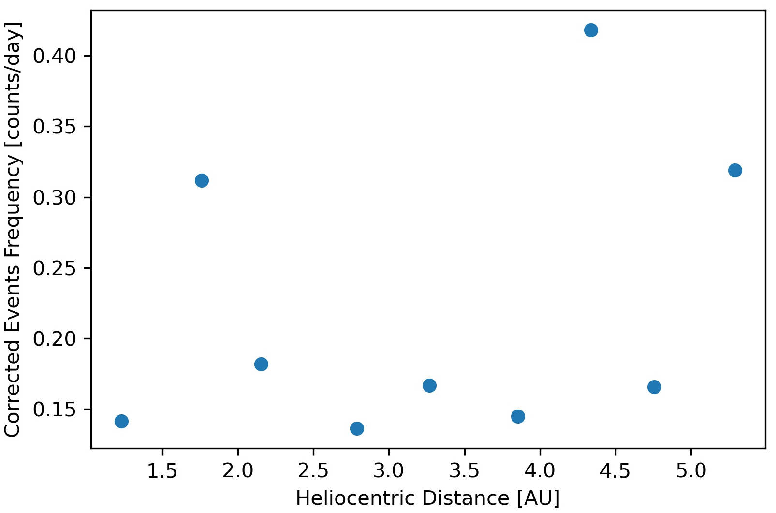
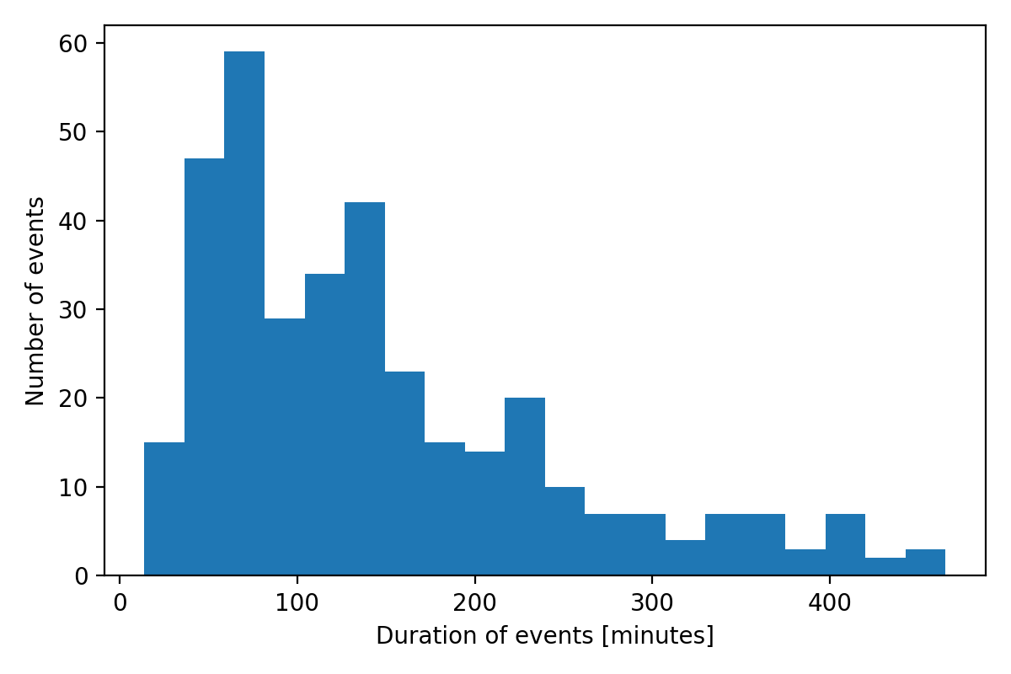
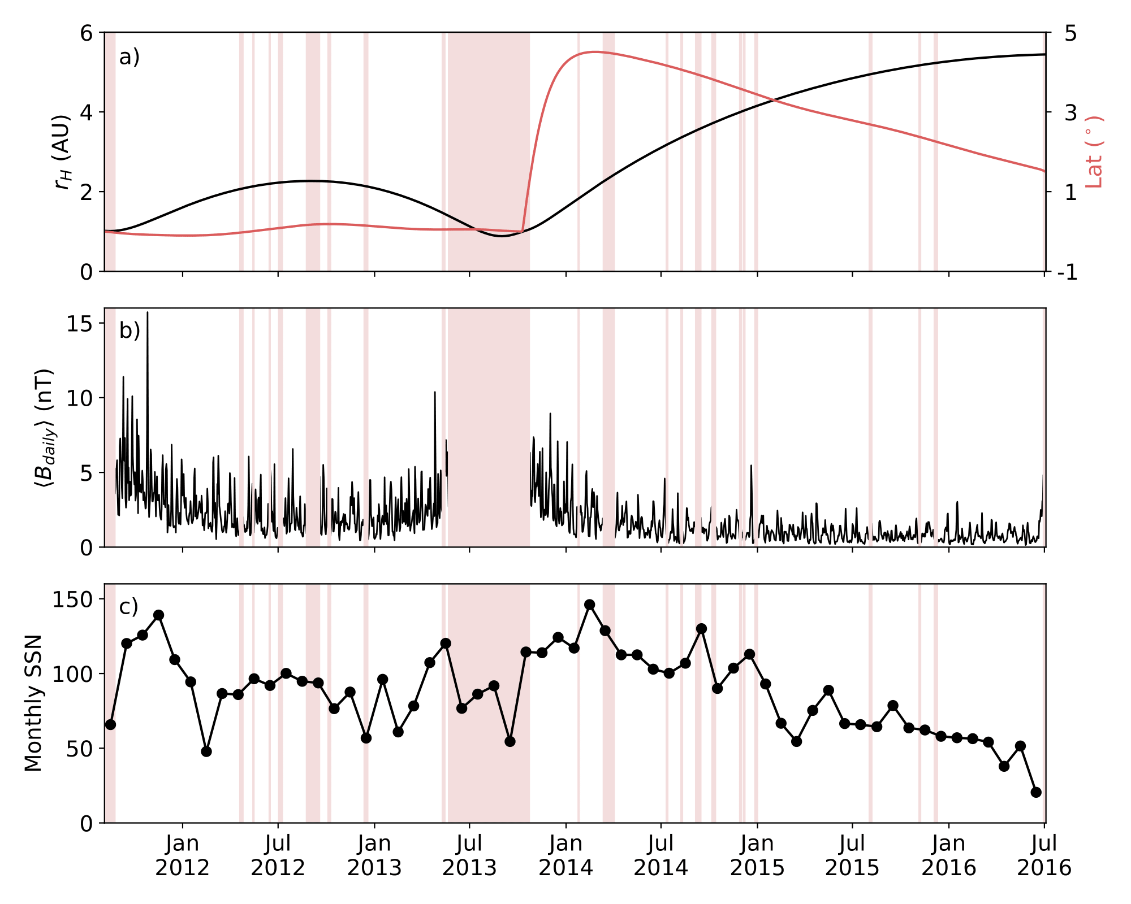
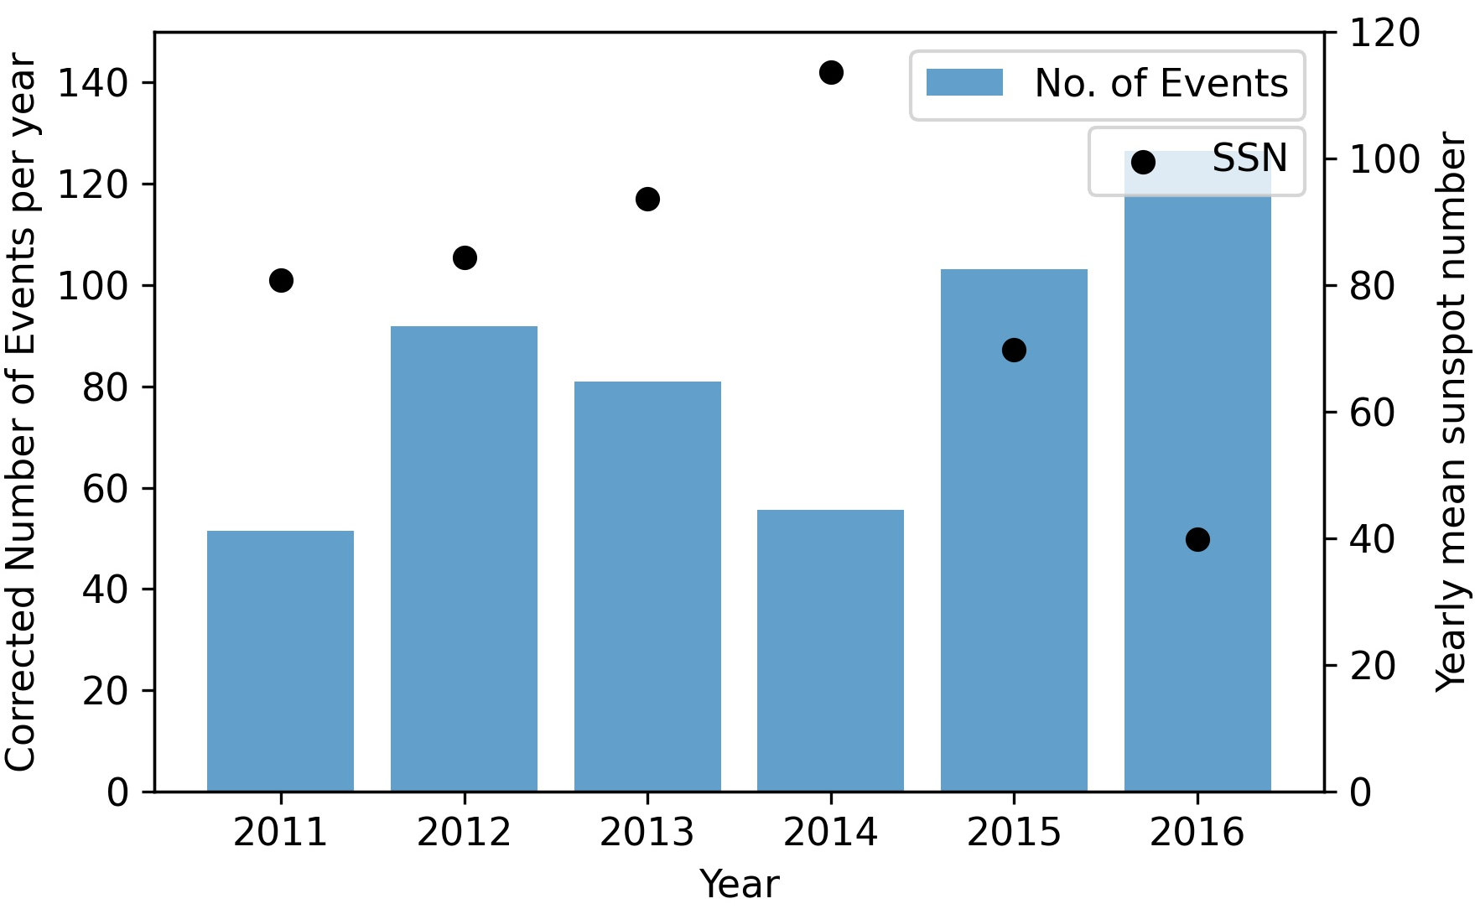
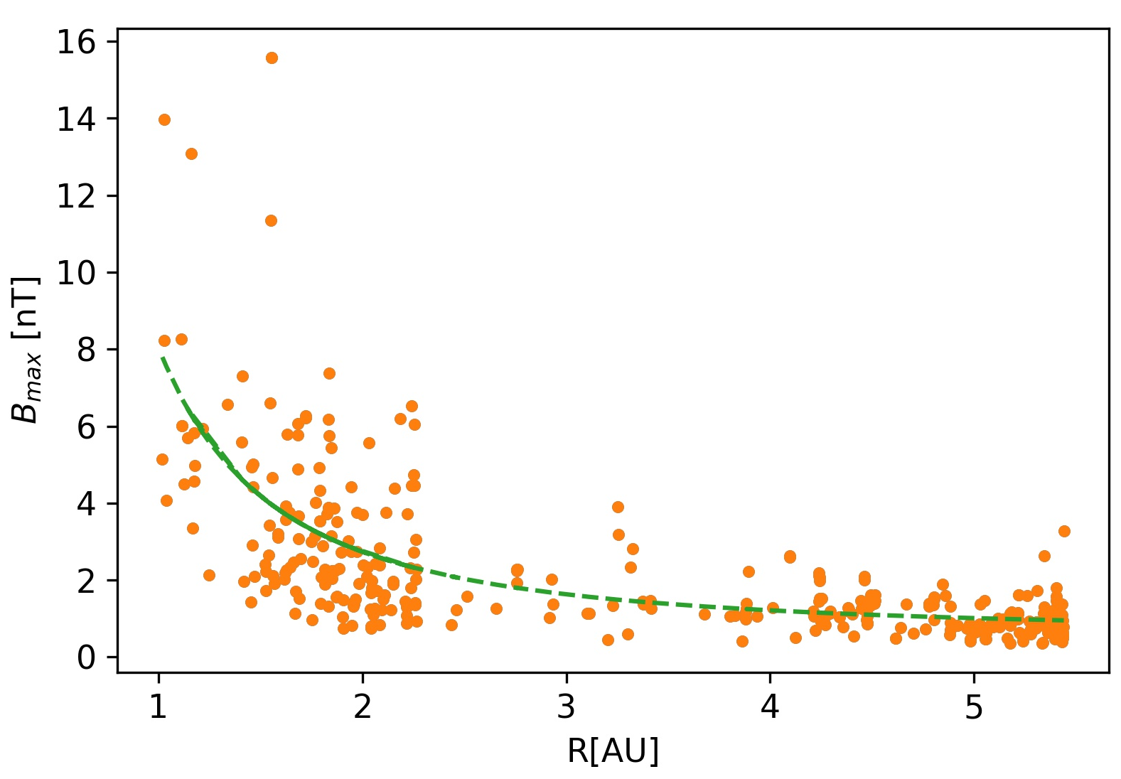
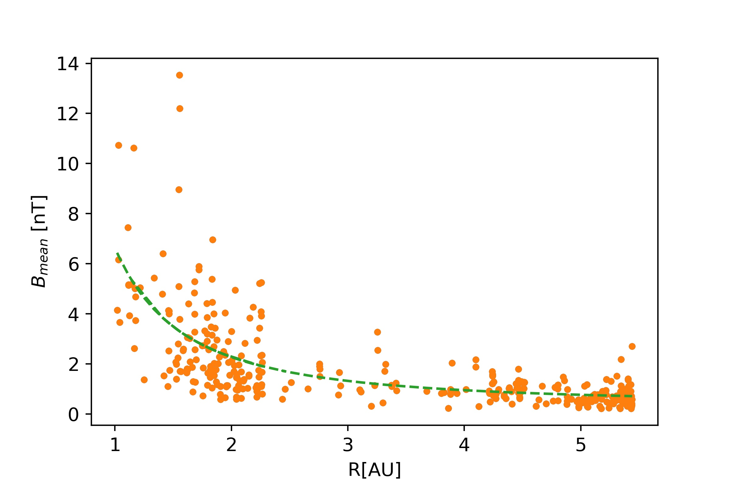
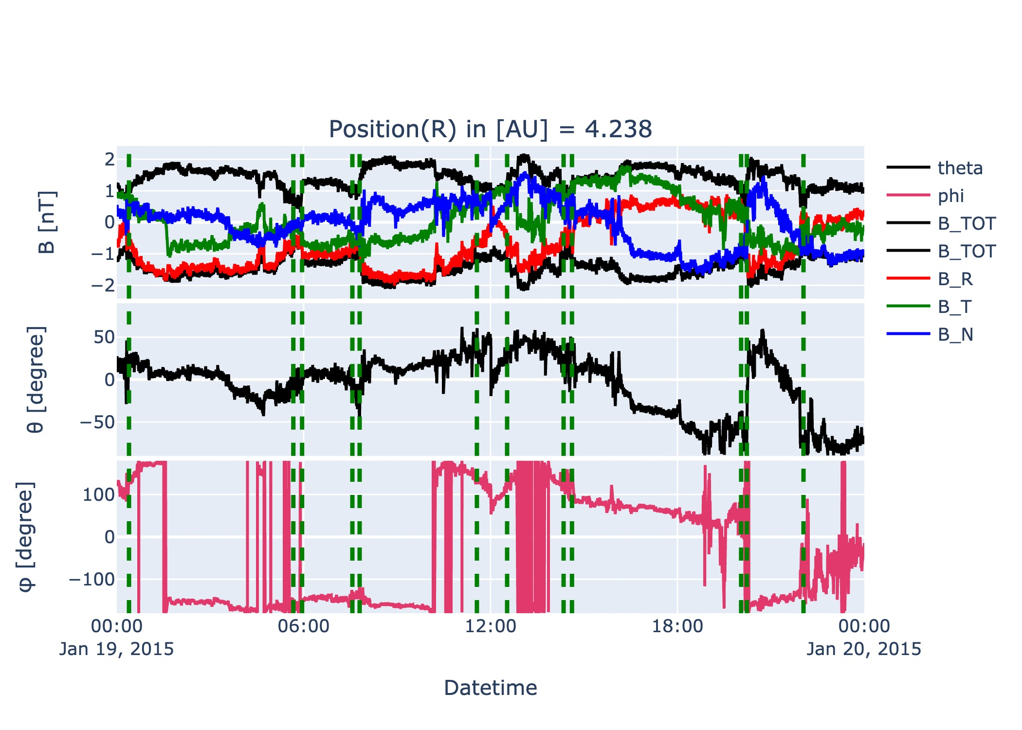
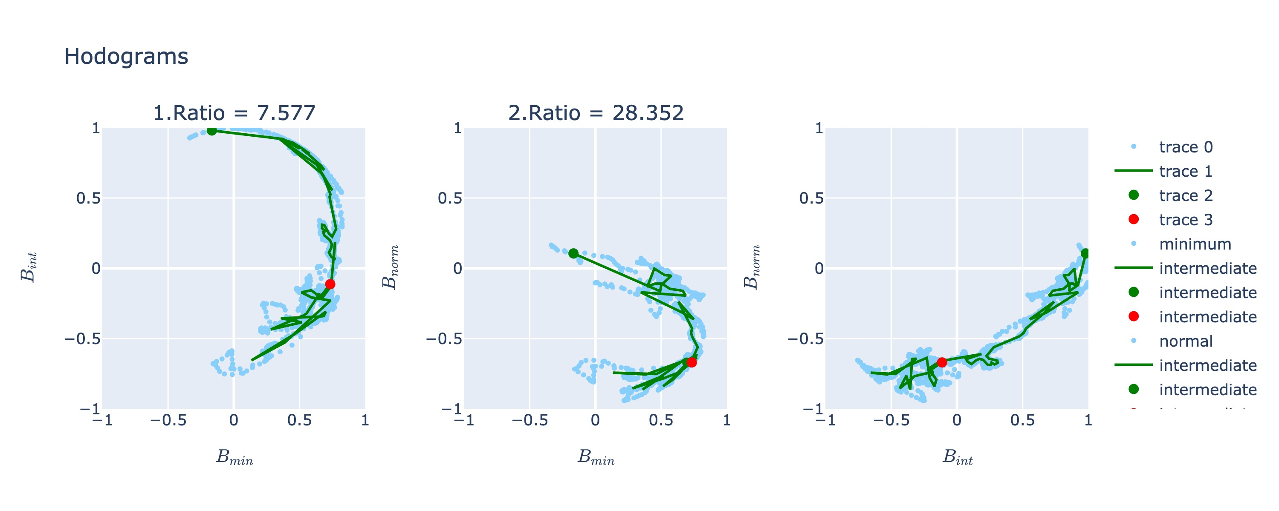
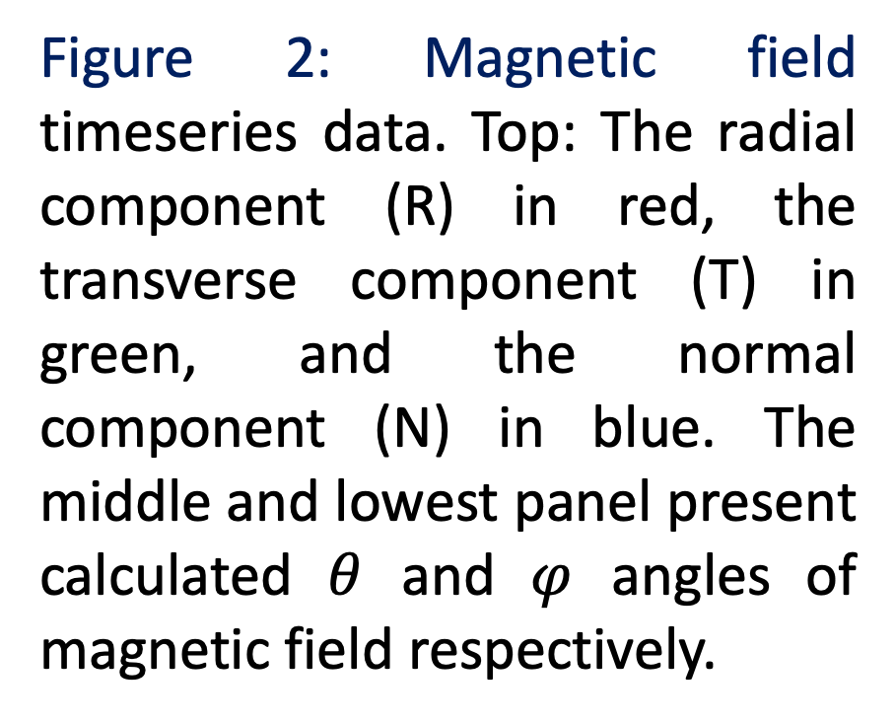
Characterization of Small Flux Ropes Using Juno
Spacecraft Data
Sahanaj Aktar Banu¹(sahanaj.banu@unh.edu), Réka Winslow¹, Camilla Scolini^{1,2}, Emma Davies¹
¹University of New Hampshire, NH, ²University Corporation for Atmospheric Research (UCAR), Boulder, CO
1. Motivation:
5. Properties of SFRs:
  Small flux ropes can be described as helical magnetic field lines twisted into a cylindrical shape around a strong axial field with duration of few minutes to few hours.
  We use Juno cruise phase (Aug 25, 2011 - June 30, 2016) data to characterize and build a catalog of Small flux ropes (SFRs)
  Origin of SFRs is still an open question, with solar origin or in interplanetary space as possibilities [Cartwright & Moldwin 2010; Murphy et al., 2020; Chen et al., 2019; Zhao et al., 2020].
  Juno spacecraft traveled from Earth to Jupiter, covering a large heliocentric distance range between 1 AU to 5.4 AU.
  Statistical evolutions of SFRs can be understood in this wide distance range and may shed light on their origin.
As a preliminary result, 354 SFRs have been detected. Properties of those events are presented below.
Figure 4: Corrected* number of events observed per day with the radial distance.
Number of events per day ranges between 0.14 and 0.42.
No clear dependance with distance.
2. Juno dataset:
In the absence of solar wind plasma data, SFRs are identified using magnetic field data only.
1 second resolution data in the RTN coordinate system.
Applied visual detection technique to inspect ~ 5 years of magnetic field data.
Figure 5: Histogram of the duration of the events.
Duration ranges between 0.23hr and 7.75hr.
Mean, median and mode duration of SFRs are ~2.4hr, ~2hr, and ~1hr, respectively.
Figure 1: Overview of Juno cruise phase data. a) Heliocentric distance (left) and latitude (right) of the Juno orbit in heliocentric ecliptic coordinates (HAE). b) The mean daily magnetic field magnitude. Vertical lines indicate days for which magnetometer data is unavailable. c) Monthly mean sunspot number. Figure from [Davies et al., 2021].
Figure 6: Corrected* number of SFRs per year (left) with sunspot number per year (right) is projected.
Events per year ranges between 51 and 126, largest number of events in 2016.
No clear dependance with solar activity.
3. Identification criteria for SFR:
  Ratio of the average magnetic field strength around the maximum within the flux rope to the background interplanetary magnetic field has to be greater than 1.3 [Cartwright & Moldwin 2010; Murphy et al., 2020].
  Gradual change in polarity or smooth rotation greater than 30º in at least one of magnetic field components [Cartwright & Moldwin 2010; Murphy et al., 2020; Yu, W., et al., 2014; Klein & Burlaga 1982].
  Duration of the event must not be greater than 8 hr based on the shortest ICME flux rope during Juno cruise phase is ~12 hr [Davies et al., 2021].
  Applied minimum variance analysis (MVA): The ratio of maximum to minimum eigenvector must be greater than or equal to 6 [Cartwright & Moldwin 2010] and the ratio of intermediate to minimum eigenvector must be greater or equal to 2 [Murphy et al., 2020].
  Use magnetic hodograms of events to select only ones with clear rotations.
B_{max}(R) = 7.44 R^{-1.80} + 0.60
B_{mean}(R) = 6.26 R^{-1.71} + 0. 37
4. Examples of SFRs: 19 January 2015 Events
Six candidates detected on Jan 19, 2015. The dashed lines delineate the start and end times of each event.
Figure 2: Magnetic field timeseries data. Top: The radial component (R) in red, the transverse component (T) in green, and the normal component (N) in blue. The middle and lowest panel present calculated $θ$ and $φ$ angles of magnetic field respectively.
Figure 7: Variation with heliocentric distance of the maximum (left) and mean (right) magnetic field strengths of SFRs. The dashed line is the least squares fit to the data.
Radial dependance found R^{-1.80} and R^{-1.71} for B_{max} and B_{mean}, respectively.
For B_{max}, between 0.31 and 0.47 AU [Murphy et al., 2020] and 0.31 to 5.5 AU [Cartwright & Moldwin 2010] radial dependance found R^{-1.88} and R^{-0.98}, respectively.
For B_{mean}, between 0.31 and 0.47 AU [Murphy et al., 2020] found R^{-1.98}.
1
2
3
4
5
6
* Corrected Number is normalized by the duty cycle of Juno magnetometer.
Event 5:
Duration is 5.5hr
The MVA ratio of maximum to minimum eigenvector is 28.4; the MVA ratio of intermediate to minimum eigenvector is 7.6
The ratio of the average maximum magnetic field strength to the background is 2.2.
6. Summary and Outlook:
Analysis performed on the preliminary database of 354 SFRs.
We investigated the properties of SFRs such as variation of occurrence frequency, maximum and mean magnetic field strength with heliocentric distance, and event observed per year with solar activity.
Finalization of the SFR database through double checking all the events with collaborators.
Future investigation on the magnetic field decay with distance required to clarify differences in expansion rates compared to previous studies.
Investigate the occurrence of SFRs with heliospheric current sheet crossings.
Figure 3: Magnetic hodograms of Event 5. Each plot shows pairs of normalized magnetic field component.

