Slide 1



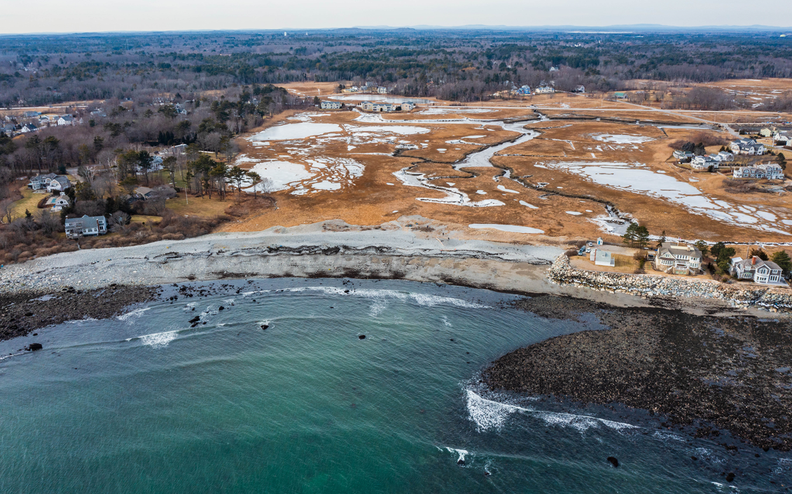

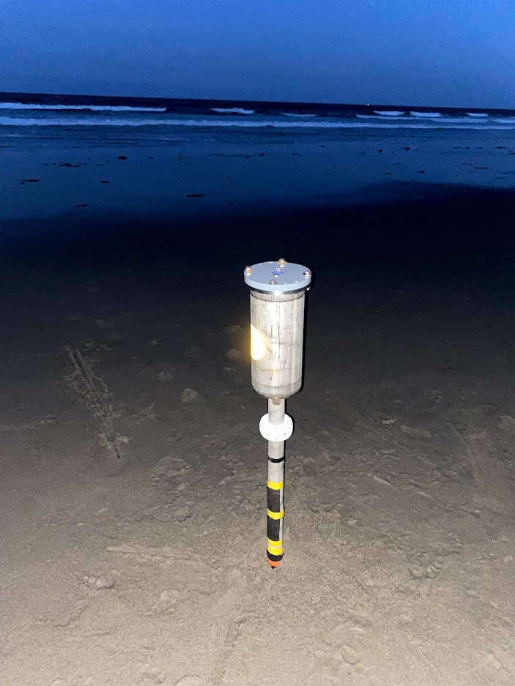
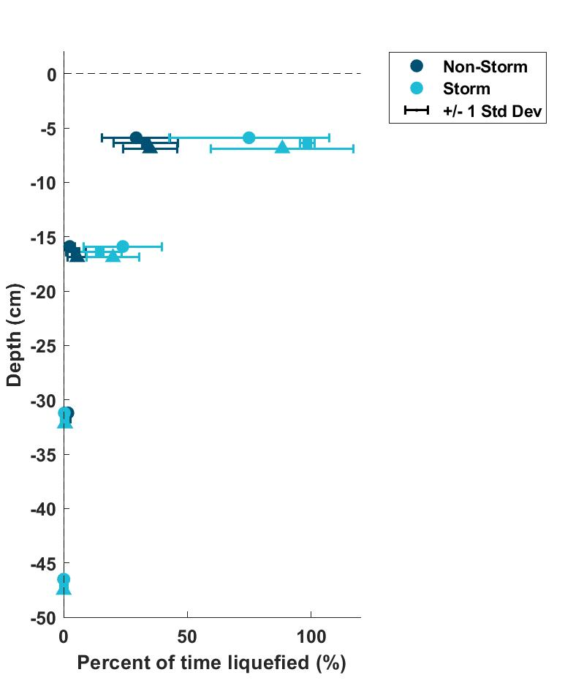
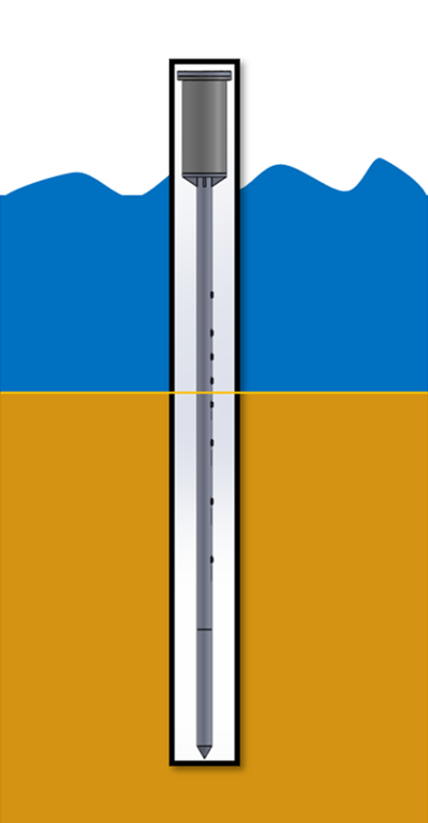
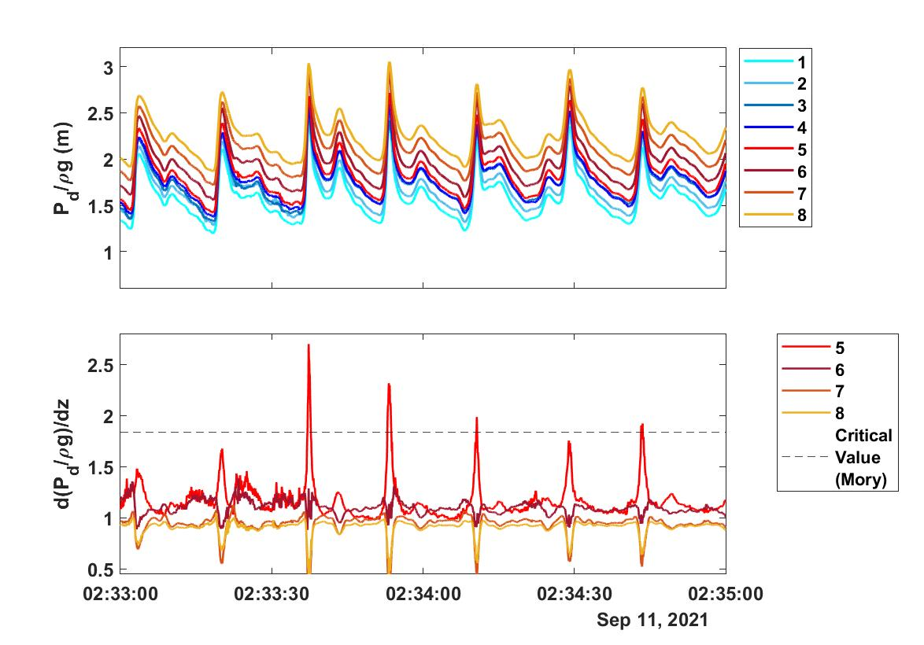
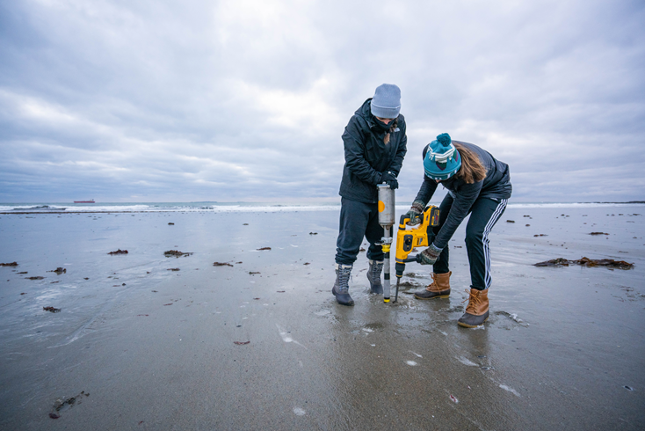
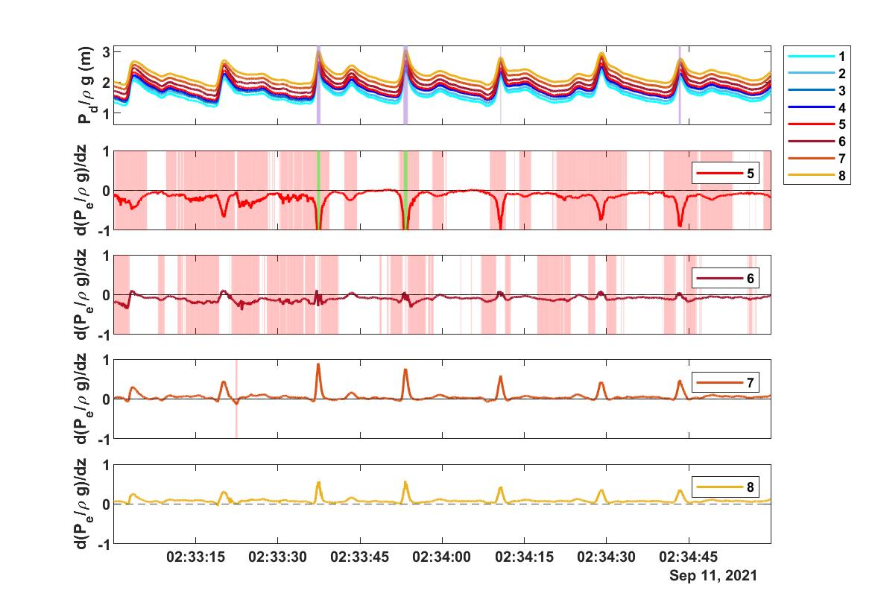
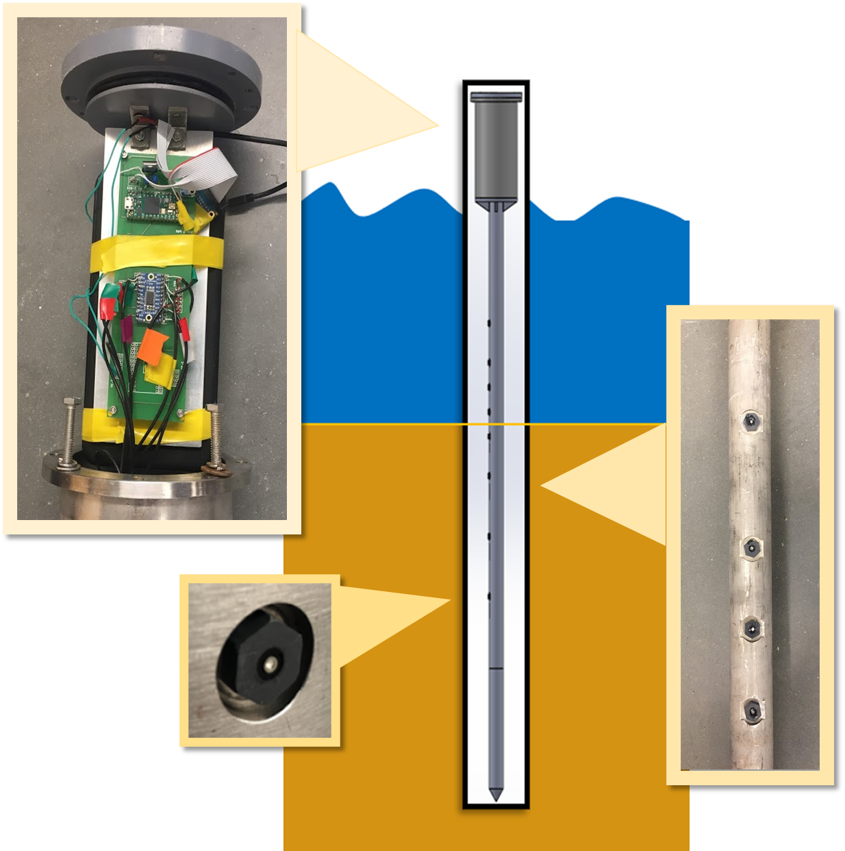
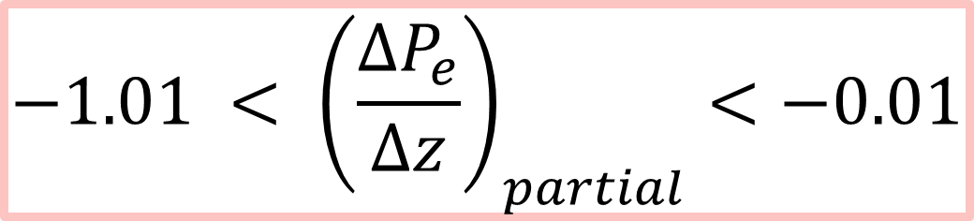
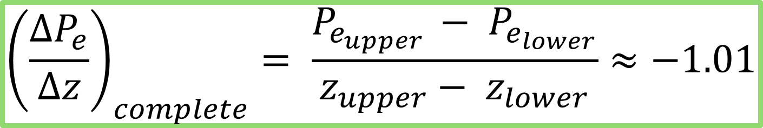
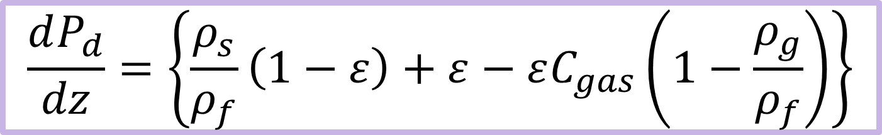
Unraveling Beach Erosion from Extreme Storm Events:
Field Evidence of Wave-Induced Momentary Liquefaction
Melissa Marry and Diane Foster
Acknowledgments
In addition to support from NH Sea Grant and SERDP we would like to acknowledge:
Spencer Marquardt, Savannah DeVoe, Corina Gudinas,
Jon Hunt, Garett Forhman
Motivation
Results: Momentary Liquefaction Criteria
Results: Percent of Time Liquefied
Extreme storm events can lead to significant sediment erosion
Small-scale sediment transport mechanisms not well understood, particularly from a field setting
Mory et al. 2007 defines a critical vertical pressure gradient value to induce momentary liquefaction
 | Offshore Wave Height (m) | Offshore Wave Period (s) | Wave Shape |mean Asymmetry|
January | 1.94 – 3.90 | 5.56 – 13.33 | 0.63 – 0.75
September | 1.01 – 2.30 | 4.35 – 18.18 | 0.96 – 1.23
$$\frac{dP_{d}}{dz}=\left\{\frac{ρ_{s}}{ρ_{f}}\left(1−ε\right)+ε−εC_{gas}\left(1−\frac{ρ_{g}}{ρ_{f}}\right)\right\}$$
Pressure in meters, P_{d}
Elevation, z
Density of air, water, and sediment ρ_{g,} ρ_{f,} ρ_{s}
Porosity of sediment, ԑ
Gas content, C_{gas}
January
September
+/- 1 Std Dev
Photo: Rye, NH
Credit: Tim Briggs, NH SeaGrant’
Momentary Liquefaction
Seabed loses its bearing capacity and fails due to temporary loss of effective stress between individual sand grains
Caused by vertical pressure gradients in the sand during the passage of a wave
January
4th-5th, 2021
September
10th-12th, 2021
Tropical Storm Larry
Methods
Bond/Wengrove 2020 defines a critical vertical excess pore pressure gradient value to induce momentary liquefaction
Pressure Stick
Key Takeaways
Resolve vertical pressure gradients
Fully autonomous
8 diaphragm pressure/temperature sensors (MS5837-02BA)
  - 70 cm spread
Sampling rate: approximately 18 Hz
$${\left(\frac{∆P_{e}}{∆z}\right)}_{complete}= \frac{P_{e_{upper} }− P_{e_{lower}}}{z_{upper}− z_{lower}}≈−1.01$$
Excess pore pressure in meters, P_{e}
Elevation, z
Location of sensors in the sand in reference to each other, upper and lower
Pressure Stick can observe momentary liquefaction.
Momentary liquefaction impacts close to the sediment line (within 15 cm).
Extreme storm conditions may increase the frequency and depth of these events.
$$−1.01 < {\left(\frac{∆P_{e}}{∆z}\right)}_{partial}<−0.01$$
Future Work
Pressure Stick version 2.0
Second instrument to resolve where the sediment bed is located
NH Sea Grant Overwash Project
More direct connection to erosion – potentially deploy multiple Pressure Sticks in multiple cross-shore locations
References
M. Mory et al. “A Field Study of Momentary Liquefaction Caused by Waves around a Coastal Structure”. Journal of Waterway, Port, Coastal, and Ocean Engineering 133.1 (Jan. 2007), pp. 28–38. doi:10.1061/(asce)0733-950x(2007)133:1(28).16
Hailey G. Bond. “Beach Dune Subsurface Hydrodynamics and the Formation of Dune Scarps”. MA thesis. Oregon State University, 2020. url: https://ir. library.oregonstate.edu/concern/graduate_thesis_or_dissertations/ t722hh438?locale=en.
M. Sumer and J. Fredsøe. The Mechanics of Scour in the Marine Environment. World Scientific, 2002.
Notes:
https://storymaps.arcgis.com/stories/20b380ecb1bc40c9b5663c5d9f27839b
https://www.nhc.noaa.gov/data/tcr/AL122021_Larry.pdf

