Slide 1

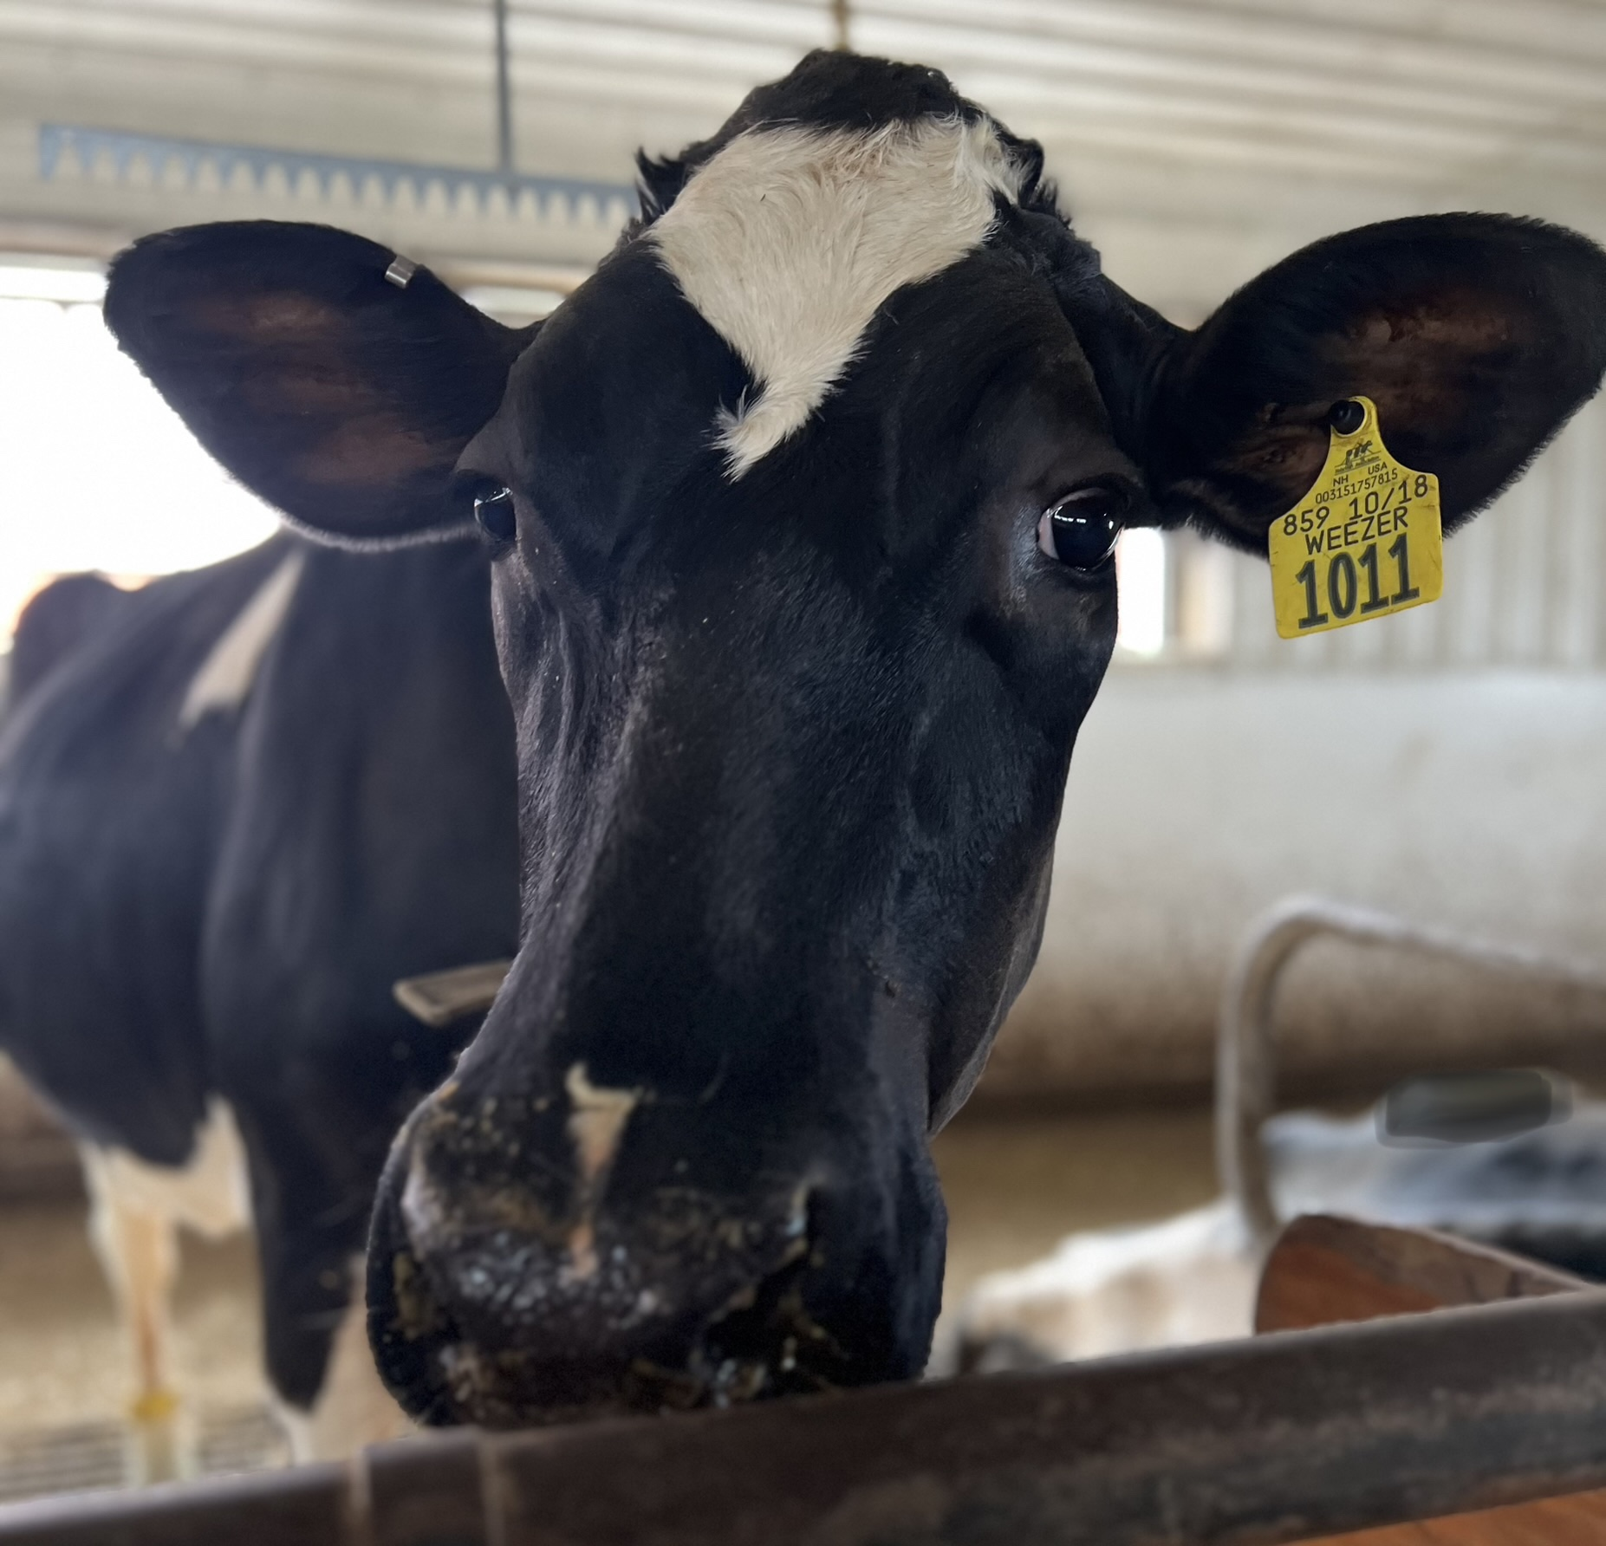
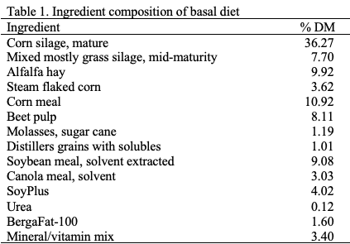

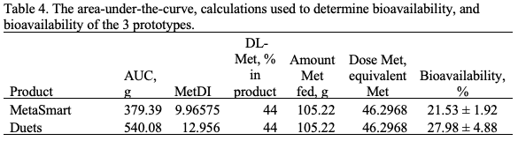
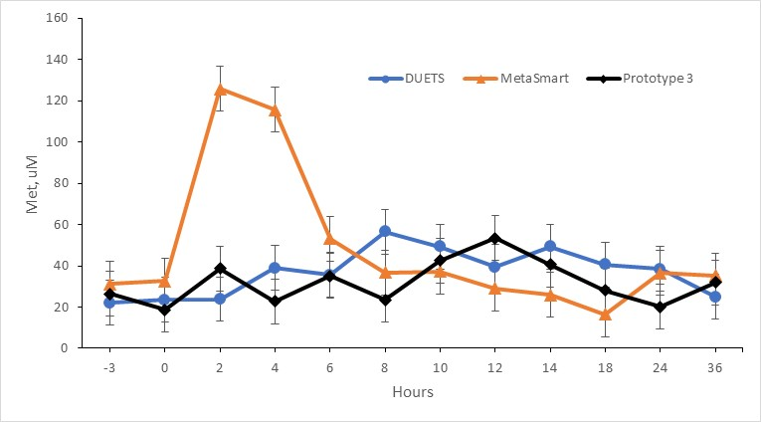
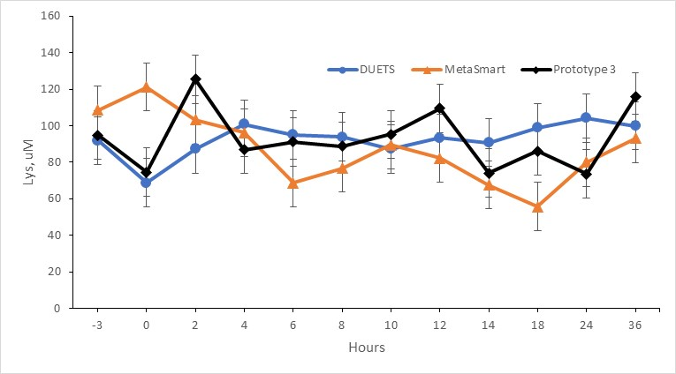
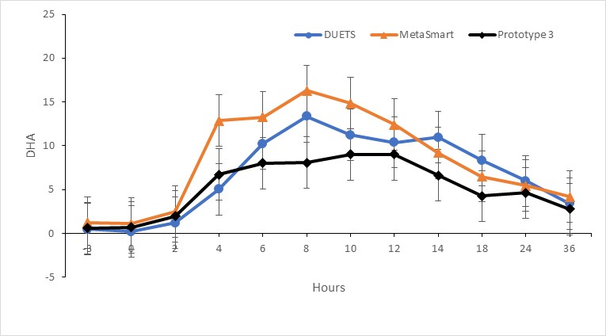
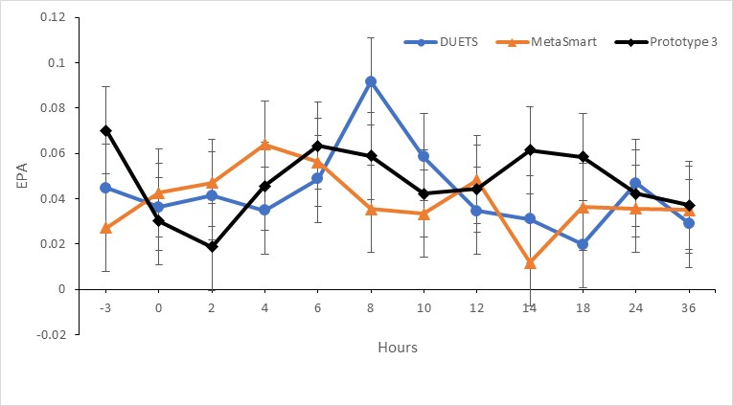

Bioavailability of Methionine Prototype
Using the Area Under the Curve Method
Liza M. Balet and Nancy L. Whitehouse
College of Life Science and Agriculture, University of New Hampshire, Durham, NH, USA 03824
18
Introduction
Tables
Bioavailability is the proportion of the drug that enters circulation when introduced into the body.
DHA is an essential human nutrient that naturally occurs in milk. The concentrations can be influenced by dietary intake and the rumen microbiome.
Methionine is a co-limiting amino acid that is essential for milk protein synthesis, and support fat synthesis and metabolic balance.
After treatment was added to the TMR at 8pm, blood samples were then collected at 1am, 4 am, 6am, 8am, 10am, noon, 2pm, 4pm, 6pm, 10pm, 4am, and 4pm
Conclusions
This was a preliminary trial to see how the amino acids would interact with the vegan oil that was added.
Metasmart was the control treatment
In figure 1, methionine did not peak as high as we were predicting.
The treatment caused an increase in both DHA and EPA.
In figure 4, DUETS peaked.
From these results we were able to determine the bioavailability of the methionine analogues.
Objective
To determine the bioavailability of Met, DHA, and Lys from two prototype products.
Materials and Methods
Three multiparous lactating Holstein were used in a 3 x 3 Latin Square
The prototypes were mixed with 0.5 kg of TMR, placed in a plastic container with lid, and stored at 4 C for 8 h before feeding. Prototypes were placed into the rumen via the rumen cannula after the “0” h blood sample.
All cows were fed the same basal diet throughout the study (Table 1)
Cows were fed for restrictive feed intake (~ 95 %) starting the day before dosing to the end of the sampling period on day three
Conclusions
Results
This was a preliminary trials to see how the amino acids would interact with the vegan oil that was added. In figure 4 the goal was to concentrate down DHA, but it didn’t concentrate as much as it was expected to, as it should have matched the control. There was more EPA in the product than expected. Lysine was not as protected as we thought it would be. Overall, the prototype was a wash and didn’t react in they way we thought it would From this study ADISSEO will need to reformulate the product to get the expected results.
Treatments:
Trt 1: Vegan Oil (224.9g) = 71.4 g of DHA + Dry HMTBi (105.22 g) = 46.3 g of Met eq.
Trt 2: DUETS (160 g) = 71.4 g of DHA and 46.3 g of Met eq
Trt 3: Lys/Algae complex (122.76 g) = 71.4 g of DHA and 42.41 g of Lys
The Yadj values will then be analyzed using the mixed model of SAS (9.4) according to the following model. The PDIFF option in SAS was used to evaluate treatment differences. Significance P ≤ 0.05 and trends were noted P > 0.05 to P < 0.10.
Figure 1. Methionine concentration (µM) over the 36 hr collection period.
Figure 2. Lysine concentration (µM) over the 36 hr collection period.
References
SAS version 9.4; SAS Institute, Inc., Cary, NC
Huang, G., Zhang, Y., Xu, Q., Zheng, N., Zhao, S., Liu, K., Qu, X., Yu, J., & Wang, J. (2020). DHA content in milk and biohydrogenation pathway in rumen: A Review. PeerJ, 8. https://doi.org/10.7717/peerj.10230
Seymour, W. M. (2016). Role of Methionine and Methionine Precursors in Transition Cow Nutrition with Emphasis on Liver Function. University of Florida Animal Science. Retrieved April 19, 2023, from https://animal.ifas.ufl.edu/apps/dairymedia/rns/2016/2.%20Seymour.pdf
Acknowledgements
Figure 3. Docosahexaenoic acid concentration (umol) over the 36 hr collection period.
Figure 4. Eicosatetraenoic acid concentration (umol) over the 36 hr collection period.

