Slide 1


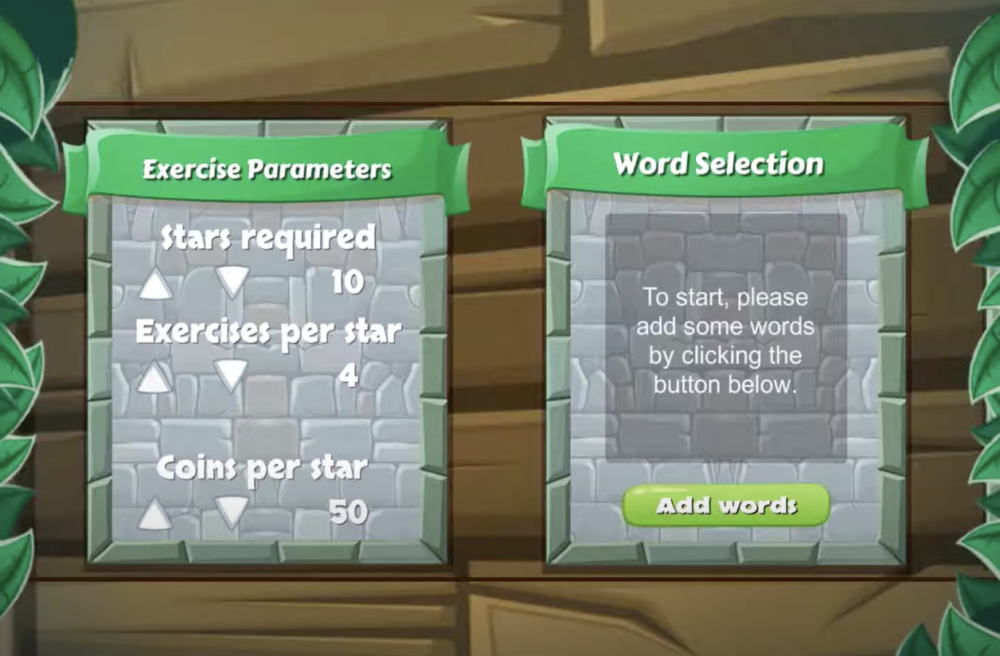
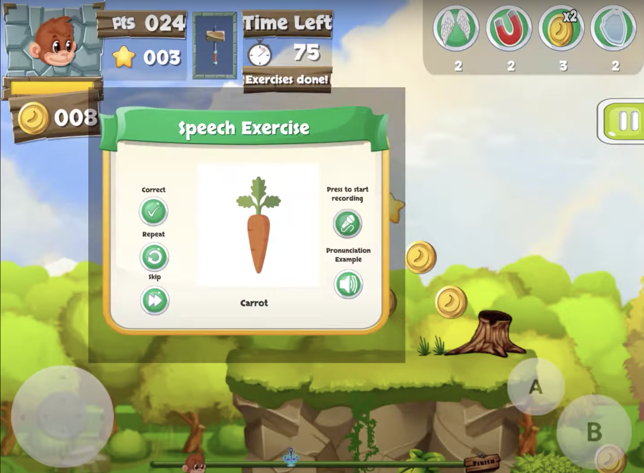
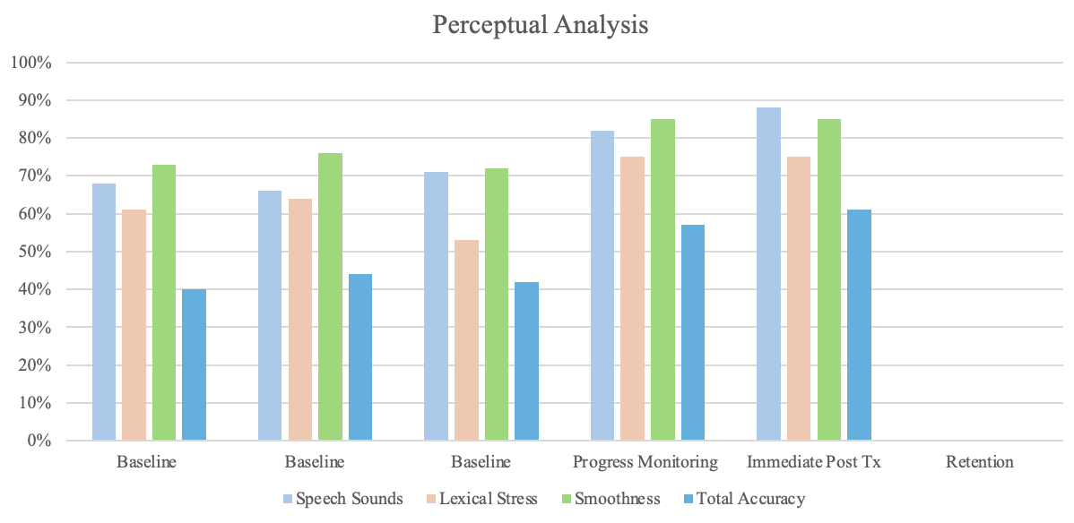
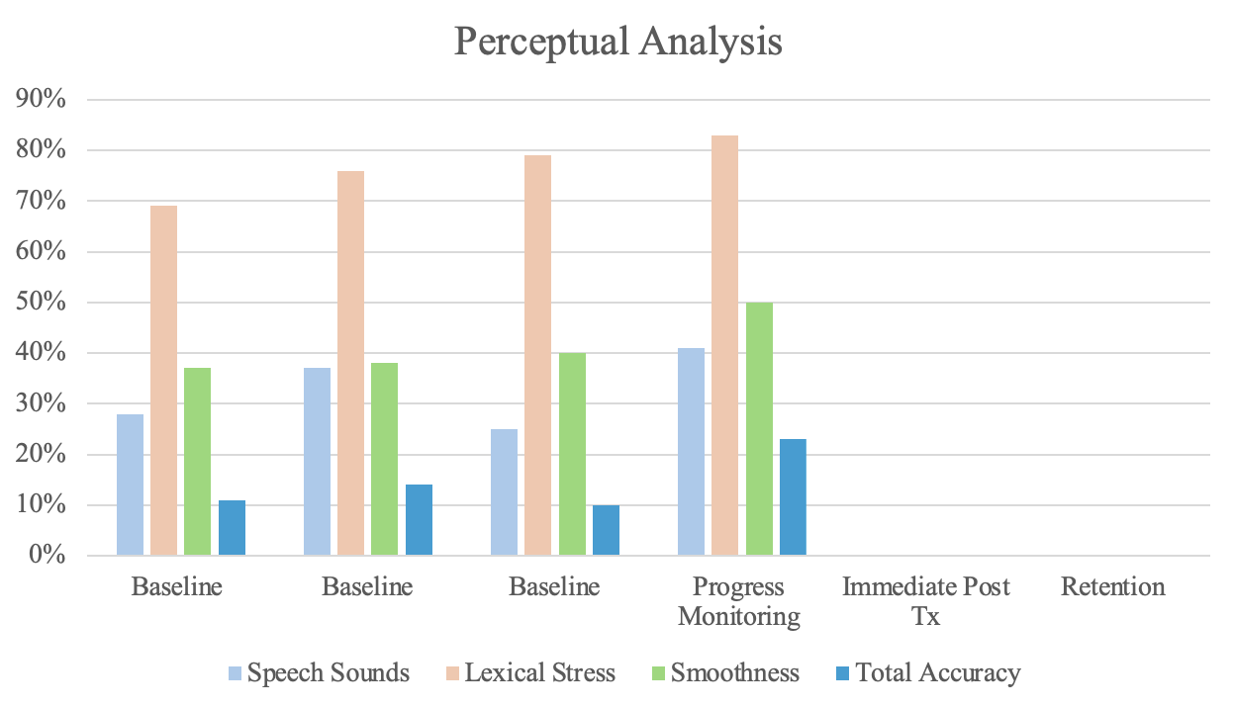
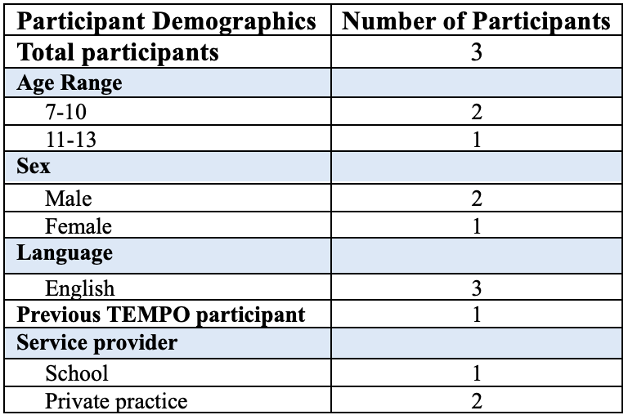
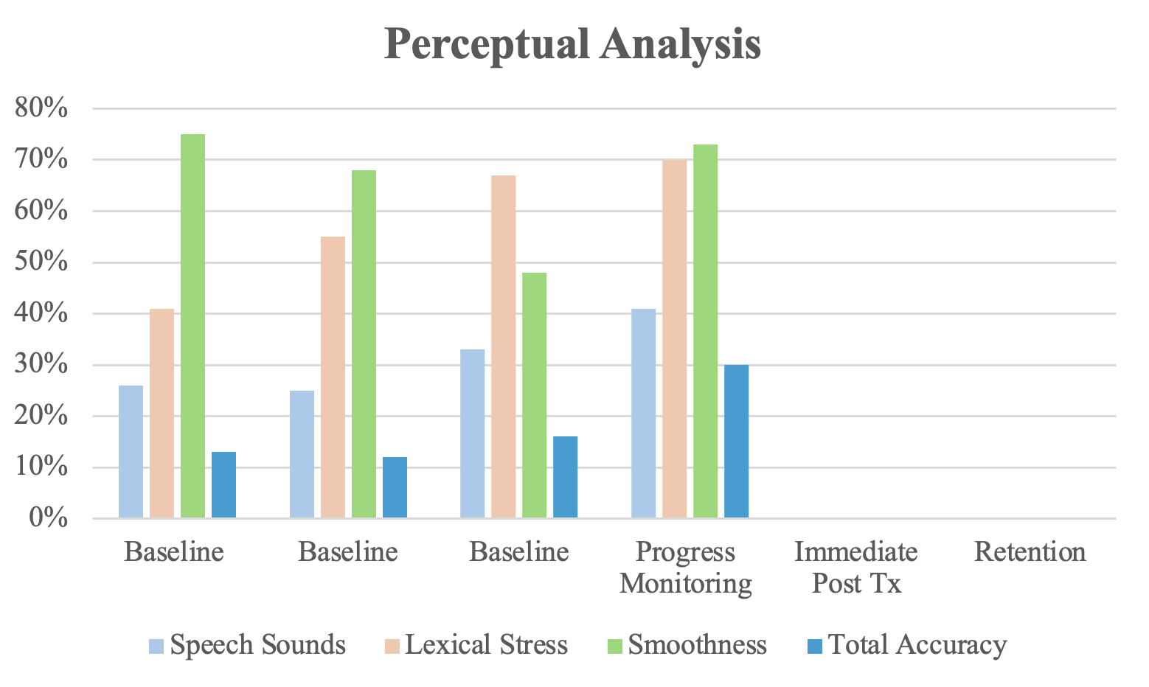
Say Bananas: A Pilot Study on an App-Based Intervention as a Modality of Home Practice
Kate Sjostedt, B.S.
Advisor: Donald A. Robin, Ph.D.
Department of Communication Sciences & Disorders, University of New Hampshire
Introduction
Game Images
Qualitative Results
Childhood apraxia of speech (CAS): a motor programming disorder which affects the spatiotemporal aspects of motor movements in speech (McNeill, Robin, & Schmidt, 2009)
Perceptual characteristics include speech sound distortions, equal stress across syllables, and increased segmental and intersegmental durations in between words and syllables.
This study was designed to evaluate the efficacy of a newly developed app implemented as a modality of home practice while adhering to the intensive protocol of the Treatment for Establishing Motor Program Organization (TEMPO). These data collected through perceptual analyses and in-depth questionnaires represent the first study using the app in children with CAS with the hypothesis that children will demonstrate similar gains as in traditional TEMPO.
Setting Game Parameters
Example Speech Exercise
Child
Children reported enjoying the features that the game had to offer (e.g. rewards, characters, gameplay features).
A child reported that they wished to have an opportunity to practice more words that they use in their “every day conversational speech”.
Clinician
Clinicians enjoyed the flexibility that this app allowed for in order to administer an intensive intervention.
Two clinicians noted that implementing difficulty levels would have been helpful for younger children.
Clinicians appreciated the parent training day, however they noted that more parent training would have been beneficial.
Family
Families have enjoyed being involved in helping their child at home.
Families reported that they would use this app in the future to help with their child’s speech.
Parents reported noticeable improvements in their child’s speech.
Methodology
Perceptual Analysis Results
Conclusions
Children were recruited from a local school and private practice. Based on NIH standards, providing intervention in a natural environment is considered state of the art intervention. In this study, children receive traditional face-to-face intervention, and intervention in a natural setting.
This study is a single subject design where the subjects serve as their own control. This feasibility study collected three baseline data points, progress monitoring data, immediate post treatment data, and retention data.
Participant 1
Participant 2
Conclusions
  Children demonstrated steady gains evident by perceptual analysis in the three characteristics of CAS.
  Participants, families, and clinicians expressed their enjoyment of the app implementation and how it provides flexibility to clinicians to provide intensive intervention to children with CAS.
Future directions
  Incorporate the data from acoustic analyses to further analyze data.
  Test on a larger participant pool with speech sound disorders, CAS, and phonological disorders.
  Provide more opportunity for parent training prior to the start of app implementation.
The traditional TEMPO protocol is intensive which results in 16 sessions of intervention and four sessions for data collection (Miller et al., 2021). With the implementation of the app, traditional TEMPO intervention is implemented two days per week, while the app is used five days per week for four weeks. On the fifth day of each week, the clinician employed a parent training session.
Game Design
Acknowledgements
Special thanks to my advisor Don Robin, my committee members Kirrie Ballard, Molly Beiting, Rae Sonnenmeier, and all others who have contributed to the success of this project.
This game was designed to serve as a collaborative opportunity of practice between child, parent, and clinician. To set the game parameters, an adjustable window appears to select adequate repetitions. The next step is the word selection process which is generated by the SLP based on the child’s target sounds. The sounds are available in multiple contexts (e.g. initial, medial final) and in varying complexities (e.g. monosyllabic, multisyllabic).
Once a speech exercise appears during gameplay, the child says the word. They can request a model from their parent if necessary. After the repetition, based on parental feedback and jurisdiction, the child can select correct, incorrect, or skip.
Participant 3
References
Ahmed, B., Monroe, P., Hair, A., Tan, C. T., Gutierrez-Osuna, R., & Ballard, K. J. (2018). Speech-driven mobile games for speech therapy: User experiences and feasibility. International journal of speech-language pathology, 20(6), 644-658.
Hair, A., Monroe, P., Ahmed, B., Ballard, K. J., & Gutierrez-Osuna, R. (2018, June). Apraxia world: A speech therapy game for children with speech sound disorders. In Proceedings of the 17th ACM Conference on Interaction Design and Children (pp. 119-131).
Kleim, J. A., & Jones, T. A. (2008). Principles of experience-dependent neural plasticity: implications for rehabilitation after brain damage.
Maas, E., Robin, D. A., Hula, S. N. A., Freedman, S. E., Wulf, G., Ballard, K. J., & Schmidt, R. A. (2008). Principles of motor learning in treatment of motor speech disorders.
McNeil, M. R., Robin, D. A., & Schmidt, R. A. (2009). Apraxia of speech: Definition and differential diagnosis. Clinical management of sensorimotor speech disorders, 2, 249-267.
Miller, H. E., Ballard, K. J., Campbell, J., Smith, M., Plante, A. S., Aytur, S. A., & Robin, D. A. (2021). Improvements in speech of children with apraxia: The efficacy of Treatment for Establishing Motor Program Organization (TEMPOSM). Developmental Neurorehabilitation, 24(7), 494-509.

