Slide 1

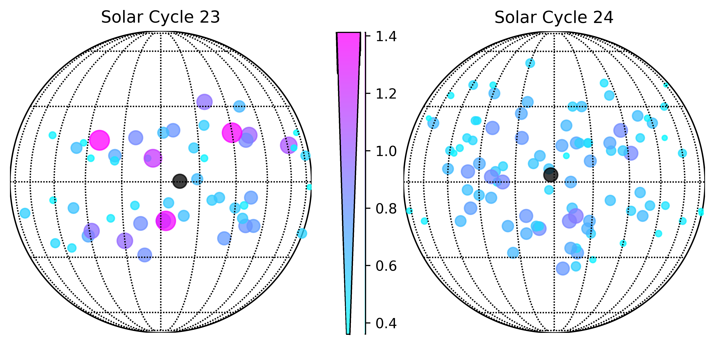
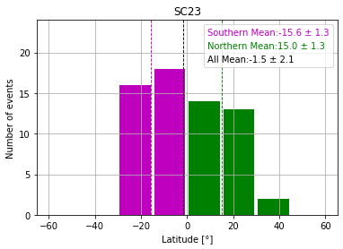
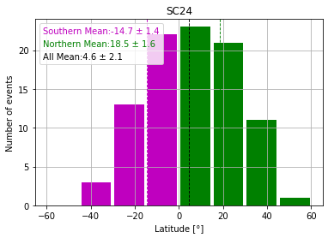
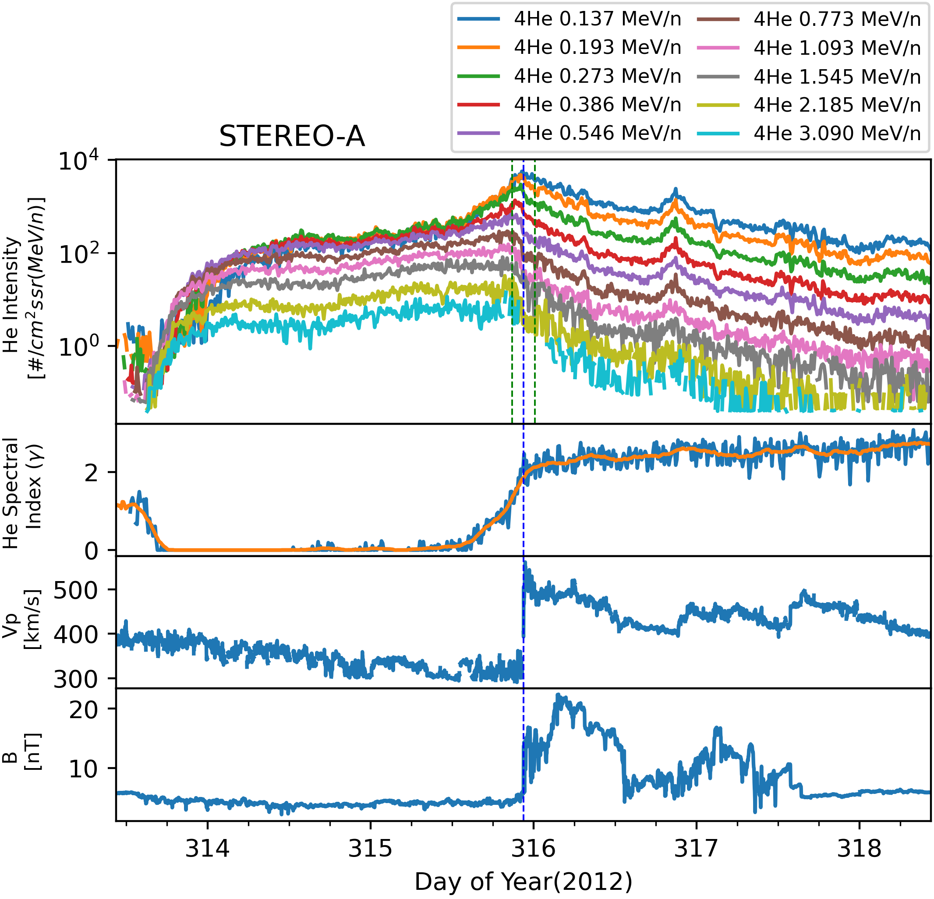
A. Santa Fe Dueñas (University of New Hampshire), N. Lugaz (University of New Hampshire), N. Al-Haddad (University of New Hampshire), B. Zhuang (University of New Hampshire), R. W. Ebert (SwRI), M. I. Desai (SwRI), L. K. Jian (NASA Goddard Space Flight Center) adolfo.santafeduenas@unh.edu
CME Deflection during Energetic Storm Particle Events in Solar Cycles 23 and 24
Introduction
Results
We investigate the deflection in energetic storm particle (ESP) driven by coronal mass ejections (CMEs) during solar cycles (SCs) 23 and 24. We use observations from NASA’s ACE and STEREO missions of helium (He), oxygen (O), and iron (Fe) intensities from ~0.13 to 3 MeV/nucleon. We examine the angular distribution of ESP intensities and the correlation of ESP intensities with the near-Sun CME speed and the average transit CME speed for eastern and western events.
N
N
E
W
E
W
CME Speed Ratio
Methodology
Surveyed energetic helium (He), oxygen (O), and iron (Fe) ion observations ranging from 0.1 to 3 MeV/nucleon using the Ultra-Low Energy Isotope Spectrometer (ULEIS) on ACE spacecraft during SC 23 ESP events between August 1998 and December 2006.
Surveyed the same type of observations using Suprathermal Ion Telescope (SIT) on STA and STB and ULEIS on ACE during SC 24 ESP events between January 2009 and December 2019.
Selected the events where the energetic particle intensity profiles exhibited a synchronized increase of at least 200% within ±3 hours of the shock arrival time in the He, O, and Fe intensities.
Ensured no other dominant shocks were present within a 1-day window.
Computed the speed ratio between near-Sun and average transit CME speeds of the ESP events and plotted it against source flare heliographic location to determine the average CME deflection during both SCs (Fig 2).
S
S
Fig 2. The solar source locations of CMEs for ESP events observed at 1 au during solar cycles 23 and 24 in heliographic coordinates. The SC 24 ESP events include STA, STB, and ACE observations, whereas SC 23 includes only events from ACE. The black point shows the average position of the flare source for ESP events observed at 1 au. The size and color of the scatter points represent the speed ratio between the near-Sun and average transit CME speeds of the ESP events.
Fig 3. Latitude distribution of CMEs for ESP events observed at 1 au during solar cycles 23 and 24
Discussion
Our findings revealed that during the weakest solar cycle, 24, there were more Northern than Southern CME events and similar numbers of Eastern and Western CME events observed at 1 au. Conversely, the strongest solar cycle, 23, exhibited similar numbers of Northern and Southern CME events (Fig 3) and more Western than Eastern CME events. The heliographic distribution of the CME speed ratio suggests that, on average, CMEs experienced a deflection of 7.2° from the West and 0.2° from the North during solar cycle 23, while during solar cycle 24, the deflection was 1.3° from the East and 2.7° from the North (Fig 2).
ACKNOWLEDGEMENTS
Work at UNH was supported by NASA grants: 80NSSC20K0700, 80NSSC21K0463 and 80NSSC23K1057.
Fig 1. An example of an ESP event observed by STEREO-A on day of year 315 in 2012.

