Slide 1
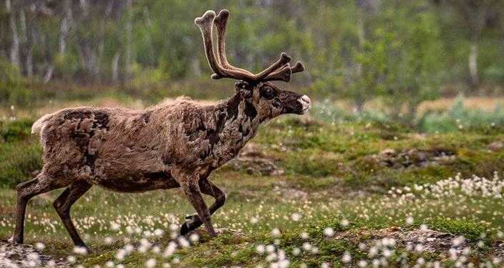
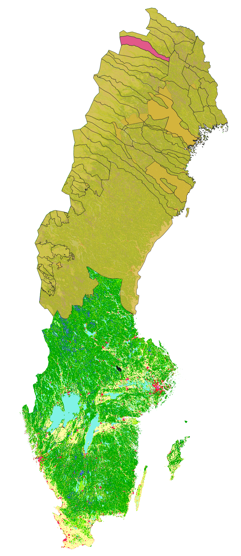
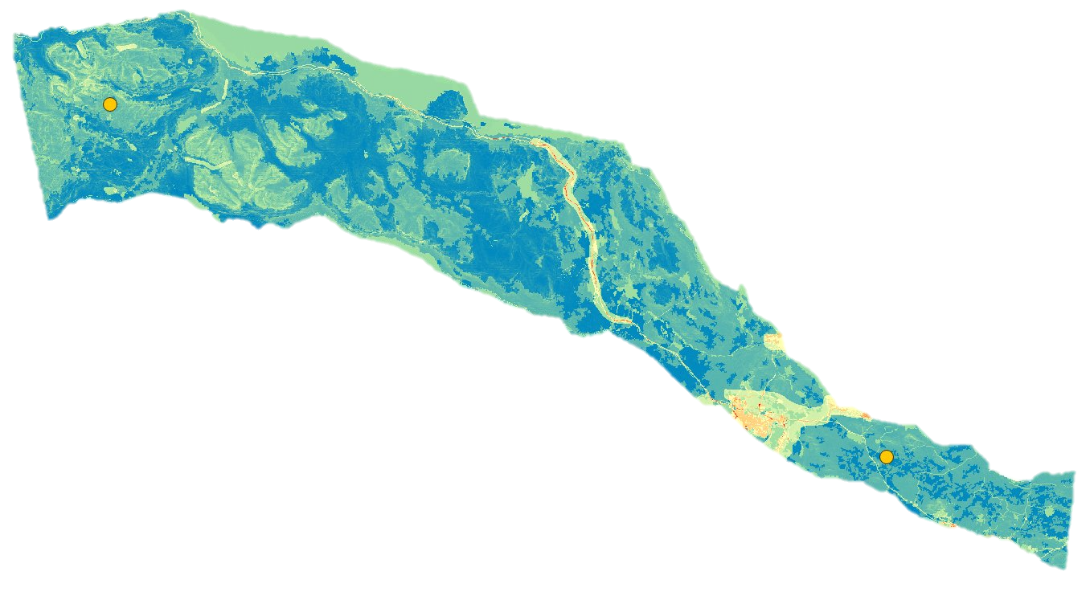
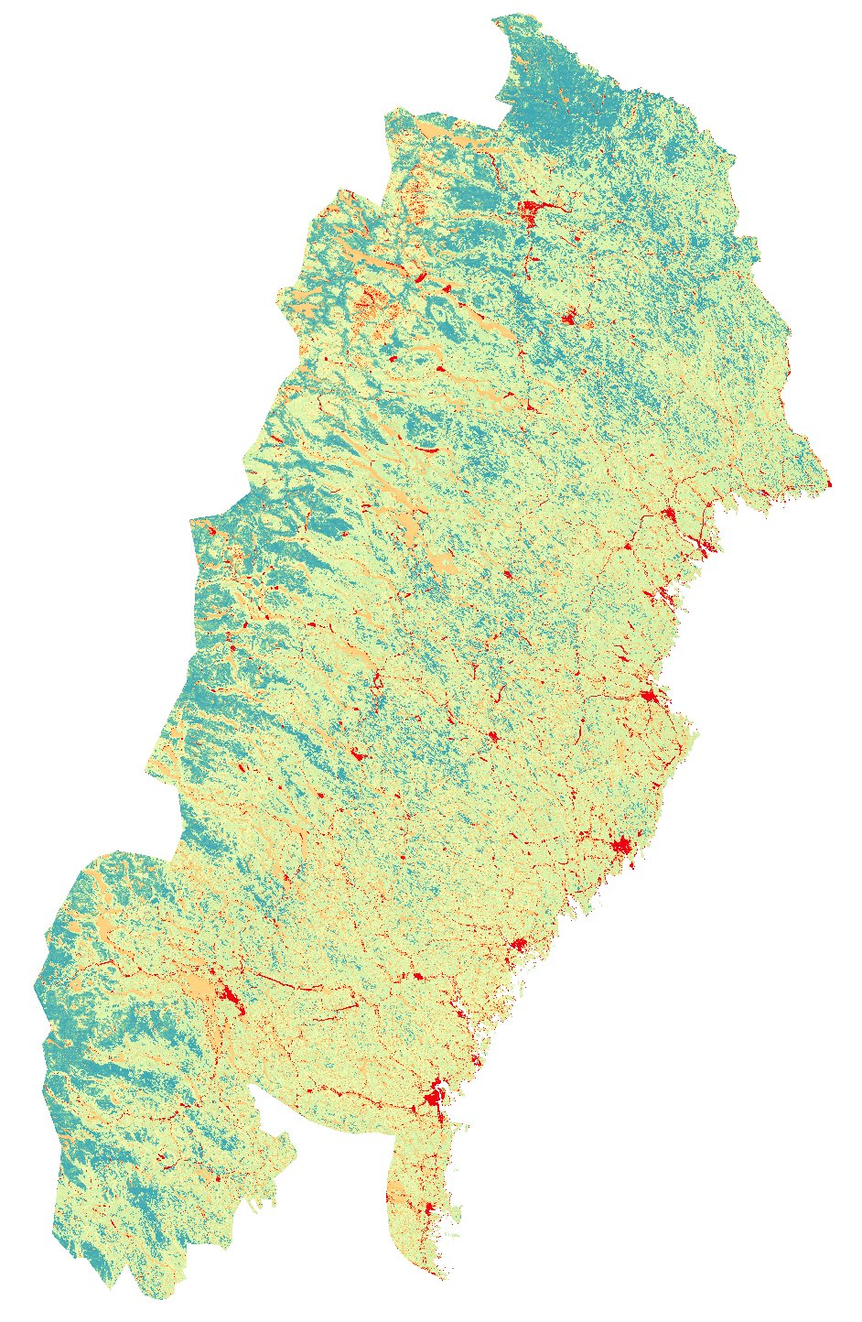
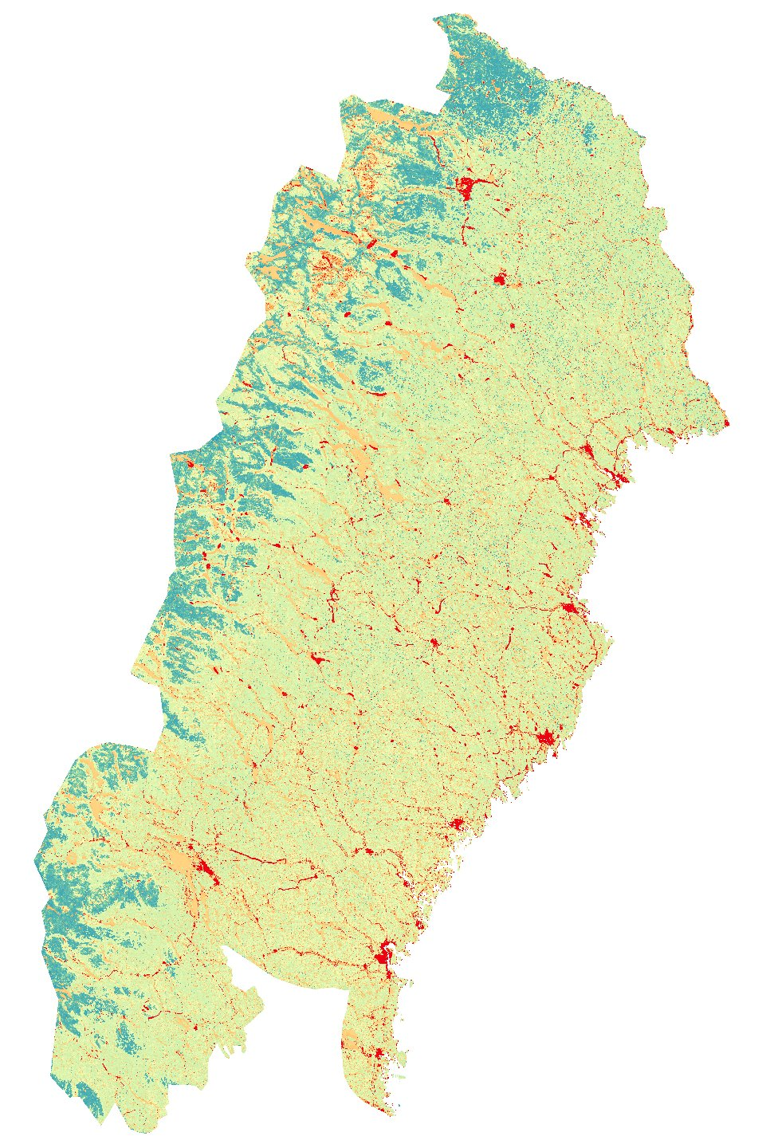
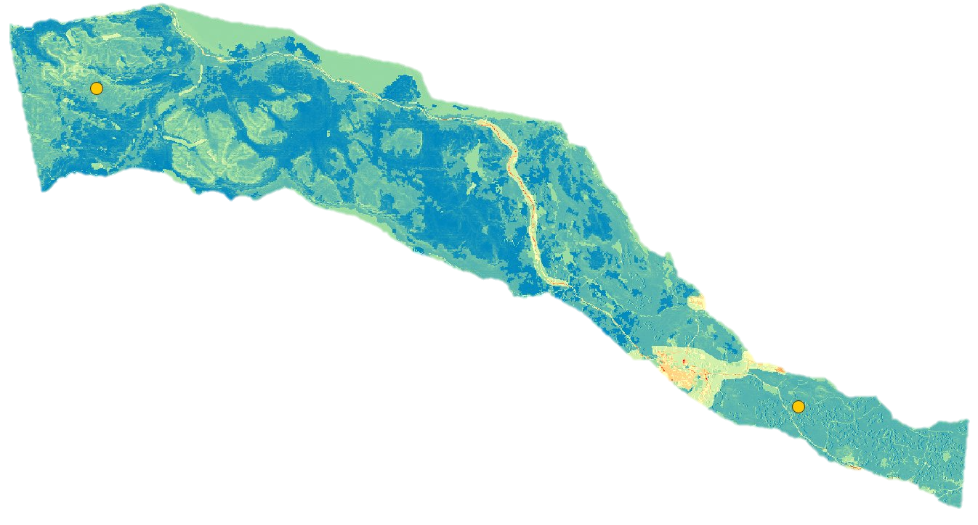
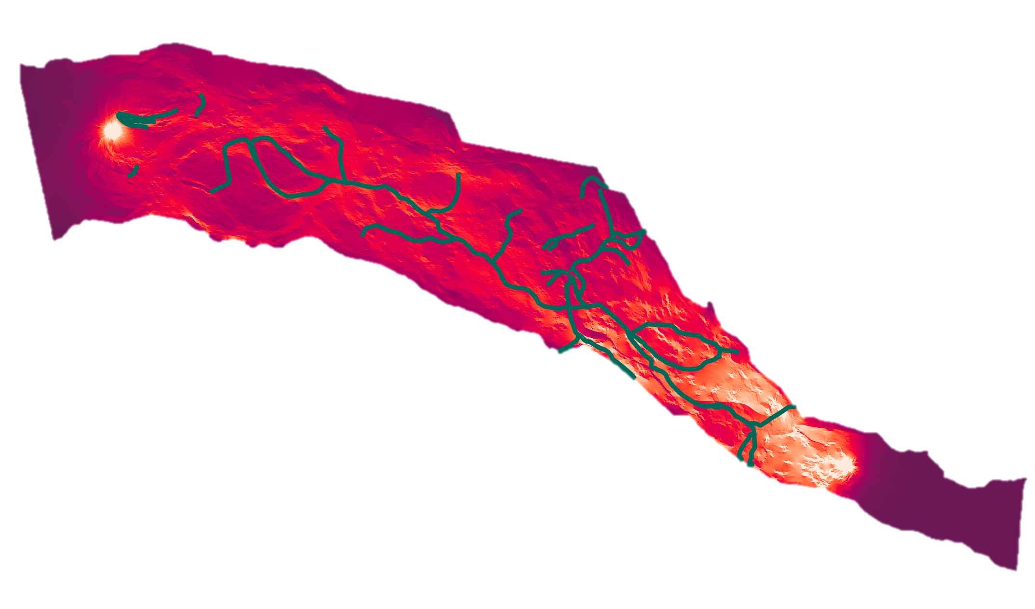
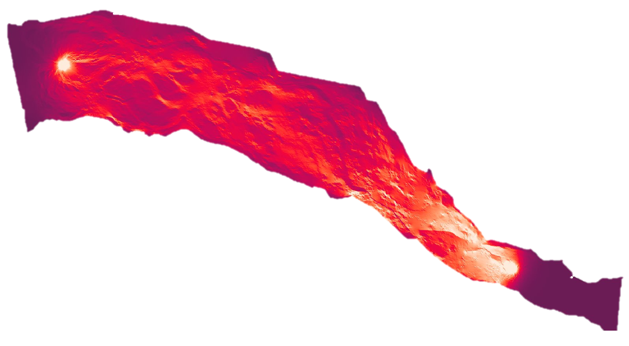
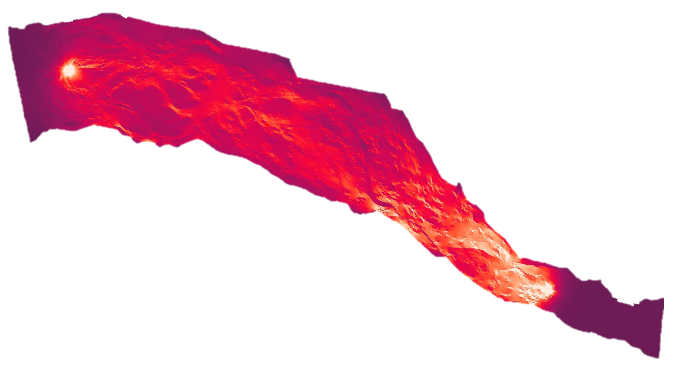









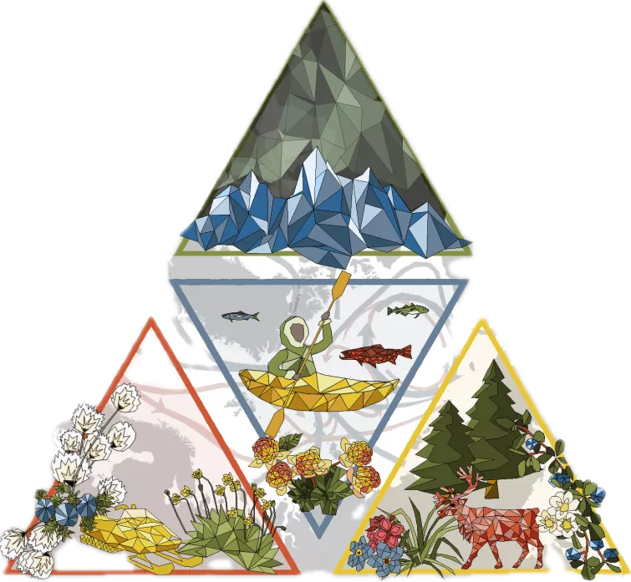
The Impacts of Climate Change on Reindeer Migration in Swedish Sápmi
Our model suggests that climate change will decrease landscape connectivity across Sámi herding villages in northern Sweden.
PC: Marlo Wilcox
Else Schlerman, Nathan Alexander, Samuel Bratsman, Elham Ajorlou, Helen Sears, Jessica Gilman Ernakovich, Michael Palace, Ruth Varner
Convergent Arctic Research Perspectives and Education (CARPE), University of New Hampshire, Durham, NH
STEP 1: Create cost surfaces with publicly available GIS data and weight based on how feature would impact reindeer movement.
Gabna
Village
BACKGROUND:
• Reindeer herding is an integral cultural practice of the Sámi people.
• Climate change causes permafrost thaw and ground subsidence in the Arctic, which disrupts reindeer movement between seasonal herding grounds.
• Here, we heeded the call of the Sámi Council Report (2023) to “analyze and map the impacts of climate change on land use” using a remote sensing approach.
All Sámi
Herding
Villages
Present Cost Surface
METHODS:
• We modeled resistance to reindeer movement across Sámi villages using spatial analysis tools and datasets.
• We weighted publicly available data based on
ecological literature to assess their impact on
reindeer movement. Higher weight corresponded
with increased resistance to movement (scale of
LOW:1 to HIGH:20).
• We added together the weightings to create our cost surface and used it to model landscape connectivity in Circuitscape.
We compared current and future landscape connectivity to identify landscape morphology that affects reindeer movement.
Present cost surface
Future Cost Surface
Future cost surface:
Increased resistance of permafrost landforms to model permafrost thaw
STEP 2: Isolate the Gabna village cost surface and determine start and end points based on summer and winter herding grounds.
STEP 3: Run cost surfaces through Circuitscape to create a connectivity model. Ground truth to known Sámi herding pathways and compare present and future connectivity.
RESULTS:
• We find a significant difference (p = 0.004) between Circuitscape values from random points along reindeer herding pathways and points randomly distributed across the area.
• We compared random points along the pathways between present and future models and find a decrease in conductance values (Welch Two Sample t-test, p<0.001), which could indicate a need to change herding pathways.
• We compared random points across the region between present and future models and find a decrease in value variability (Welch Two Sample t-test, p<0.001), which might indicate an increase in pinch points in the future.
Circuitscape model of present scenario
COST SURFACE DATASETS:
Circuitscape model with existing reindeer herding pathways from the Länsstyrelsernas Geodatakatalog
CORINE: Landcover Classification
Resistance: 1 (Grasslands and peatlands)
10 (Forests, rocky/bare areas)
20 (Urban or industrial areas)
Circuitscape model of future scenario
CORINE: Water
Resistance: 10
WorldPop: Population Density
Resistance: 1 (pop < 0.5 ppl/km²)
20 (pop > 0.5 ppl/km²)
CHALLENGES:
• We are not reindeer herders. Our weightings for the cost surface were based on literature and not on-the-ground knowledge.
• Our weightings reflect the summer months, yet reindeer herding occurs across seasons. How do we add seasonality to our model?
• We want to include increased anthropogenic pressures and other climate change factors (e.g. insect harassment, rain on snow events) to our future climate cost surface.
• Sami village boundaries are drawn by the Swedish government – reindeer don’t follow them. How do we more accurately model reindeer movement?
PATHS FORWARD:
• We are beginning a collaboration with Niklas Labba, a Sámi herder. We hope to validate our weightings for the cost surface and refine this tool to better meet the needs of Sámi reindeer herders.
ACKNOWLEDGEMENTS:
• We would like to thank Jerker Bexelius, Melissa Clark, and Karli Tyance Hassell for their consultation on the project.
• We conducted our project in N’dakinna, the traditional ancestral homeland of the Abenaki, Pennacook and Wabanaki Peoples. Our data come from Sápmi, where the Sámi people have lived and stewarded the land since time immemorial.
Trafikverket: Roads, Highways
Resistance: 20 (Highways)
10 (Roads)
#2125868
Trafikverket: Railroads
Resistance: 20
MERIT Digital Elevation Model:
Terrain Ruggedness and Slope
Resistance: Scaled from 1-20
Länsstyrelsernas Geodatakatalog: Fences and Areas of Difficult Passage
Resistance: 20
Poster Session: GC11L Climate Change in Fragile Contexts: Responses, Adaptation, and Security I, Poster #: 0090, Contact: else.schlerman@unh.edu
Notes:
Notes:
In Powerpoint, click View > Guides
Keep text within gutter guides.
Author list: Don’t split names onto two lines (e.g., “Jimmy [break] Smith”). If that happens, use a new line, unless you need the space. Bold the first names of anybody who’s presenting in person.
Intro/methods/result: Do not drop below font size 28, but if you have extra space, jack up the font size until the space is full.
Do not use color in the sidebars except in graphs/figures. It’ll pull attention from the center and slow interpretation for passersby.

