Slide 1




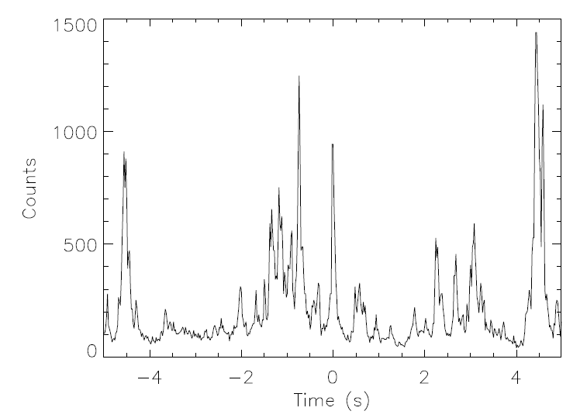
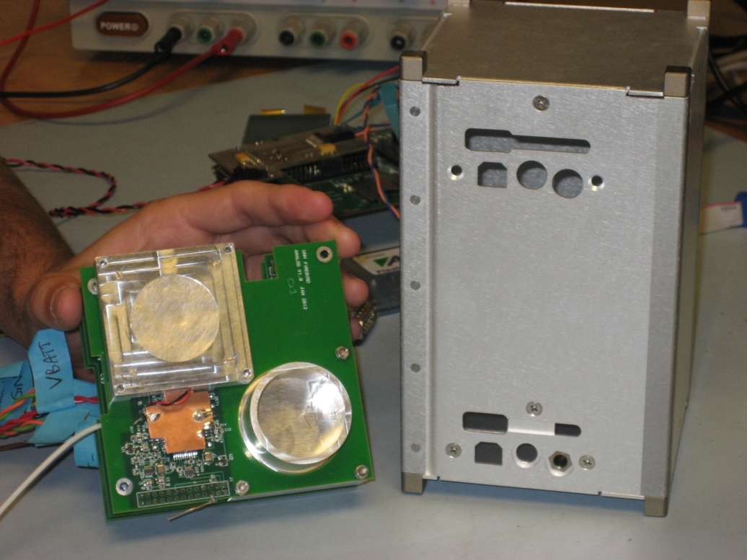
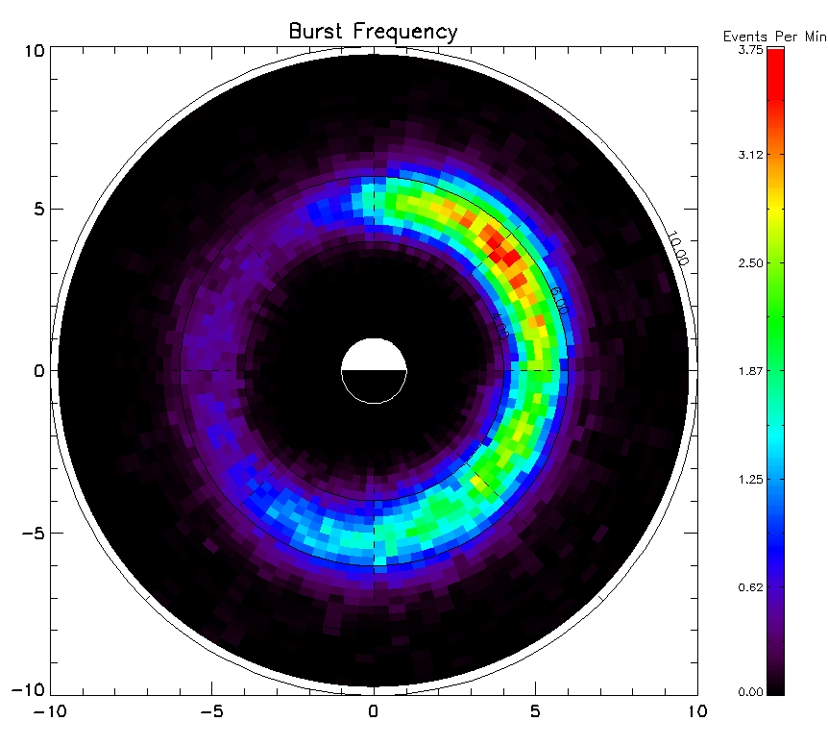
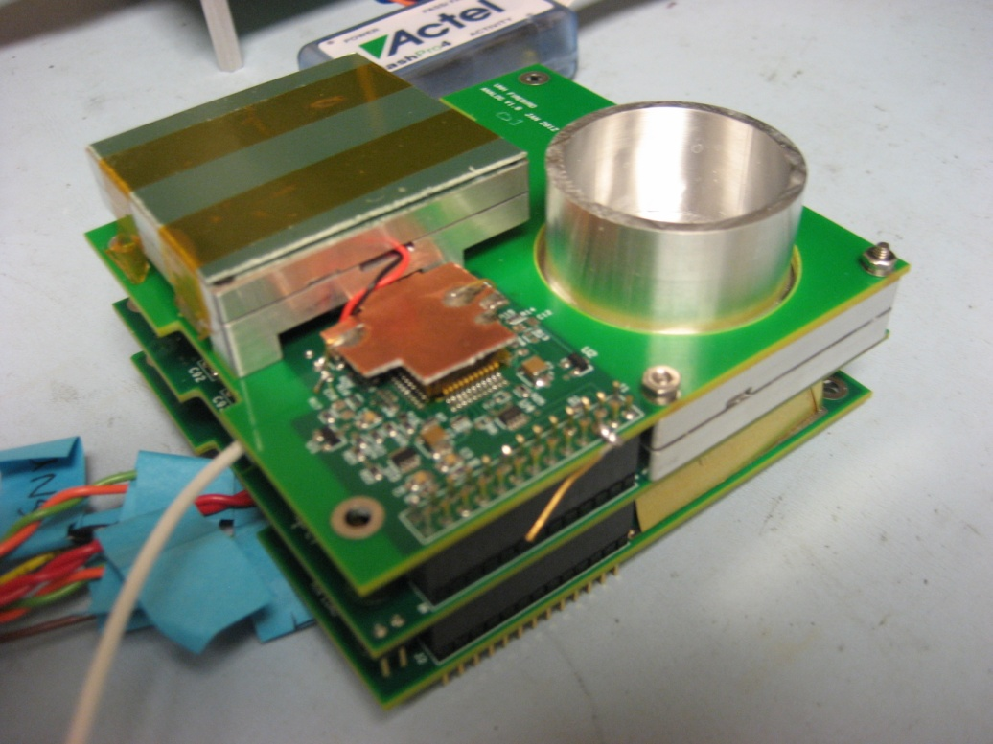
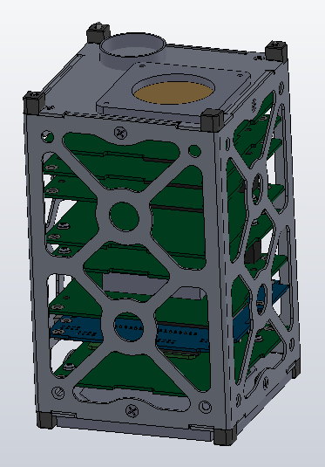
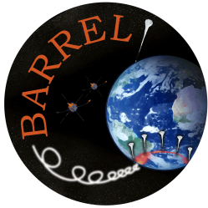
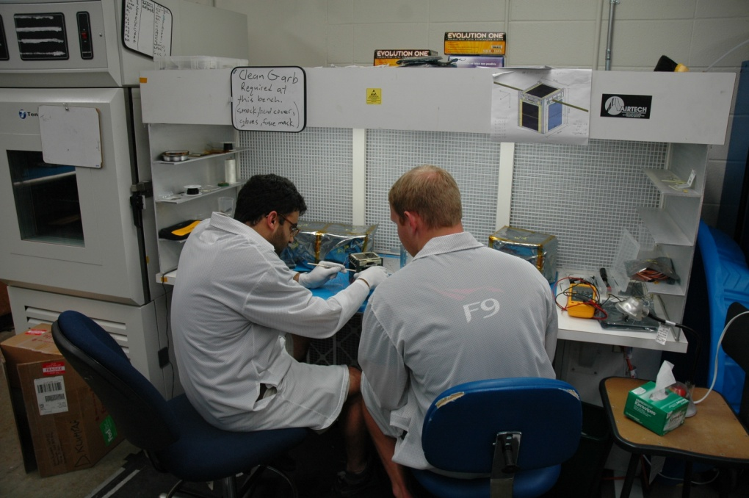
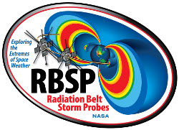
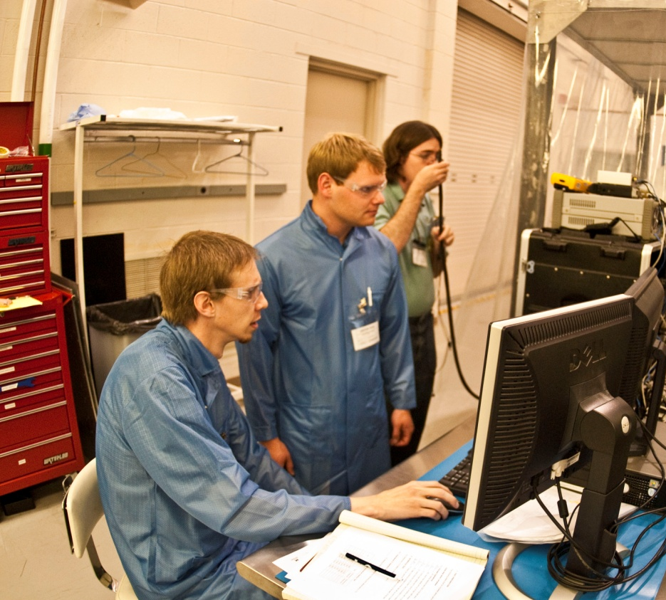
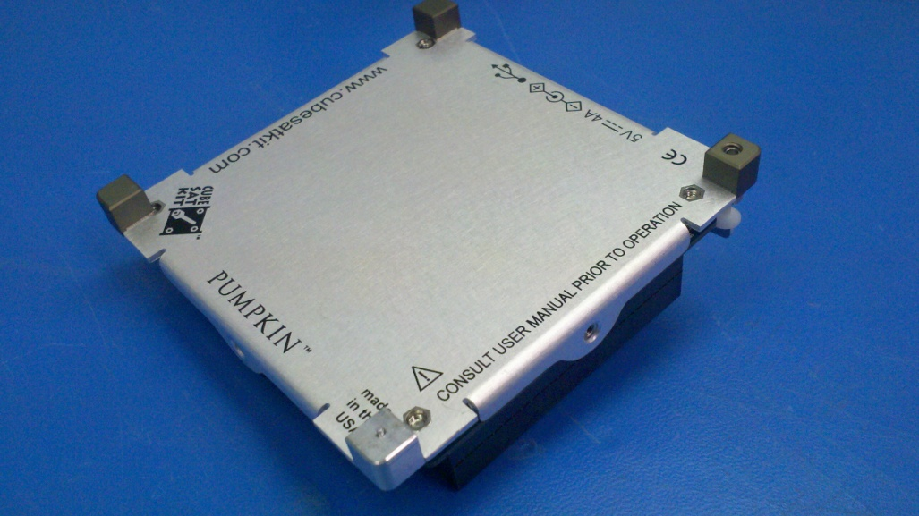
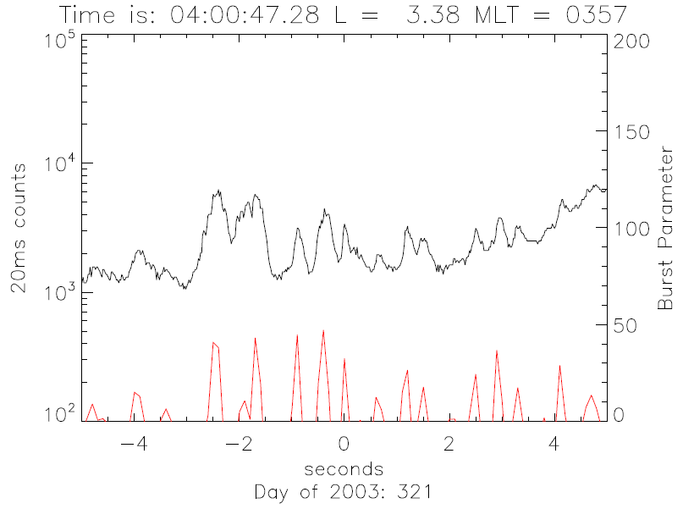
Focused Investigations of Relativistic Electron Burst Intensity, Range, and Dynamics (FIREBIRD)
H. Spence¹, D. Klumpar², J.B. Blake³, A.B. Crew¹, S. Driscoll², B.A. Larsen⁴, J. Legere¹, S. Longworth¹, E. Mosleh², P. O’Brien³, S. Smith¹, L. Springer², and M. Widholm¹
¹ University of New Hampshire, ² Montana State University, ³ Aerospace Corporation, ⁴ Los Alamos National Laboratory
Science Motivation
Mission Concept
What are Microbursts?
Fly 2 identical 10x10x15cm CubeSats that will make simultaneous measurements of electrons at the high time resolution required at a variety of spatial separations.
What is the spatial scale size of an individual burst?
  --As the two spacecraft increase in separation the decrease in correlation between the two measurements determines the scale size of individual events
What is the energy dependence of an individual burst?
  --Each CubeSat has a pair of electron detectors that will measure electrons from 200keV to 1MeV at 18.75ms time resolution
How much total electron loss do burst produce globally?
  --Integrating the total number of microbursts seen, along with information about the individual burst content along with measurements from other platforms (BARREL, RBSP) will enable us to better constrain microburst loss
Microbursts are short (~100ms), impulsive bursts of electron precipitation. Microbursts represent a form of particle loss from the Earth’s Radiation Belts to the Earth’s atmosphere through pitch-angle scattering due to waves.
Why Microbursts?
The dynamics of the Earth’s radiation belts are governed by the interplay between various source and loss terms. By understanding microbursts, and the processes behind them we can better understand how the radiation belts evolve, and ideally better predict the space environment.
Above: Snapshot of a series of >1MeV microbursts observed by SAMPEX
Below: Map showing the statistical distribution of microbursts over a 10-year period
Above: Top view of FIRE EM unit with spacecraft structure
Below: Profile view of FIRE EM stack for bench-top testing
FIREBIRD Science Questions
FIREBIRD’s operations are geared towards increasing our understanding of microbursts by answering 3 Science questions:
What is the spatial scale size of an individual burst?
What is the energy dependence of an individual burst?
How much total electron loss do burst produce globally?
FIRE
FIREBIRD Divides into 2 components:
FIRE (Top ½ U)—UNH sensor module
BIRD (Bottom 1U)—MSU spacecraft
BIRD
Student Involvement
Engineering Challenges/Solutions
Synergies with Other Missions
One of the major components of CubeSat missions is having substantial student involvement in the mission design, construction, and execution. Students form a multidisciplinary team and are mentored and supervised by engineering and science professionals.
While the CubeSat platform facilitates some of the science, the resource limitations also present a number of challenges.
FIREBIRD’s measurements are naturally complementary to several upcoming NASA missions. NASA’s Radiation Belt Storm Probes mission will provide in situ measurements of the waves and particle distributions within the radiation belts that give rise to microbursts . Additionally, BARREL is a complementary mission to RBSP that consists of a balloon array that will be trying to measure the global scale of microburst precipitation, and FIREBIRD will naturally be able to assist in this.
Controlled Separation: Since areas of interest are going to be when the two CubeSats are close together, we have looked into various methods of having a very controlled separation of the two satellites. As such, the separation springs at the feet of one of our CubeSats has been modified with a known and tested spring, with very predictable spring constant, in order to achieve this goal.
Telemetry: Owing to power constraints the telemetry budget for FIREBIRD is intrinsically limited. As such, we are unable to download all of the hi-resolution event data produced on board. The solution to this is to produce a MicroBurst Parameter (MBP) that is used for event identification at a slower time rate and then use that to select periods to download the full data for.
Below: MSU Team doing Environmental Testing at Space Dynamics Lab .
Left: Example interval of microbursts observed by SAMPEX with MBP over-plotted for identification
Above: Assembly and Integration work at MSU
Left: CubeSat separation spring feet
Acknowledgements
We gratefully acknowledge the NSF Geospace Section of the Division of Atmospheric and Geospace Sciences for their support of this project. Work at the University of New Hampshire was supported by the National Science Foundation through the CubeSat Program under grant number AGS-1035642; likewise, work at Montana State University was supported by grant number ATM-0838034.

