Slide 1

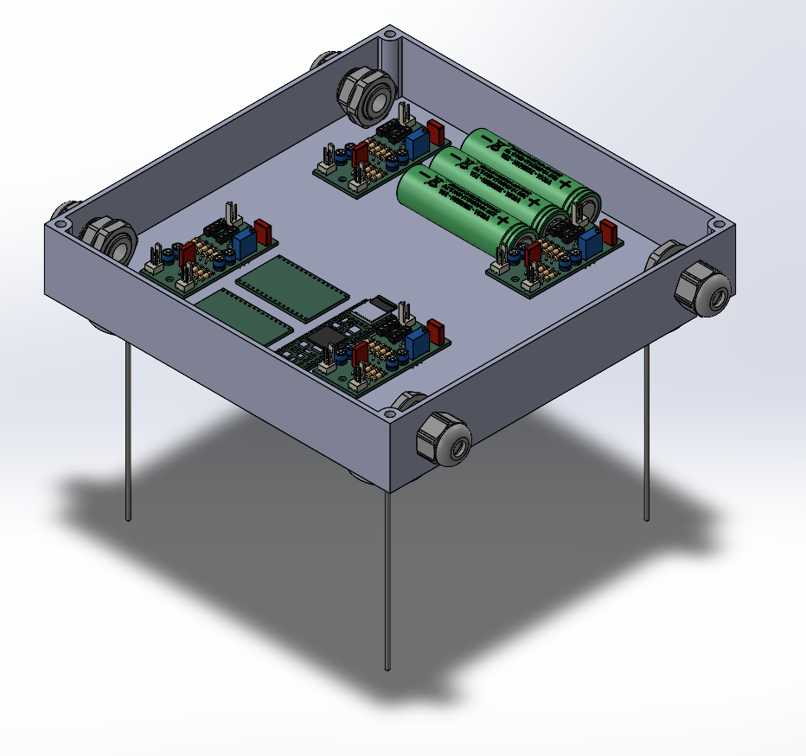
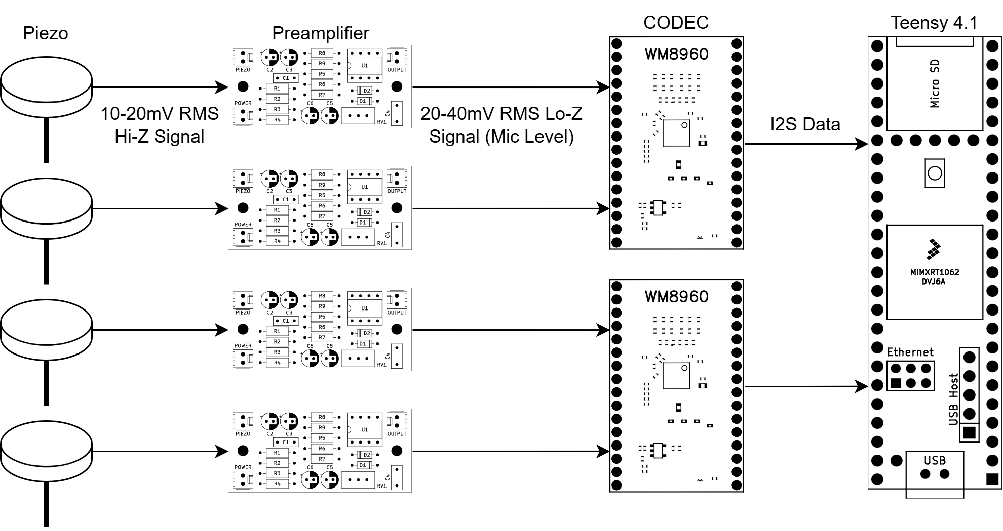
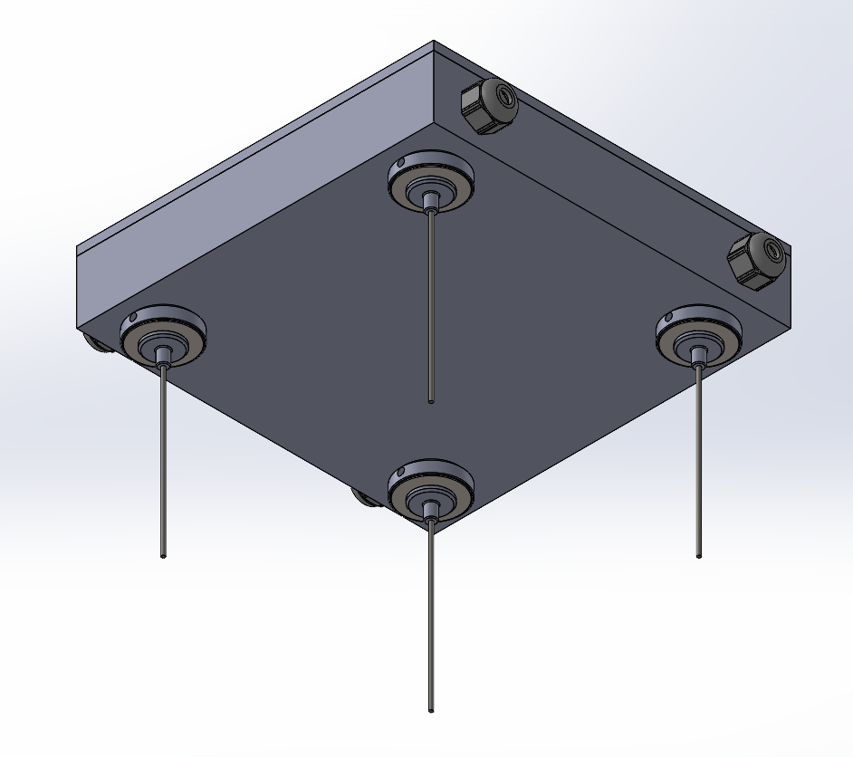
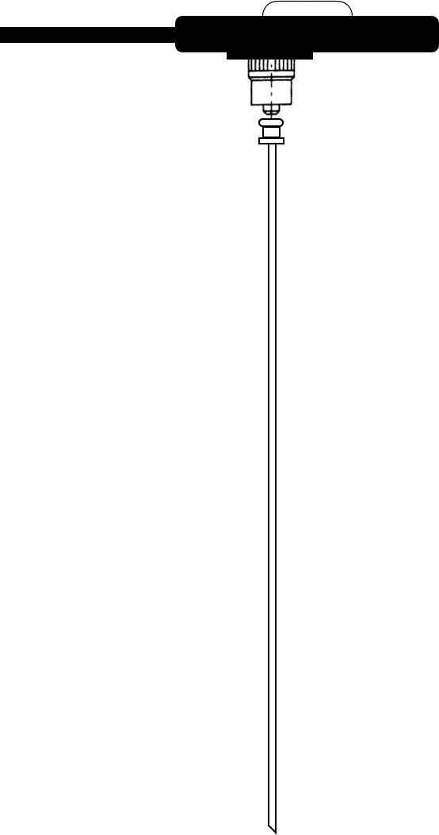
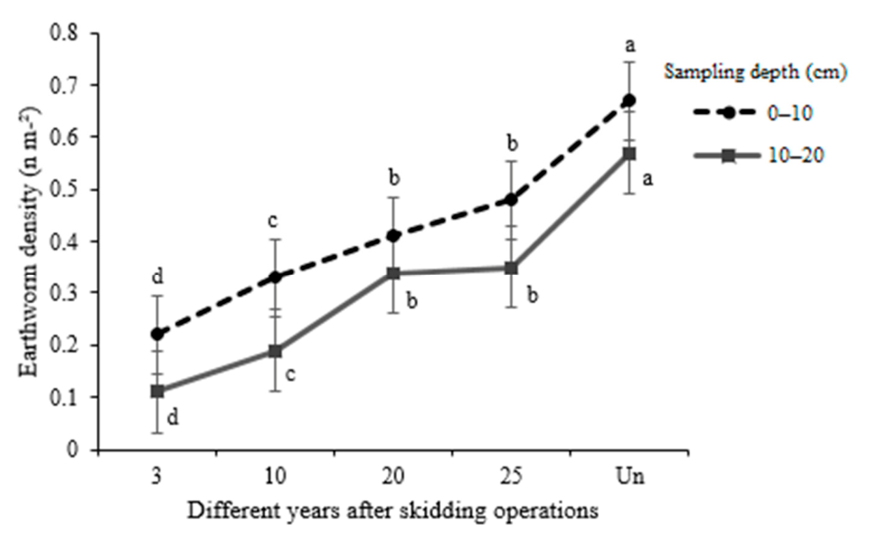
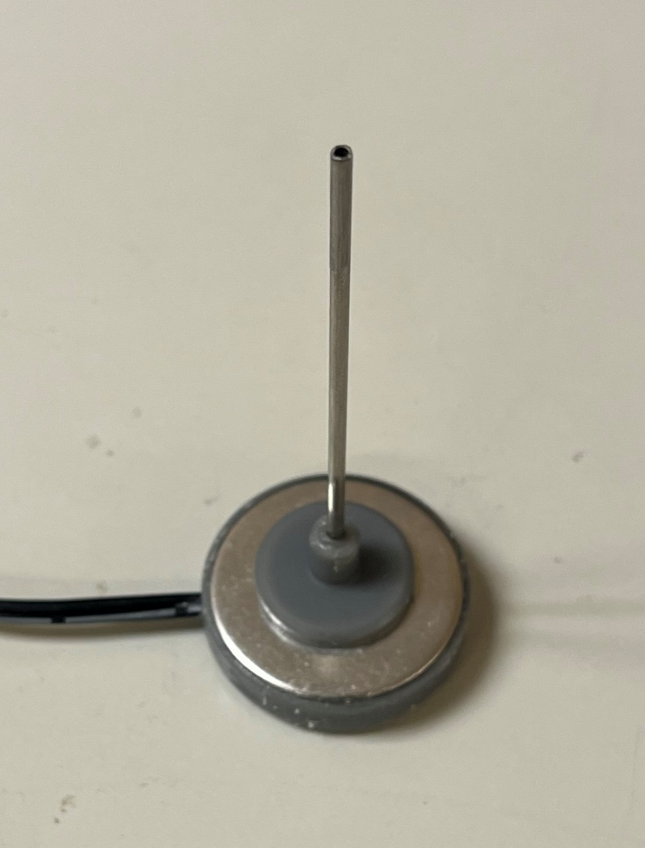
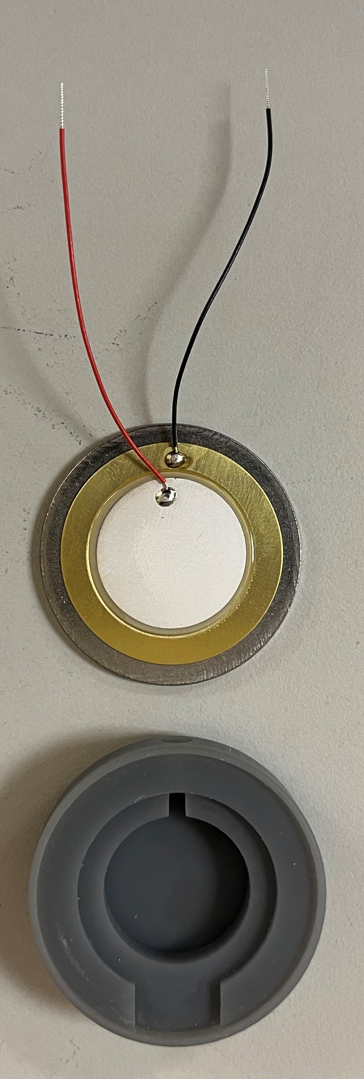
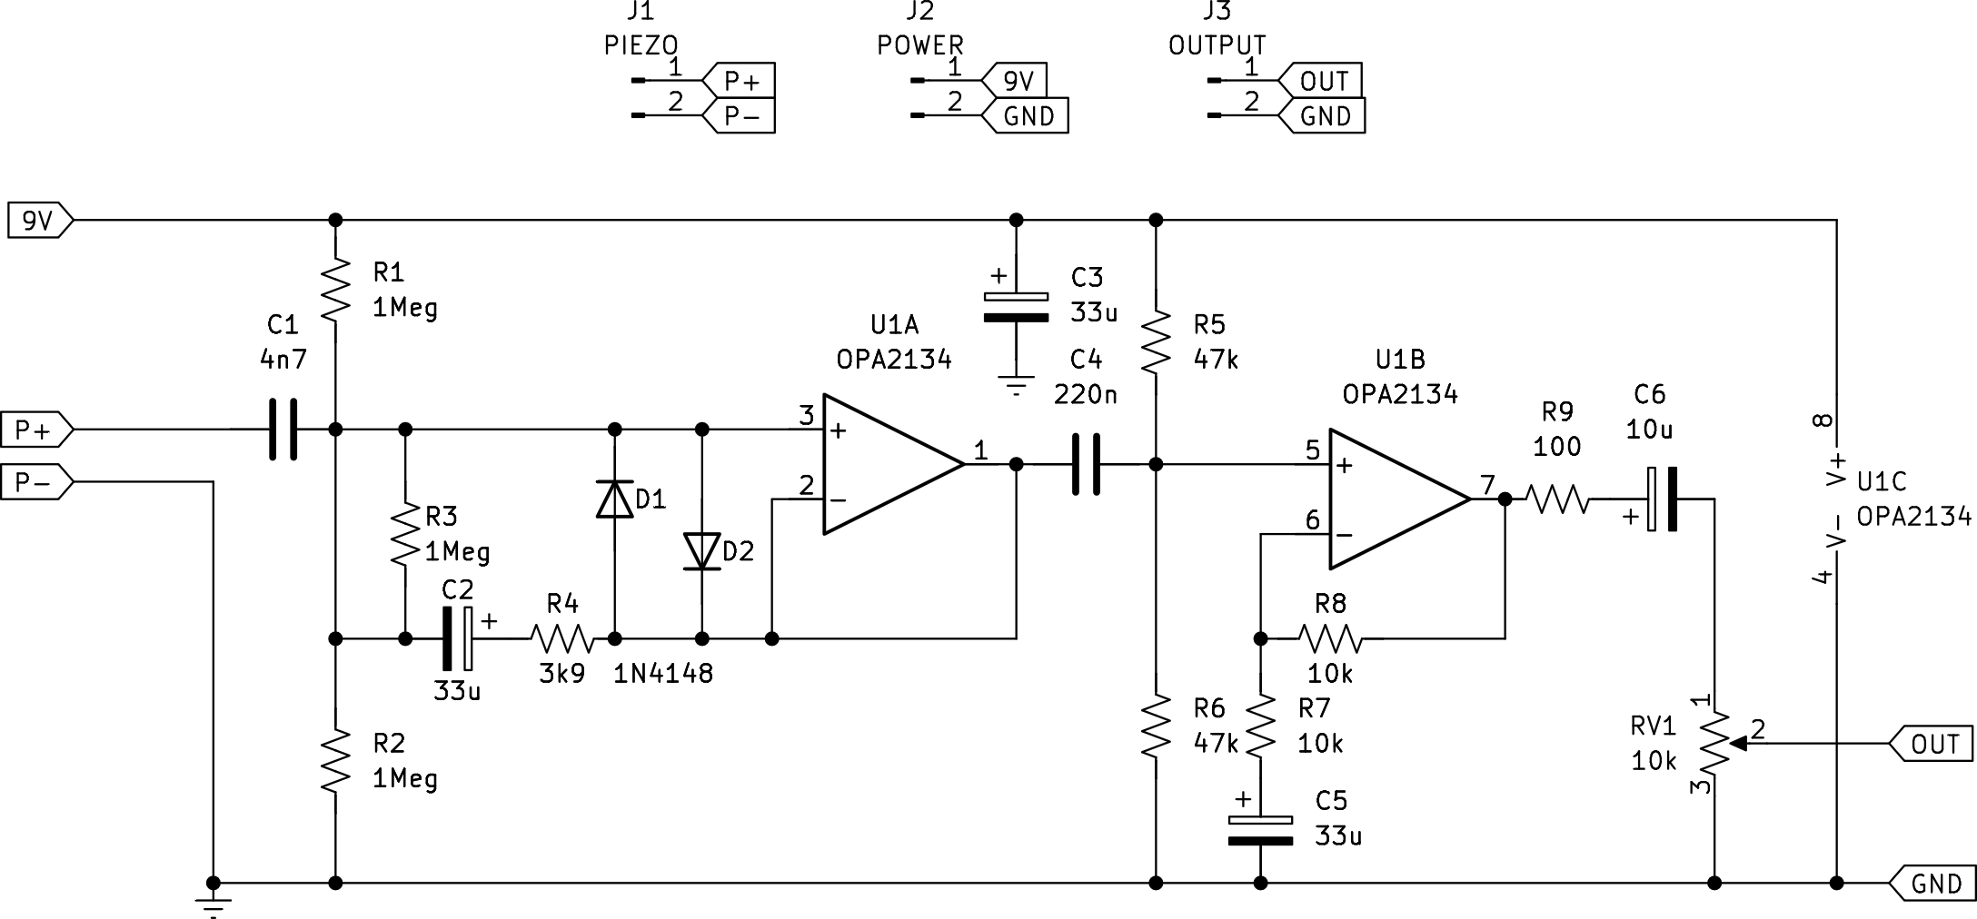
Subterranean Bioacoustic Sensing:
A Novel Approach for Soil Monitoring and Pest Detection
Keith Sangillo, MD Shaad Mahmud, Rebecca Sideman, Jeff Garnas
Electrical and Computer Engineering, University of New Hampshire, Durham, NH 03824
Introduction
Sensor Design
Beamforming
The purpose of the project is to design and develop a microphone array that can measure small signals emitted by organisms living underground (Bioacoustics).
The project has four main criteria:
  Highly sensitive
  Easily Deployable
  Self-contained
  Cost-effective
Signal Chain
SolidWorks Model
The inclusion of 4 microphones in a circular array allows for beamforming to detect signal direction.
Counting
Using this data, the sensor can count the number of incoming signals over a minimum threshold, which gives the number of organisms moving through the soil.
Locating
Beamforming can be used to inform growers of the exact location where pests are living in the soil, allowing them to be exterminated. The sensor could be used to “sniff out” pests and report their exact location.
Previous Efforts
The Sensor
Applications
Jeremiah Audette and Andrew Peloquin, Computer Engineering students at UNH, explored using MEMS microphones buried underneath the soil to detect the location of Earthworms. While they were successful at running a beamforming algorithm in MATLAB and detecting signals in the soil, earthworms were too quiet to be heard by the sensor. The MEMS microphones were also very susceptible to noise above the surface. At the depth of 4 inches, the soil would only attenuate the signal between 1.1 and 2.9 times [1]. However, Researchers at the University of Warwick were able to pick up Earthworm sounds using contact microphones attached to metal probes [2].
Piezo Microphone Design
Earthworms as Indicators of Soil Health
Early pest detection
The sensor could be used in a greenhouse setting to detect pests in soils. As they move through soils, organisms emit a unique sound or “footprint” that can be detected. By listening for these footprints, the sensor could warn growers early about the presence of pests. Specifically, white grubs, wire worms, and jump worms are being focused on.
Soil health monitoring
Growers could use this device to determine if useful organisms such as earthworms and springtails are present in the soil. In places that have been affected by a drastic event such as a fire or intense deforestation, the sensor could monitor rewilding progress.
Leading Bioacoustic Microphone [3]
Project Design
Changes in earthworm biomass (Mean ± SD) in different years after the logging operations (i.e., 3, 10, 20, 25 years, and Un: Undisturbed area) in two soil depths. Different letters indicate statistically significant differences among skid trails and undisturbed area by Duncan’s test (p < 0.05) [6].
The Solution
Piezo Preamplifier
Acknowledgements
Due to the success of previous researchers, contact microphones were chosen. To differentiate the device from other similar projects and to leverage already existing code from Audette and Peloquin, an array was chosen. This gives the device certain capabilities that no other subterranean acoustic devices currently possess. A circular array was chosen for omnidirectionality. Due to its sensitivity and ease of use, this sensor can be used to research many different bioacoustic signals.
Piezo transducers have a very high impedance, which means that the input stage must also have a very high impedance. Directly connecting a piezo to a microphone input will result in severe attenuation, especially at higher frequencies. The preamp’s primary purpose is to offer a low impedance source for the CODEC and has a relatively small gain of 2 (6dB). Texas Instrument’s OPA2134 op-amp was chosen due to its extremely high input impedance (10TΩ) [4]. The preamp design is based upon a design by Rod Elliott [5].
Schematic
Thanks to the NHAES and COLSA for providing supporting information.
References
[1] M. Oelze, W. O’Brien, and R. Darmody, “Measurement of Attenuation and Speed of Sound in Soils,” Soil Science Society of America Journal, vol. 66, 2002.
[2] BBC, “Soil sounds: Why scientists are listening to ‘noisy’ worms,” Apr. 19, 2024. [Online]. Available: https://www.bbc.co.uk/newsround/68847885
[3] J. French, “The C-series+ ‘Ecoutic’ Microphone.” [Online]. Available: https://jezrileyfrench.co.uk/ecoutic-microphone.php
[4] “OPAx134 High-Performance, SoundPlus Audio Operational Amplifiers.” Texas Instruments, Nov. 2024. [Online]. Available: https://www.ti.com/lit/gpn/OPA2134
[5] R. Elliott, “Piezo Pickup Preamplifiers.” Mar. 2020. [Online]. Available: https://sound-au.com/project202.htm
[6] H. Sohrabi, M. Jourgholami, M. Jafari, F. Tavankar, R. Venanzi, and R. Picchio, “Earthworms as an Ecological Indicator of Soil Recovery after Mechanized Logging Operations in Mixed Beech Forests,” Forests, vol. 12, no. 1, 2021, doi: 10.3390/f12010018.

