Slide 1
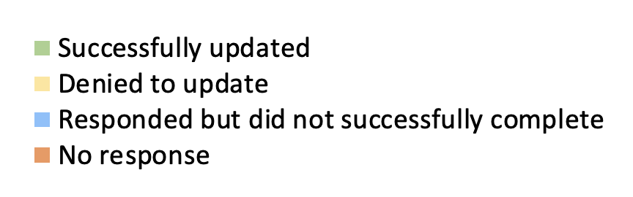


Accessibility Communication Challenges for NH Organizations
Lauren Reid, MS, OTR/L, Occupational Therapy Trainee
Institute on Disability at the University of New Hampshire
Introduction
Benefits of Providing Accessibility Information
Outcome of Outreach
Unite Us Description
Unite Us is an online care coordination platform that allows government, healthcare, and community-based organizations to refer community members to services that meet their health needs.
The New Hampshire Department of Health and Human Services (NH DHHS) is using Unite Us to implement a closed-loop referral system for the state. This means that the outcome of a referral (e.g., if the person accesses the service or not) is trackable. This partnership reduces redundancies and improves health outcomes.
Project Goal
Increase the number of organizations who share accessibility information on Unite Us.
Identify barriers that organizations experience when trying to provide accessibility information to the directory.
Enhances transparency and reduces barriers for clients
Demonstrates a commitment to inclusion
Applies to everyone at some point in their life
Increases awareness of organizations and community members
Four organizations successfully updated their accessibility information.
Five organizations denied to update their information because they felt that their organization did not need to be listed on Unite Us.
Seven organizations responded but did not update their information. They were connected with a representative from Unite Us for further assistance but did not follow through.
Twenty-seven organizations did not respond to outreach efforts.
Current Accessibility Choices on Unite Us
ADA accessible
Blind accommodations
Deaf and hard of hearing accommodations
Interpreter/translation services
Conclusions and Next Steps
Accommodation need is specific to each individual and environment. It is difficult to categorize and discuss accessibility in broad terms (e.g., the 4 categories currently used on Unite Us). Organizations found it difficult to determine if they met the criteria to list an accessibility feature. Future research may aim to determine if providing specific definitions and offering a space for narrative descriptions increases clarity.
Future research must explore the perspectives of community members with disabilities and organizations to determine what accessibility information is useful to list on Unite Us. It will be important to consider all aspects of accessing services such as scheduling an appointment, accessing a physical space, and communicating with staff and peers.
The NH DHHS and Unite Us should continue to engage in outreach (preferably via phone) to educate community members and organizations about the existence and use of the platform.
When completing outreach to organizations, multiple attempts may be necessary. Many organizations directed the outreach phone call through multiple people and the message often became lost. It may be beneficial to choose a small number of organizations to communicate with at one time to ensure follow through as repeated contact attempts led to better outcomes.
Outreach Process
Completed a search of the New Hampshire Unite Us database for food assistance and mental/behavioral health organizations that were currently receiving on-platform referrals and did not have any accessibility information listed on the platform. Identified 43 organizations.
Met with the New Hampshire Unite Us representative to understand the experience of the organization and the community member on the platform.
Met with the New Hampshire Disability and Health Advisory Work Group to determine what accessibility information may be useful to organizations and community members. Engaged in discussions with the group about effective outreach methods.
Sent emails to each of the identified organizations asking them to update their information and followed up with a phone call 1-2 weeks after. Sent a final reminder email to organizations who were successfully reached via phone or email.
Analyzed input from community partners and University of New Hampshire Disability and Health program team.
Shared recommendations with Unite Us, NH DHHS, and identified organizations.
Feedback from Organizations
”I’m not sure what a deaf or hard of hearing accommodation is.”
”I don’t want to mislead anyone.”
”We are not ADA accessible, but we make accommodations for people who use wheelchairs based on their individual needs.”

