Slide 1


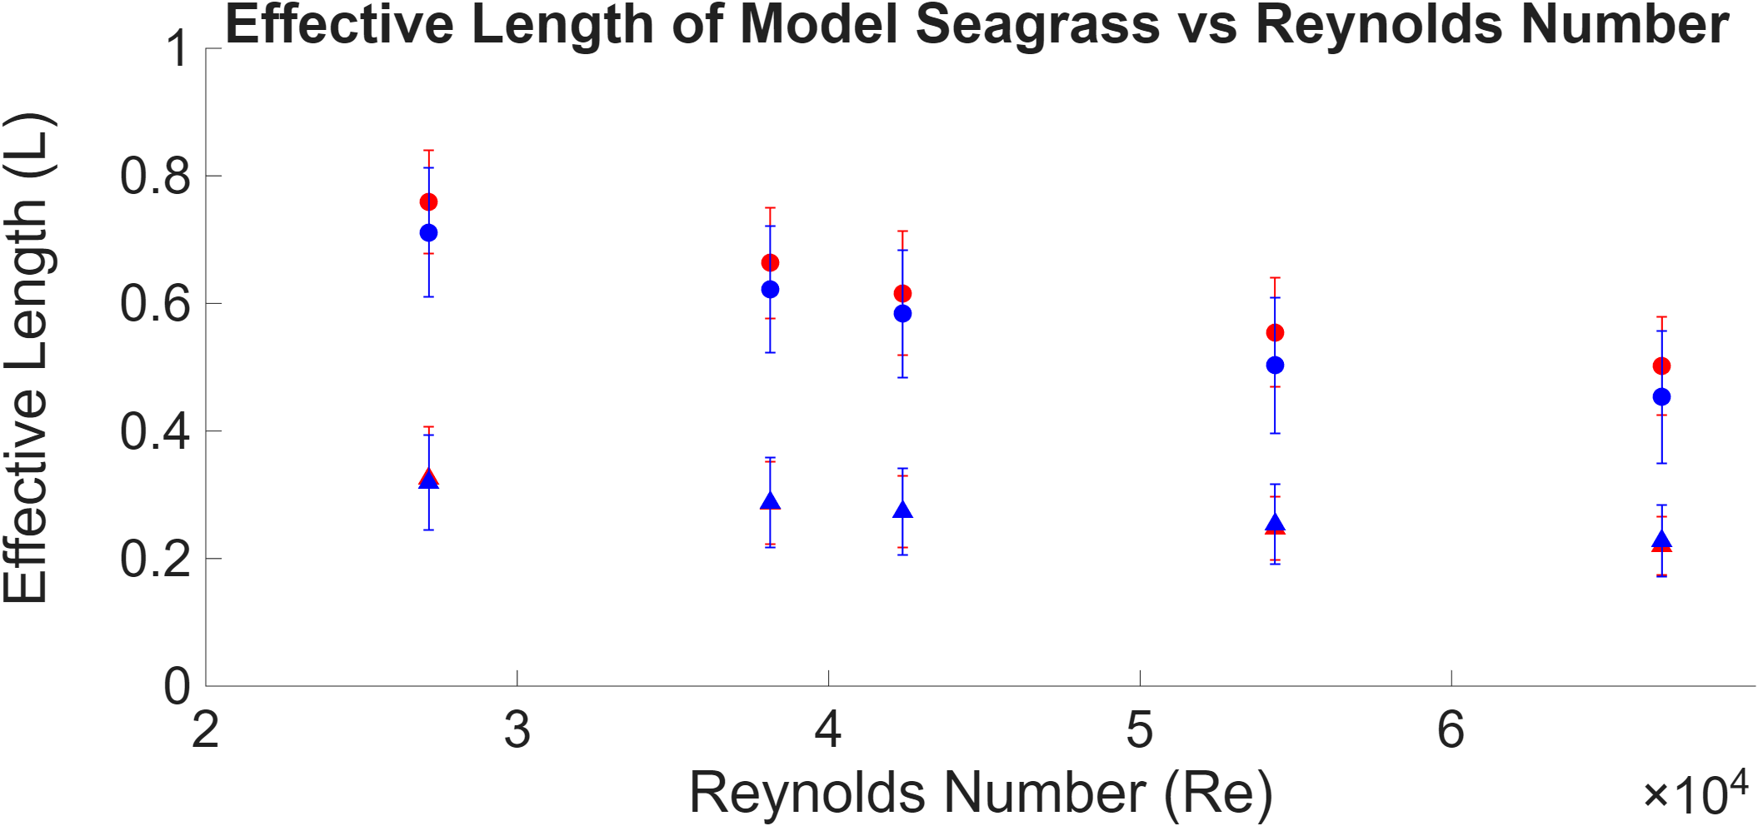
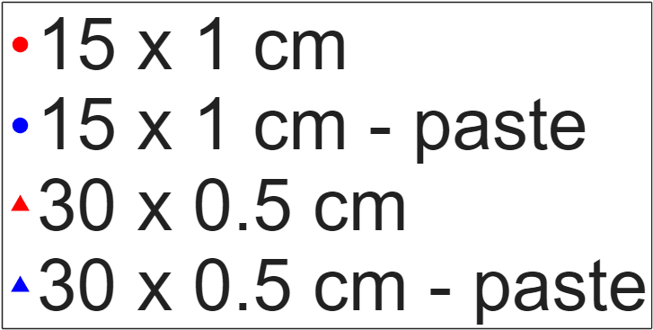
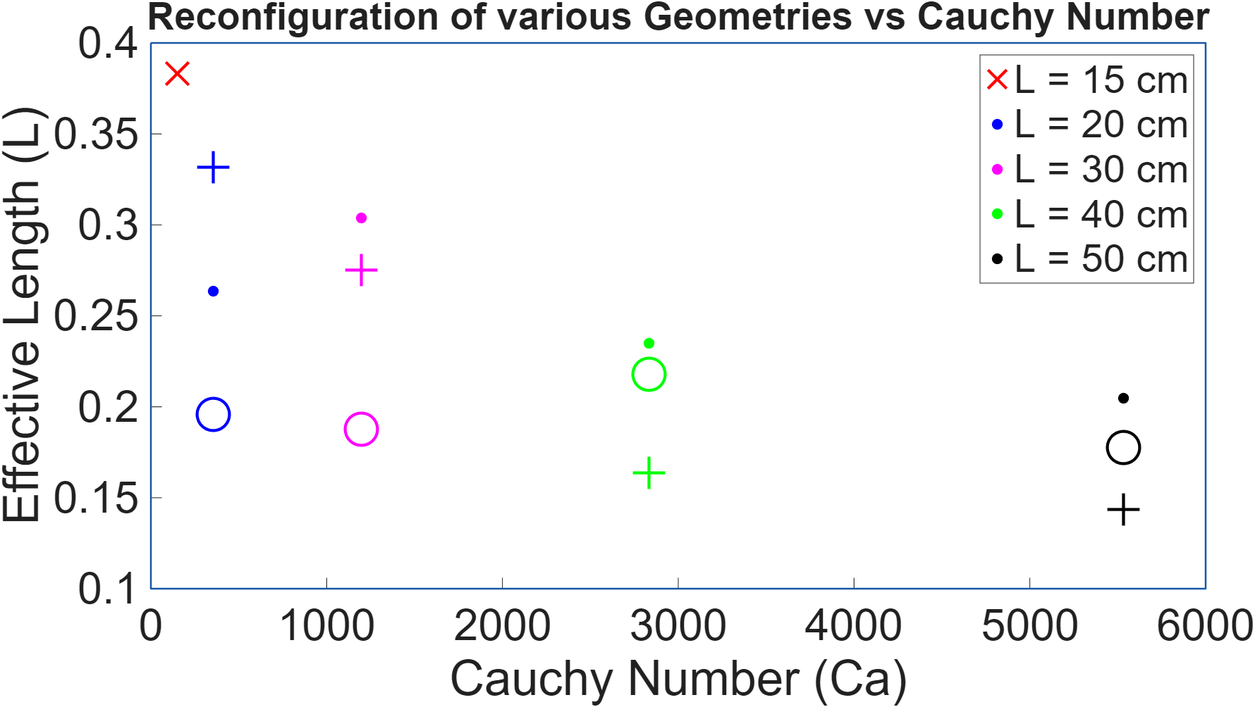
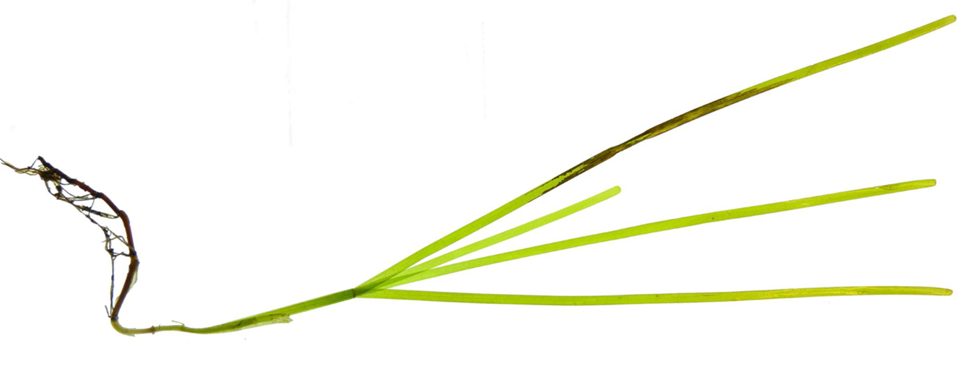
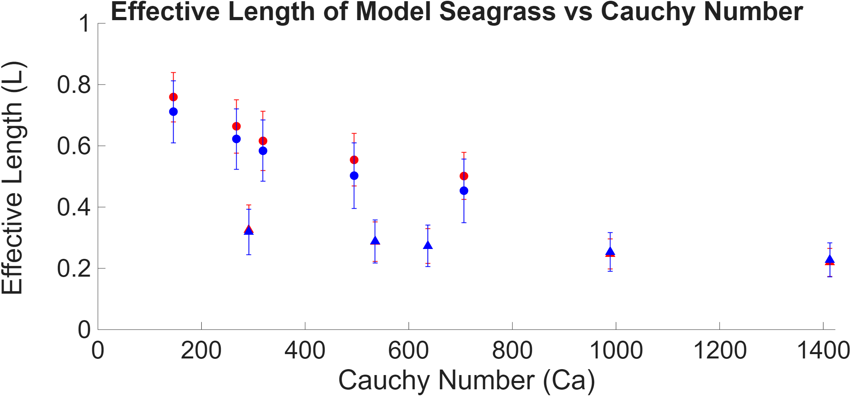
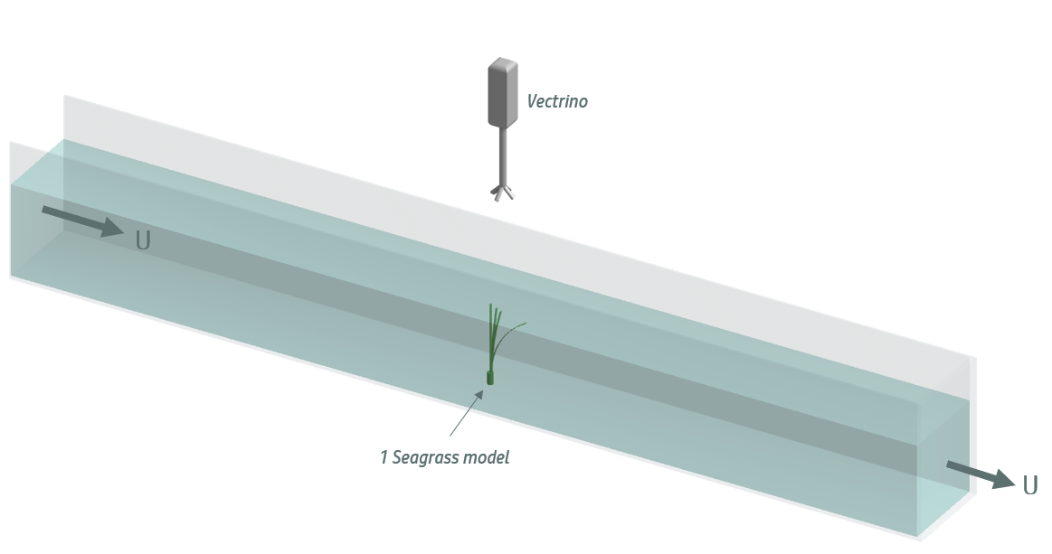
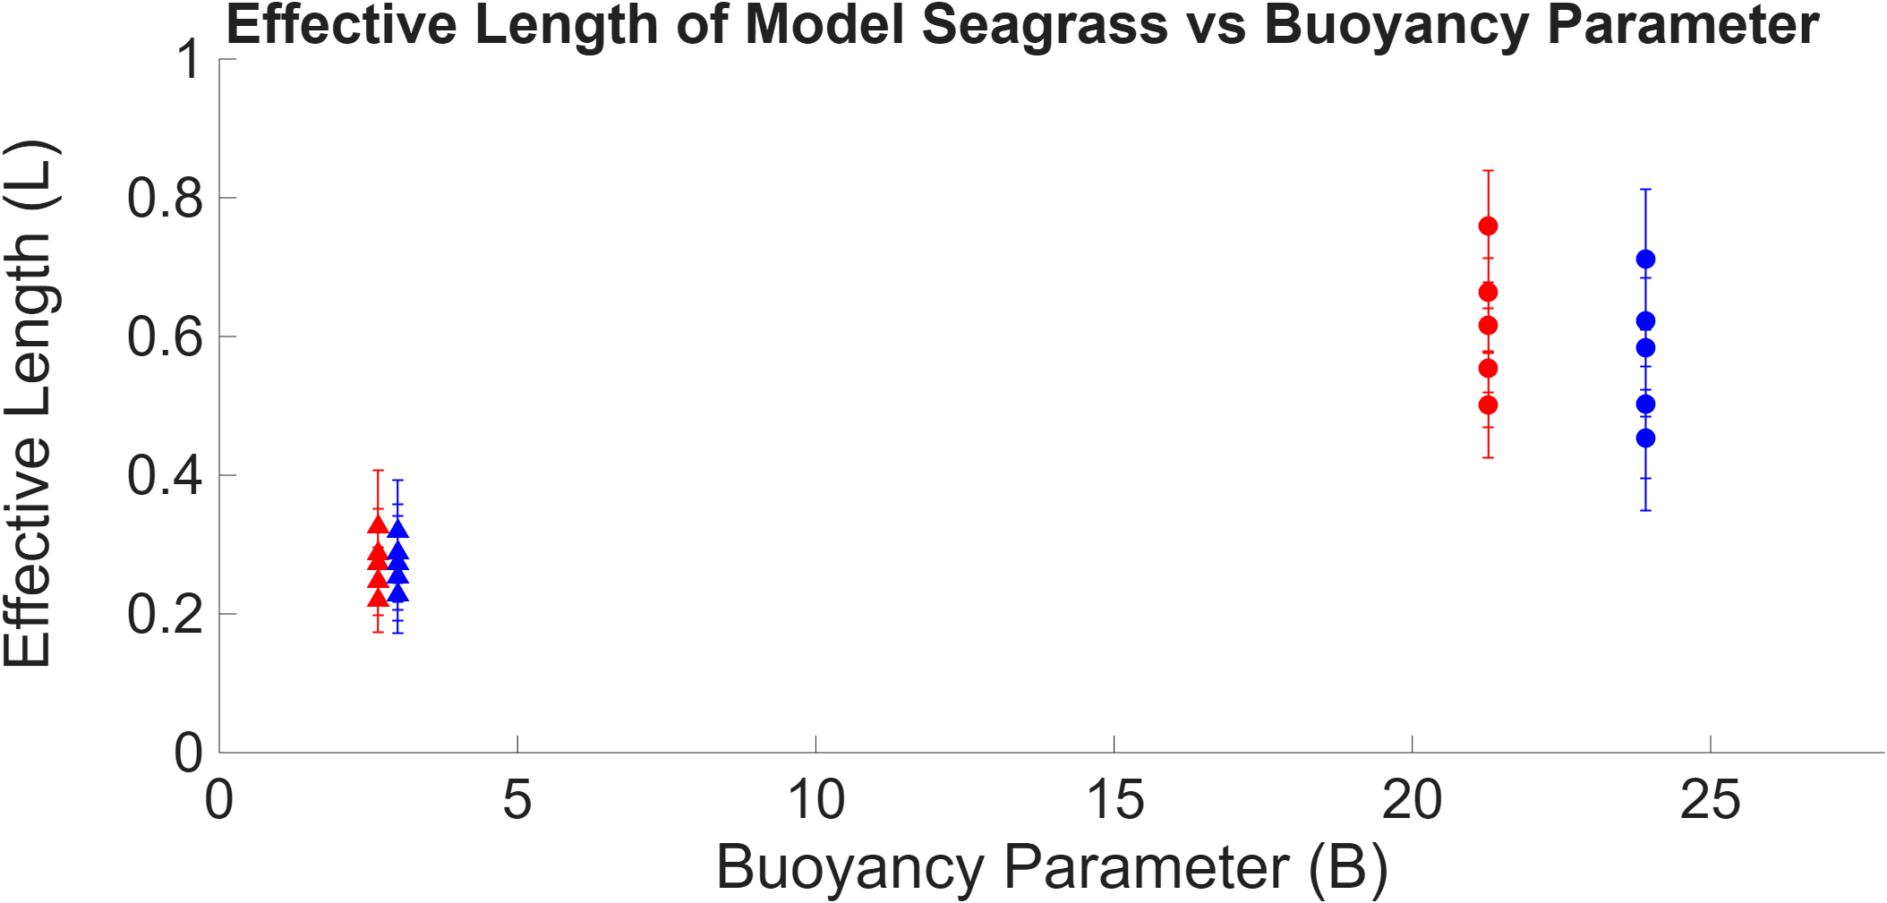
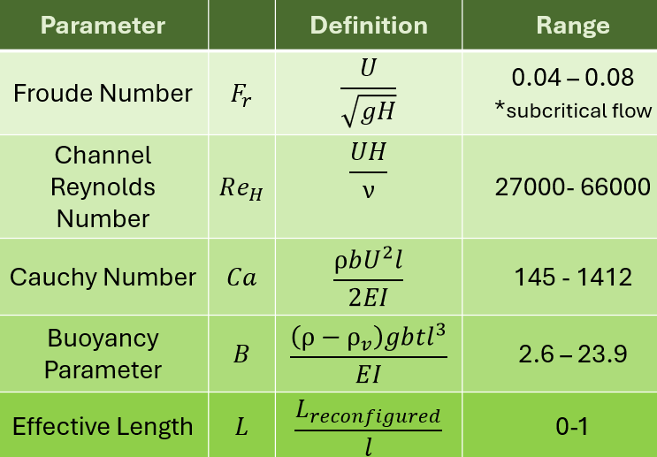
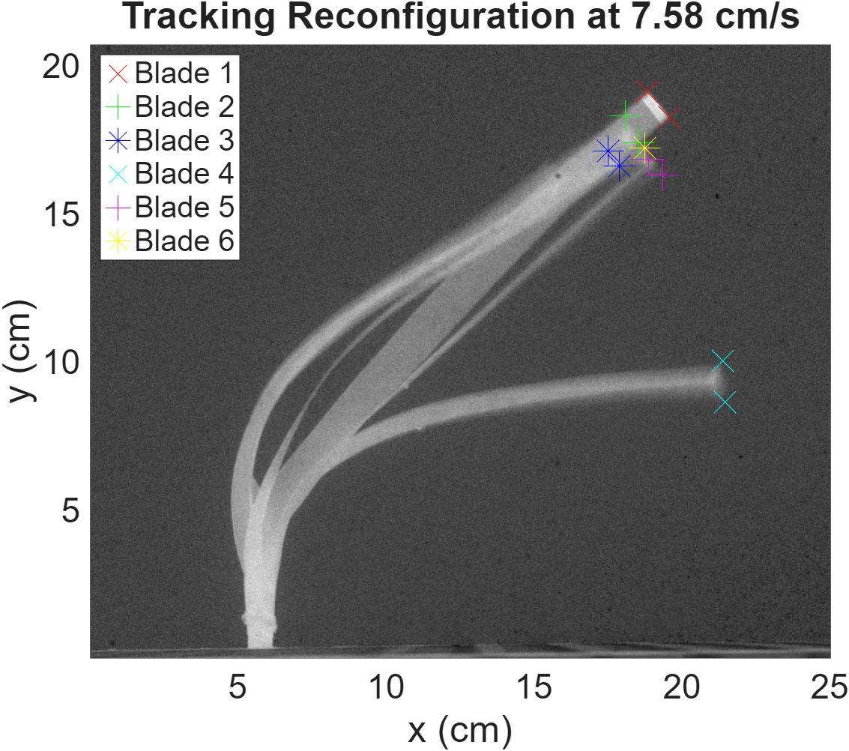
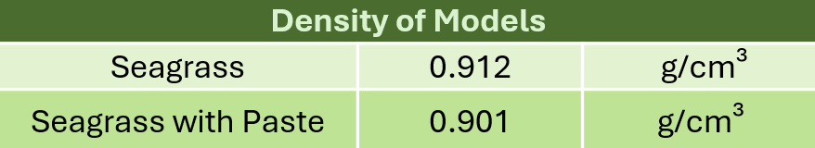
Impact of a model disease paste on the fluid-structure interaction dynamics
of mimic seagrass
Marina Keller¹, Lyriq Turner², Avery Wilson¹, Theresa Oehmke³, Tracy Mandel^{1,3}
¹Center for Ocean Engineering, University of New Hampshire; ²Biophysics, Brown University; ³Mechanical Engineering, University of New Hampshire | marina.keller@unh.edu
Introduction
Results - Model Disease Paste
Results – Plant Geometry
Seagrass meadows are vital for marine habitat, sediment stability, and carbon storage, yet they are declining by 7% per year [1].
A primary mode of disease transmission in seagrass, such as via the opportunistic Labyrinthula zosterae, occurs through contact between an infected blade and its healthy neighbors [3].
Because these pathogens spread via blade-to-blade contact [4],
a disease-modeling paste is used to study disease transmission.
The effects of applying this paste
to laboratory seagrass models,
commonly used [5], remains unknown.
U = 10.8 cm/s
Figure 1: Infected Zostera marina, Common North Atlantic Seagrass [2]
  This research aims to answer:
  How does plant geometry affect fluid–structure interaction?
  Does the application of disease paste change these dynamics?
Figure 9: Impact of plant geometry on reconfiguration across 65 models
Methods
Conclusion
Methods
  Effective length (L) decreased as Reynolds and Cauchy numbers increased, consistent with expected increases in reconfiguration at higher flow velocities.
  Model disease paste effects include:
    Decreased effective length (L) in both geometries.
    Increased buoyancy parameter (due to lower density) in both geometries
    15 × 1 cm models: 5–9% reduction in L
    30 × 0.5 cm models: 2–3% reduction in L
Vectrino
Tested individually in flume; motion recorded at 100 Hz for 10s.
Streamwise velocity measured with acoustic velocimeter.
  120 seagrass models tested at 5 flow rates, split into healthy and diseased groups.
  13 plant geometries tested at 10.8 cm/s.
1 Seagrass Model
Figure 2 Experimental Setup
Acknowledgments and Citations
I would like to thank my advisor, Dr. Mandel, for her unwavering support, communication, guidance and patience in this research. I would also like to thank Eli Rousseau for his training and assistance. Finally, my partner Luke for his encouragement and support throughout this research.
[1] 18.Waycott M, et al. Accelerating loss of seagrasses across the globe threatens coastal ecosystems. Proc. Natl Acad. Sci. USA. 2009;106:12377–12381. doi: 10.1073/pnas.0905620106.
[2] S. Jakobsson-Thor, J. Brakel, G. B. Toth, and H. Pavia, “Complex Interactions of Temperature, Light and Tissue Damage on Seagrass Wasting Disease in Zostera marina,” Front. Mar. Sci., vol. 7, Oct. 2020, doi: 10.3389/fmars.2020.575183.
[3] L. K. Muehlstein, D. Porter, and F. T. Short, “Labyrinthula Zosterae Sp. Nov., The Causative Agent of Wasting Disease of Eelgrass, Zostera Marina,” Mycologia, vol. 83, no. 2, pp. 180–191, Mar. 1991, doi: 10.1080/00275514.1991.12025994.
[4] Eisenlord ME, Agnew MV, Winningham M, Lobo OJ, Vompe AD, Wippel B, Friedman CS, Harvell CD, Burge CA. High infectivity and waterborne transmission of seagrass wasting disease. R Soc Open Sci. 2024 Aug 7;11(8):240663. doi: 10.1098/rsos.240663. PMID: 39113773; PMCID: PMC11303036
[5] R. B. Schaefer and H. M. Nepf, “Flow Structure in an Artificial Seagrass Meadow in Combined Wave-Current Conditions,” Front. Mar. Sci., vol. 9, p. 836901, Feb. 2022, doi: 10.3389/fmars.2022.836901.
This material is based upon work supported by the National Science Foundation under award number OCE-2339079.
30 x 0.5 cm seagrass model
U = 7.58 cm/s
Re = 27166
L
Figures 5-7 : Reconfiguration of model seagrass (measured as L) across 5 flow rates
Figure 8: Decrease in seagrass density due to disease paste application.
Figure 3 : Relevant non-dimensional numbers.
Figure 4 : Effective Length across 6 blades

